Slide 1



Drug Recognition Expert
Condensed Instructor
Development
Course
Session 1 – Introduction
February 2017

Slide 2

Content Segments
Welcome
Facilities, Logistics, Classroom Conduct
Course Format
Introduction
Final Participation Demonstration
Questions and/or Concerns
Notes:
Session 1: Introduction to the Drug Recognition Expert (DRE) Condensed Instructor Development Course (IDC)
Estimated time for Session 1: 1 Hour (depending on class size)
Session Objectives
Using the provided agenda, review course objective and other administrative matters
Using the windowpane exercise, participants will express expectations of the course
Participants are expected to actively engage in course activities
Contents
A. Welcome
B. Facilities, Logistics, and Classroom Conduct
C. Course Format
D. Introduction
E. Final Participation Demonstration
F. Questions and/or Concerns
Materials
Presentation slides Self-Adhesive Easel/Easel Pad
Colored Dry-Erase Markers Tape
Copy of agenda/schedule Participant list
Tent cards and/or name tags
Pre-test
Instructional Notes are presented in bold italic throughout the sessions.

Slide 3

Drug Recognition Expert
Condensed Instructor Development Course
Session 1:
Introduction
Notes:
Welcome
Welcome to the Drug Recognition Expert (DRE) Condensed Instructor Development Course (IDC)
Stress the importance of open communication, effective feedback, and participation.
Session 1: Introduction
Estimated time for Session 1: 1 Hour
Materials:
Presentation slides
Self-Adhesive Easel/Easel Pad
Colored Dry Erase Markers
Tape
Copy of agenda/schedule
Participant list
Tent cards and/or name tags
Pre-test
Computer speakers (for embedded videos)
_____________________________________________________________________
_____________________________________________________________________
_____________________________________________________________________
_____________________________________________________________________

Slide 4

Session Objectives
Review course objectives and other administrative matters
Discuss expectations of the course
Discuss participant expectations in the course
Notes:
Session Objectives
At the conclusion of this session, participants should be able to:
Review course objectives and other administrative matters
Demonstrate the Cycle of Instruction (Optional)
Discuss expectations of the course
Discuss participant expectations in the course
Remove “Demonstrate the Cycle of Instruction” from the slide if you do not use the optional exercise.
_____________________________________________________________________
_____________________________________________________________________
_____________________________________________________________________
_____________________________________________________________________
_____________________________________________________________________
_____________________________________________________________________

Slide 5
Course Goals and Objectives
Describe how learning strategies contribute to training effectiveness
Apply facilitation and effective questioning skills
Apply effective strategies for handling common problem situations
Use standard NHTSA/IACP DRE lessons plans
Develop and use training aids
Notes:
Course Goals and Objectives
This course will provide you with specific information on how to effectively train and motivate DRE candidates.
You will be able to:
Describe how learning strategies contribute to training effectiveness
Apply facilitation skills
Apply effective questioning skills
Apply effective strategies for handling common problem situations
Use the standard NHTSA/IACP DRE lessons plans
Develop and use training aids
_____________________________________________________________________
_____________________________________________________________________
_____________________________________________________________________
_____________________________________________________________________
_____________________________________________________________________
_____________________________________________________________________

Slide 6

Notes:
B. Facilities, Logistics, and Classroom Conduct
Circulate a copy of the roster for participants to verify if information is correct or if changes need to be made. Inform participants a copy of the completed roster will be given to each of them at the completion of the course.
Take a few minutes to describe the facilities and logistics of the particular location. Include directions to restrooms, vending machines, and/or location of refreshments.
Discuss building layout, including: emergency exits, fire extinguishers, fire alarm pull stations, and meeting area in case of a building evacuation.
_____________________________________________________________________
_____________________________________________________________________
_____________________________________________________________________
_____________________________________________________________________
_____________________________________________________________________

Slide 7

Course Etiquette
Be respectful
No disparaging remarks
Be on time
No Internet or personal business
Cell phones off or in vibrate mode
Participate
Notes:
Explain participants need to be respectful to other participants, as well as the host property.
Remind participants we want to hear about successes, lessons learned, and challenging situations.
Remind participants to turn cell phones off or put them into vibrate mode, and do the same to yours.
Tell participants that participation in class discussion is encouraged.
Course Etiquette
Be respectful
No disparaging remarks
Be on time
Do not surf the Internet or conduct business while the course is in session
Cell phone off or in vibrate mode
Active participation
_____________________________________________________________________
_____________________________________________________________________

Slide 8

Course Format
Active participation is required
Interactive
Participant Manual
Breaks and lunch
Additional activities
Notes:
C. Course Format
Ask participants if they have a copy of the agenda. Review daily agenda for course. Briefly review the week’s schedule and procedures to be followed. This is very important, as you will be discussing why you did this during Session 2.
Emphasize: This course is intended to make you an effective DRE instructor.
This course is participant dependent, which means active participation is required. Give the participants a sense of responsibility for the process
Interactive teaching methods will be used, including facilitated group discussions, games, and activities
Participant manual: Explain the participant manual contains the training visuals and curriculum used throughout the course. Space is provided for note taking throughout the manual. Encourage participants to use the manual as a learning aid for reviewing the information presented.
Tour Your Manual: Make sure to direct participants to sections and let them look through the manual to see the tabs, resources, etc. Be certain to point out centrally-located resources used repeatedly throughout the course, if applicable. Additional activities may include a review of the Advanced Roadside Impaired Driving (ARIDE) curriculum.
Course Format
Schedule and agenda
Breaks
Lunch
Evaluations
Final DRE Condensed IDC Exam

Slide 9

Course Evaluation
Notes:
Inform participants how the course will be evaluated. Review evaluation instructions (i.e., paper evaluations, online evaluations, and/or post course evaluations).
_____________________________________________________________________
_____________________________________________________________________
_____________________________________________________________________
_____________________________________________________________________
_____________________________________________________________________
_____________________________________________________________________
_____________________________________________________________________
_____________________________________________________________________
_____________________________________________________________________
_____________________________________________________________________
_____________________________________________________________________

Slide 10

Introductions
Notes:
D. Introduction
The following activity includes an introduction of all instructors and participants. Be enthusiastic and use humor appropriately. Humor conveys a relaxed, comfortable environment.
ACTIVITY: Windowpane
Objectives: Participants will create a windowpane using the easel/easel pad. Each participant will stand before the group, give a presentation, state their expectations of the course, and provide the faculty with insight into their experience.
Supplies Needed: Multiple self-adhesive easel/easel pads and multiple packages of colored markers.
Instructors should put an example of their windowpanes up in the classroom as an example. One of the instructors may construct a windowpane in only 1 color that is not easily readable, such as yellow or orange. The instructor who teaches Session 3 will later use this pane for a teaching moment when he or she covers the use of color and impact. After the panes are completed, the lead instructor will present his or her windowpane to the group, taking no more than two minutes. Next, the participants and instructors will present their panes. Whenever they finish their presentations, participants should tape/stick the windowpanes to the wall in the main room.
Instructions: Give each participant a self-adhesive sheet of paper. The instructor should put an example of the windowpane at the front of the class for participants to see and copy. Have them respond to the questions presented. Advise them they will be presenting their windowpane to the group as a whole. Also let them know their windowpanes will remain posted in the classroom for the remainder of the course.
*Additional instruction for the window pane activity is provided on the next page.

Slide 11

Introductions
Name
Agency
Experience as
Law Enforcement
Officer (Years)
Experience Teaching
(Years)
Your Ideal Job
(Pictures Can
Be Used)
Goal for the
Course
Notes:
Introductions
Name and agency
Experience teaching (years)
Experience as a law enforcement officer (years)
Goal for the course
Your ideal job (pictures can be used)
Whenever the instructors finish their presentations, allow 10 minutes for participants to create their own windowpanes. Participants should tape/stick the windowpanes to the wall in the main room. Allow each participant 2-3 minutes to present their windowpanes.
Name: For identification purposes
Experience: The purpose of this particular windowpane is to open up the discussion of prior work and presentation experience.
Goal for the course: Have the participant verbalize at the beginning of the training what they hope to gain by the completion of the course.
Your ideal job: A picture or drawing can be used to help describe the participant’s ideal job (helps emphasize the importance of visual aids in trainings).
_____________________________________________________________________
_____________________________________________________________________

Slide 12

Notes:
The lead instructor will review the listed expectations identified by the participants on their windowpanes. Instructors will do their best to meet as many of the listed expectations as possible by the course’s conclusion.
Thank the participants for their windowpane examples.
_____________________________________________________________________
_____________________________________________________________________
_____________________________________________________________________
_____________________________________________________________________
_____________________________________________________________________
_____________________________________________________________________
_____________________________________________________________________
_____________________________________________________________________
_____________________________________________________________________
_____________________________________________________________________

Slide 13
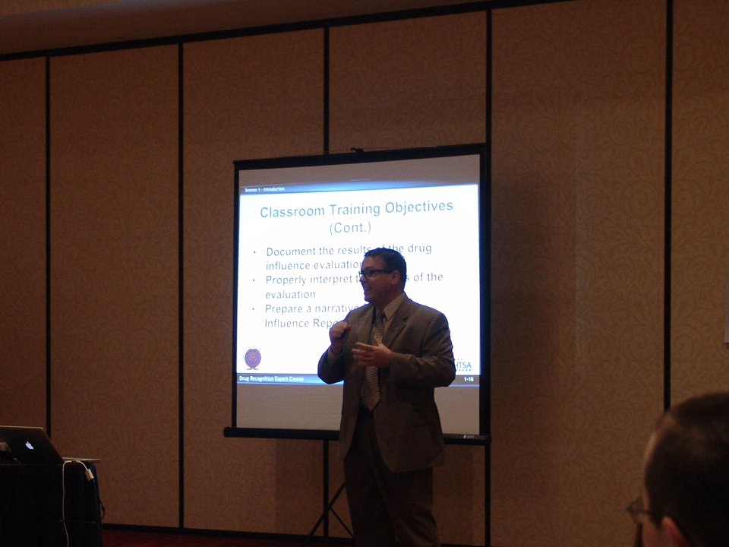
Presentations
Notes:
E. Final Participation Demonstration
Explain to participants they will be required to present a portion of the DRE curriculum as assigned. Participants will also be required to provide effective feedback to other participants’ presentations.
Advise participants they will be provided sufficient time and resources to prepare their demonstration. In addition, participants will be required to successfully complete a final DRE Condensed IDC written examination (scoring an 80% or better).
To successfully complete the class participants must complete the following:
Classroom presentations
Presentation feedback
Written Examination (minimum of 80%)
_____________________________________________________________________
_____________________________________________________________________
_____________________________________________________________________
_____________________________________________________________________
_____________________________________________________________________

Slide 14

Notes:
F. QuestionS AND/OR CONCERNS
Inquire if any participants have any questions or concerns.
Address as many of the questions and/or concerns as time allows.
Disseminate the DRE Condensed IDC Pre-test and allow 10 - 15 minutes to complete.
If time allows, review the exam and the acceptable answers.
_____________________________________________________________________
_____________________________________________________________________
_____________________________________________________________________
_____________________________________________________________________
_____________________________________________________________________
_____________________________________________________________________
_____________________________________________________________________
_____________________________________________________________________

