Slide 1



Drug Recognition Expert
Condensed Instructor
Development
Course
Session 4– The DRE Curriculum Package and Teaching Assignments
February 2017

Slide 2

Content Segments
The DRE Curriculum Package
Overview of the DRE School
Purposes of the Lesson Plans
How to Use the Lesson Plans
Outlines
Questions and/or Concerns
Notes:
Session 4: The DRE Curriculum Package and Teaching Assignments
Estimated time for Session 3: 2 Hours (depending on class size)
Session Objectives
Describe the documents that make up a standard curriculum package
Describe the content and format of the lesson plans for the DRE School
Contents
The DRE Curriculum Package
Overview of the DRE School
Purposes of the Lesson Plans
How to Use the Lesson Plans
Outlines
Questions and/or Concerns
Materials
Presentation slides
Easel/Easel pad
Markers
DRE Instructor Guide
Teaching Assignments
Instructional Notes are presented in bold italic throughout the sessions.

Slide 3

Drug Recognition Expert Condensed
Instructor Development Course
Session 4:
The DRE Curriculum Package and Teaching Assignments
Notes:
Session 4: The DRE Curriculum Package and Teaching Assignments
Estimated Time for Session 4: 2 Hours
Materials
Presentation slides
Easel/Easel pad
Markers
DRE Instructor Guide
Teaching Assignments
Computer speakers (for embedded videos)
__________________________________________________________________________
__________________________________________________________________________
__________________________________________________________________________
__________________________________________________________________________
__________________________________________________________________________
__________________________________________________________________________
__________________________________________________________________________

Slide 4

Session Objectives
Describe documents that make up a standard curriculum package
Describe content and format of lesson plans for DRE School
Notes:
Session Objectives
At the conclusion of this session, participants should be able to:
Describe the documents that make up a standard curriculum package
Describe the content and format of the lesson plans for the DRE School
__________________________________________________________________________
__________________________________________________________________________
__________________________________________________________________________
__________________________________________________________________________
__________________________________________________________________________
__________________________________________________________________________
__________________________________________________________________________
__________________________________________________________________________
__________________________________________________________________________
__________________________________________________________________________

Slide 5

DRE Curriculum
Notes:
A. The DRE Curriculum Package
A complete curriculum, or course of instruction, has been prepared for DRE training.
The DRE course spans nine full days; two days for the Pre-School and seven days for the DRE School.
__________________________________________________________________________
__________________________________________________________________________
__________________________________________________________________________
__________________________________________________________________________
__________________________________________________________________________
__________________________________________________________________________
__________________________________________________________________________
__________________________________________________________________________
__________________________________________________________________________
__________________________________________________________________________

Slide 6

Overview of the DRE School
For whom is the training intended
What is the purpose of the training
What will the participants get out of the training
Notes:
B. Overview of the DRE School
For whom is the DRE training intended? The course is designed for law enforcement candidates who have been selected to serve as DREs.
What is the purpose of the training? The ultimate goal of this course is to help prevent crashes, deaths, and injuries by improving enforcement of drug-impaired driving violations. It is not exactly clear how many drug-impaired drivers are on our nation's roads or how many crashes they cause. But even the most conservative estimates indicate these drivers kill thousands of Americans and injure at least tens of thousands of others each year.
What will the participants get out of the training? The participant who successfully completes this phase of DRE training will be able to...
Distinguish if an individual is under the influence of a drug or drugs other than alcohol, or under the combined influence of alcohol and other drugs, or suffering from some injury or illness that produces signs similar to alcohol/drug impairment
Identify the broad category or categories of drugs inducing the observable signs of impairment
Progress to the certification phase of the training
_________________________________________________________________________________
_________________________________________________________________________________
_________________________________________________________________________________
_________________________________________________________________________________
_________________________________________________________________________________

Slide 7
Overview of the DRE School (continued)
What subject matter does the course cover
What activities take place during the training
How long does the training take
Notes:
B. Overview of the DRE School
What subject matter does the course cover? The course focuses primarily on two broad topics:
The examinations, observations, measurements, etc. that constitute the DRE procedures
The nature, effects, signs, and symptoms of each of the seven categories of drugs and of the combination of the categories
What activities take place during the training? Formal presentations, or lectures, occupy approximately one-half of the course. Most of the remainder of the course is devoted to demonstrations and hands-on practice of the DRE procedures
How long does the training take? This classroom training course occupies seven training days. A typical schedule calls for each day to begin at 8 am and conclude at 5 pm. A one-hour lunch period and hourly breaks of 10 minutes are accommodated in that schedule.
_________________________________________________________________________________
_________________________________________________________________________________
_________________________________________________________________________________
_________________________________________________________________________________
_________________________________________________________________________________
_________________________________________________________________________________
_________________________________________________________________________________
_________________________________________________________________________________

Slide 8
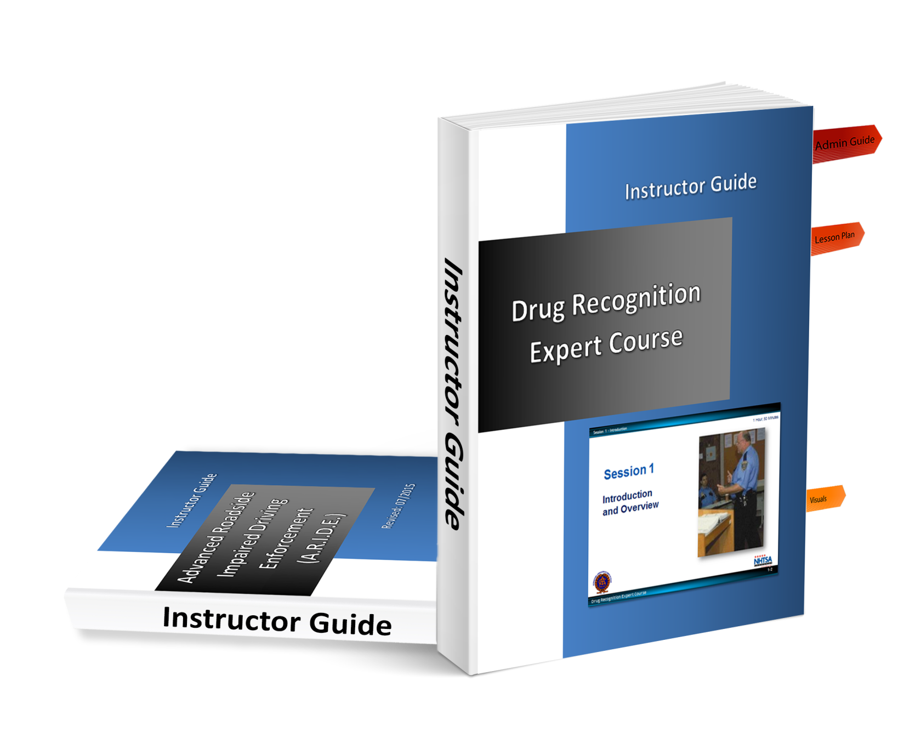
Notes:
Point out an Instructor Guide has been prepared for the course.
The Instructor Guide contains three things:
Administrator Guide
Lesson Plans
Visuals
__________________________________________________________________________
__________________________________________________________________________
__________________________________________________________________________
__________________________________________________________________________
__________________________________________________________________________
__________________________________________________________________________
__________________________________________________________________________
__________________________________________________________________________
__________________________________________________________________________

Slide 9
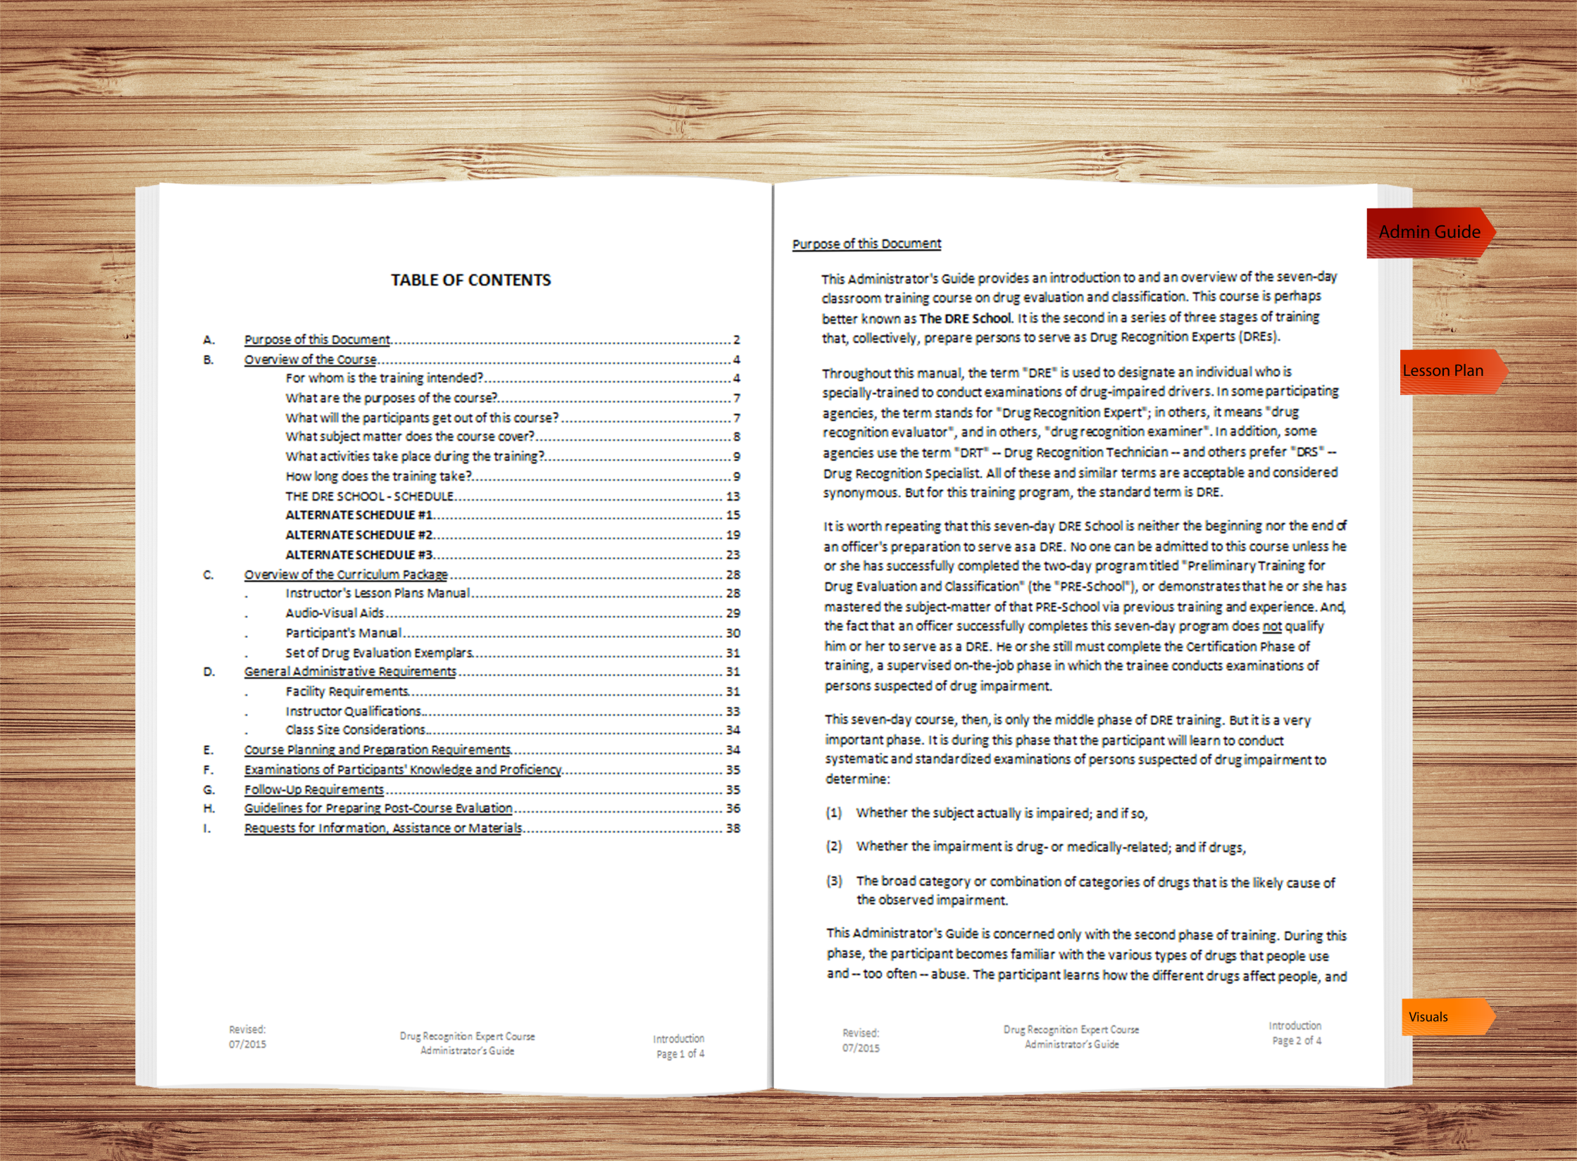
Administrator Guide
Notes:
Note the first section of the Instructor Guide is the Administrator Guide.
The Administrator Guide is intended to provide an introduction to and an overview of the course.
The Administrator Guide begins with a section called “Purpose of this Document”, a brief description of the Guide
The next section, “Overview of this Course”, gives some very important information about what the DRE School covers and who should attend
The last section, “A Synopsis of the Curriculum” gives a brief summary of the lesson plans and the visuals
As instructors, it is essential you be thoroughly familiar with the Administrator Guide.
Emphasize instructors should review Segment E. “Guidelines for Conducting a Controlled Practice Drinking Session” of the Administrator Guide for some detailed instructions regarding conducting the alcohol workshops that take place during the School.
__________________________________________________________________________
__________________________________________________________________________
__________________________________________________________________________
__________________________________________________________________________
__________________________________________________________________________

Slide 10

Purposes of the Lesson Plan
Help you get ready
Help you stay on track
Ensure consistency
Notes:
The second section (and the bulk) of the Instructor Guide are lesson plans.
C. Purposes of the Lesson Plans
Lesson plans have three main purposes.
1. Help you get ready to teach
• Ensure you have all the needed materials and resources
• Familiarize yourself with the lesson plans thoroughly before you attempt to teach a session
• Ensure you understand what the participants should become able to do
• Ensure you understand the information to present to the participants
• Ensure you can perform the skills and procedures you are to demonstrate to the participants
2. Help you stay on track
• Don’t try to memorize the lesson plans
• Don’t be afraid to refer to the lesson plans while you are teaching; they are intended to help you
3. Ensure consistency of training
__________________________________________________________________________
__________________________________________________________________________

Slide 11
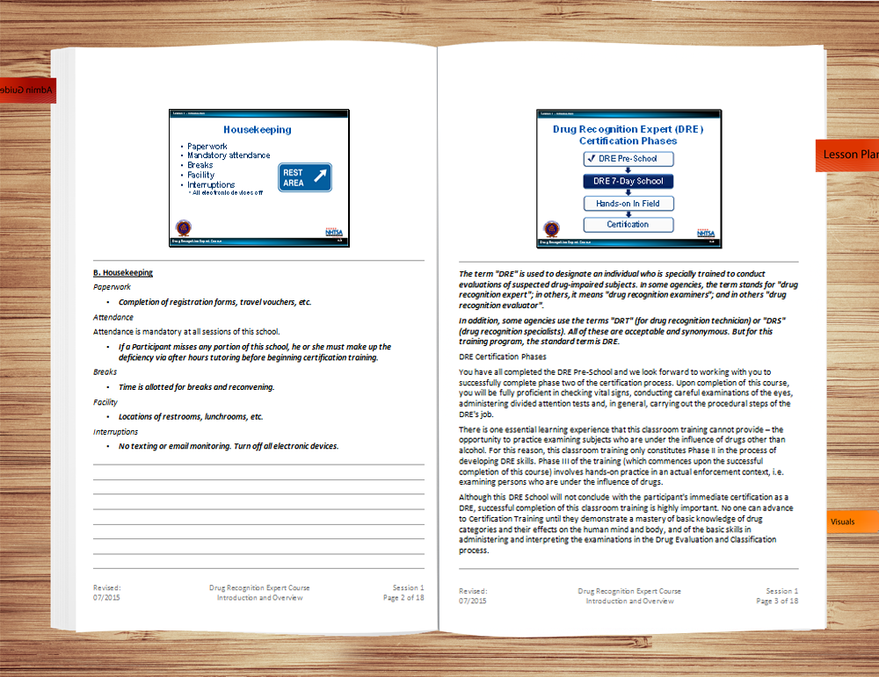
Format of the Lesson Plan
Notes:
Format of the lesson plans
The lesson plans for the DRE School are organized on a session-by-session basis
There are 10 sessions in the DRE Preliminary training
There are 32 sessions in the DRE 7-Day Curriculum
Each session has its own set of Lesson Plans
Session 1 is called “Introduction and Overview”
The first page of each set of lesson plans is called the cover page
The cover page gives the number and titles of the session and indicates the approximate amount of time the session requires
For example, Session 1 of the DRE Curriculum requires approximately 30 minutes
The second page of a set of lesson plans is the outline page
The outline page lists the learning objectives for the session, i.e., states what the participant will be able to do after successfully completing the session
The outline page also lists the content segments of the session, which correspond to the major topics covered
Finally, the outline page indicates the major types of learning activities that take place during the session
The main purpose of the outline page is to help you prepare to teach
If you are assigned to begin teaching a session, you should start by reviewing the session’s objectives with the participants
Next, preview the content and the learning activities.
__________________________________________________________________________
__________________________________________________________________________

Slide 12

How to Use the Lesson Plans
Notes:
D. How to Use Lesson Plans
Read the lesson plan
Personalize the lesson plan
Preparation using the lesson plan
__________________________________________________________________________
__________________________________________________________________________
__________________________________________________________________________
__________________________________________________________________________
__________________________________________________________________________
__________________________________________________________________________
__________________________________________________________________________
__________________________________________________________________________
__________________________________________________________________________
__________________________________________________________________________
__________________________________________________________________________

Slide 13
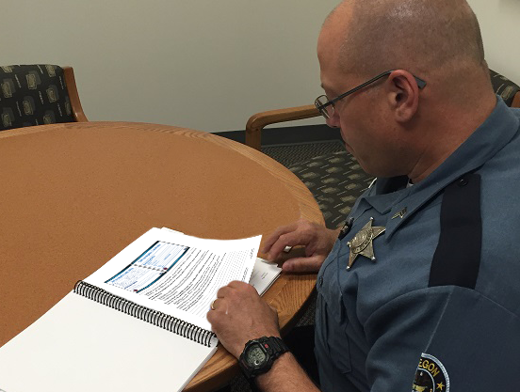
Read the Lesson Plan
Notes:
Read the lesson plan
Begin by reading not only the portion you have been assigned to present, but the entire curriculum. You will need to become familiar with the content materials as well as understand where and how it fits in the course.
If you do not understand the material, you may need to research other written material or to talk with other people familiar with the subject matter
__________________________________________________________________________
__________________________________________________________________________
__________________________________________________________________________
__________________________________________________________________________
__________________________________________________________________________
__________________________________________________________________________
__________________________________________________________________________
__________________________________________________________________________
__________________________________________________________________________

Slide 14

Personalize
Notes:
Personalize
The instructional notes area of the lesson plan can be used to insert your own examples relevant to the material being taught. This is also where you can note the prepared questions to ask the class. Personal experiences add impact and increase retention of content material. Adding our own examples incorporates our own personality and style to the training delivery.
The lesson plan should have your own notes and questions incorporated in the instructional notes. Make sure you know how the slides read and when they are to be used. You should also have any other training aids such as props, etc., available for you to practice using. If you plan to use prepared easel/easel pads, this is when you will need to prepare them.
__________________________________________________________________________
__________________________________________________________________________
__________________________________________________________________________
__________________________________________________________________________
__________________________________________________________________________
__________________________________________________________________________

Slide 15
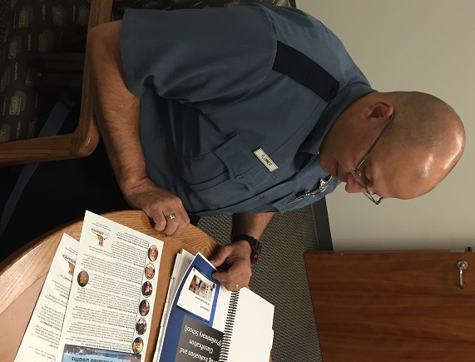
Prepare
Notes:
Preparation
Start by going through the material just as you would during the presentation, don't try to memorize it.
Some trainers use the "3 to 1" ratio for determining how much time to prepare. This formula means for every hour of instruction, we would need to prepare for three hours. However, remember subject matter knowledge, experience in training others and individual confidence levels will also influence the amount of preparation time required.
If possible, practice presenting aloud in the room you will actually be using. This will help you feel more comfortable and familiar with the surroundings. You will also look as if you are used to moving around in that environment.
If possible, record your practice presentations on video to enable you to see and hear yourself as the participants will. However, because this is not always possible, the next best-practice technique is to audio record your presentation
Here are just some of the advantages of recording yourself:
Check voice tone and rate of speech
Improve word enunciation
Substitute words that are awkward or difficult to pronounce
Listen to how we phrase questions and give feedback to responses
Practice responding to questions that might be asked
Listen for fillers such as "uh's", "and uh", "O.K.", etc
__________________________________________________________________________
__________________________________________________________________________

Slide 16

Outlines
Notes:
E. Outlines
Content Outline
Describes what is to be included
List of facts to be presented
Outline of procedures to be demonstrated
Details on concepts to be explained
Series of ideas to be discussed
Delivery Method Outline
Describes how the content will be presented
Amount of time to be spent on the topic
Audio-visual aids to be used
Questions to be posed to stimulate participation
Procedures for classroom learning activities
Indications of points to be emphasized
__________________________________________________________________________
__________________________________________________________________________
__________________________________________________________________________
__________________________________________________________________________

Slide 17

What to Take to the Classroom
Lesson Plans
PowerPoint Slides
Training Props or Demonstration Materials
Reference Materials
Notes:
What to Take to the Classroom
Lesson Plan
PowerPoint Slides
Training props or demonstration materials
Any other reference materials or notes you will be using during your presentation of the material
NOTE: Any outside materials or references must be approved by the Course Manager prior to their use.
Trainers should incorporate their individual style into the delivery.
While not all of the techniques we see used by other instructors may seem comfortable for us, we should try to find ways to enrich the learning experience for our participants. Their needs, after all, are why we conduct training.
Explain techniques or methods which reinforce learning of new information or improve retention should be an integral part of training delivery, not the exception.
__________________________________________________________________________
__________________________________________________________________________
__________________________________________________________________________

Slide 18
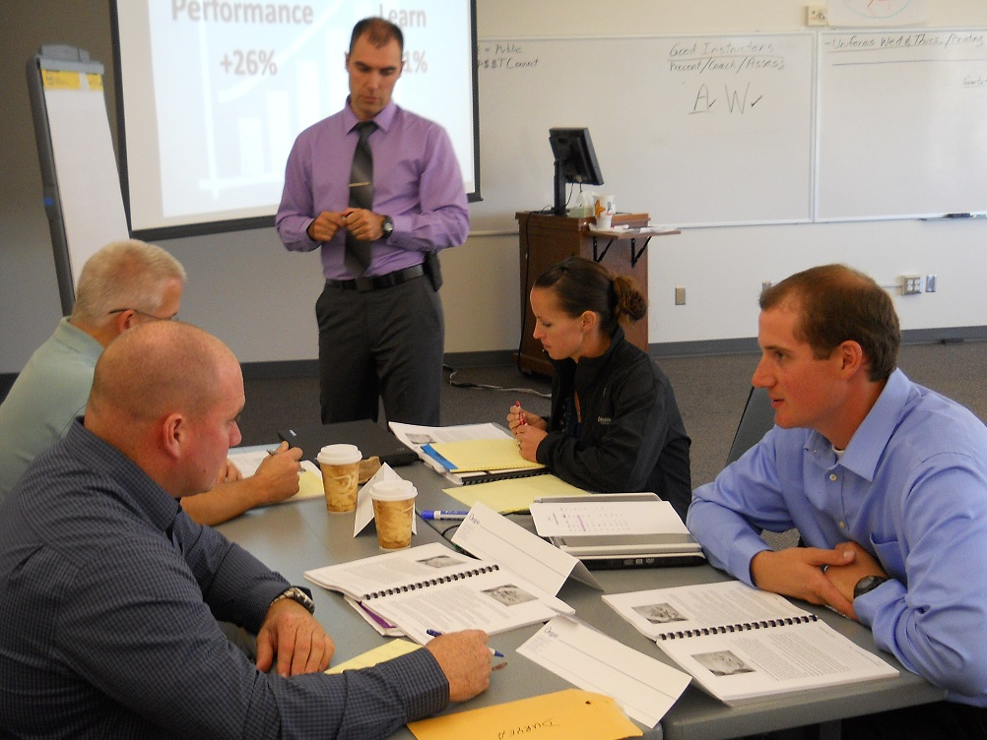
Notes:
Small Group Curriculum Activity
Divide class into 4 groups:
DRE Instructor Guide Administrator Guide group
DRE Instructor Guide Sessions 1-5 group
DRE Instructor Guide Session 6-10 group
DRE Instructor Guide Session 11-15 group
Each group will be given 15 minutes to research their topic.
Each group will present to the class the relevant information of their topic (maximum 15 minutes per group).
Key points to be elicited from the Administrator Guide group
For whom is the DRE course intended
How long is the training
Classroom requirements
Materials needed
Requirements to pass the course
Key points to be elicited from the Instructor Guide groups
This information can be located in the Appendices of the DRE Course Administrator Guide

Slide 19

Notes:
G. Questions and/or concerns
Solicit questions and comments from participants before moving to the next session.
__________________________________________________________________________
__________________________________________________________________________
__________________________________________________________________________
__________________________________________________________________________
__________________________________________________________________________
__________________________________________________________________________
__________________________________________________________________________
__________________________________________________________________________
__________________________________________________________________________
__________________________________________________________________________
__________________________________________________________________________

