Slide 1



Drug Recognition Expert
Condensed Instructor
Development
Course
Session 5 – Guidelines for Conducting DRE Certification Training
February 2017

Slide 2

Content Segments
Criteria
Conducting Practice Sessions During Certification Training
Evaluating and Documenting Candidate’s Progress
Correcting Learning Deficiencies
Administering the Certification Knowledge Exam
Signing Off on the Candidate’s Certification Progress Logs
Certification Standards
Questions
Notes:
Session 5: Guidelines for Conducting DRE Certification Training
Estimated time for Session 5: 2 Hours
Session Objectives
Describe the requirements the participants will have to achieve to qualify for DRE certification
Describe and apply procedures and techniques for delivering the final phases of DRE training
Describe proper procedures for meeting certification requirements
Conduct simulated exercises to demonstrate procedures employed in the certification process
Evaluate and document DRE candidates’ progress during certification training
Identify DRE candidates’ learning deficiencies and take appropriate corrective action
Administer and evaluate the Certification Knowledge Examination
Contents
Criteria
Conducting Practice Sessions During Certification Training
Evaluating and Documenting Candidate’s Progress
Correcting Learning Deficiencies
Administering the Certification Knowledge Exam
Signing Off on the Candidate’s Certification Progress Logs
Certification Standards
Questions
Materials
Presentation slides
Easel/Easel pad
Markers
Instructional Notes are presented in bold italic throughout the sessions.

Slide 3

Drug Recognition Expert Condensed
Instructor Development Course
Session 5:
Guidelines for Conducting
DRE Certification Training
Notes:
Session 5: Guidelines for Conducting DRE Certification Training
Estimated Time for Session 5: 2 Hours
Materials
Presentation slides
Easel/Easel pad
Markers
__________________________________________________________________________
__________________________________________________________________________
__________________________________________________________________________
__________________________________________________________________________
__________________________________________________________________________
__________________________________________________________________________
__________________________________________________________________________
__________________________________________________________________________

Slide 4

Session Objectives
Describe requirements needed to qualify for DRE certification
Describe and apply procedures and techniques for delivering final phases of DRE training
Describe proper procedures for meeting certification requirements
Notes:
Session Objectives
At the conclusion of this session, participants should be able to:
Describe the requirements needed to qualify for DRE certification
Describe and apply procedures and techniques for delivering the final phases of DRE training
Describe proper procedures for meeting certification requirements
__________________________________________________________________________________
__________________________________________________________________________________
__________________________________________________________________________________
__________________________________________________________________________________
__________________________________________________________________________________
__________________________________________________________________________________
__________________________________________________________________________________
__________________________________________________________________________________
__________________________________________________________________________________
__________________________________________________________________________________

Slide 5
Session Objectives (continued)
Conduct simulated exercises to demonstrate procedures employed in certification process
Evaluate and document DRE candidates’ progress during certification training
Identify DRE candidates’ learning deficiencies and take appropriate corrective action
Administer and evaluate Certification Knowledge Examination
Notes:
Session Objectives
At the conclusion of this session, participants should be able to:
Conduct simulated exercises to demonstrate procedures employed in the certification process
Evaluate and document DRE candidates’ progress during certification training
Identify DRE candidates’ learning deficiencies and take appropriate corrective action
Administer and evaluate the Certification Knowledge Examination
___________________________________________________________________________________
___________________________________________________________________________________
___________________________________________________________________________________
___________________________________________________________________________________
___________________________________________________________________________________
___________________________________________________________________________________
___________________________________________________________________________________
___________________________________________________________________________________
___________________________________________________________________________________

Slide 6
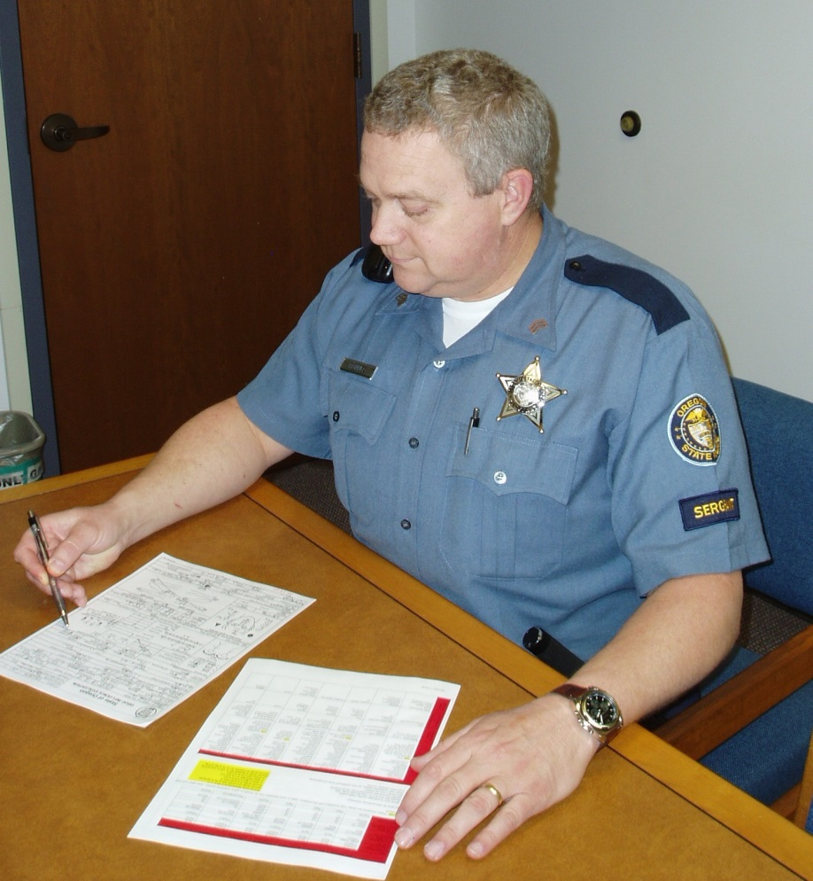
Two Important Criteria
Satisfied the unsupervised DRE candidate will properly conduct every step in the drug influence evaluation
Satisfied the DRE candidate will logically and properly interpret the results from the evaluation and reach proper conclusions regarding impairment
Notes:
A. CRITERIA
There is no simple “passing grade” for the certification phase of training. Two important criteria determine whether you will recommend a candidate for certification as a DRE:
Are you satisfied the DRE candidate, working unsupervised, will properly conduct every step in the drug influence evaluation?
Are you satisfied the DRE candidate will logically and properly interpret the results from the evaluation and reach proper conclusions regarding impairment?
Unless you can definitely answer “YES” to both questions, you must withhold your endorsement of the DRE candidate for certification.
___________________________________________________________________________________
___________________________________________________________________________________
___________________________________________________________________________________
___________________________________________________________________________________
___________________________________________________________________________________
___________________________________________________________________________________
___________________________________________________________________________________

Slide 7

Milestones
Participate in conducting at least 12 drug influence evaluations
Observe subjects who collectively exhibit signs of at least three of the seven drug categories
Opinions must be corroborated by toxicological analysis
Personally administer entire drug influence evaluation to at least six suspected impaired subjects
Acceptably answer all questions on Certification Knowledge Examination
Notes:
There are several steps the DRE candidate must complete before you can decide whether or not to endorse him or her for certification.
The candidate must have participated in conducting at least 12 drug influence evaluations
The candidate must have observed subjects who, collectively, exhibited the signs of at least three of the seven drug categories
The candidate’s opinions must be corroborated by toxicological analysis: Urine or blood specimens must be obtained from at least nine subjects examined by the candidate and chemical analysis must confirm the participant’s opinion in at least 75% of the specimens
The candidate must personally have administered the entire drug influence evaluation to at least six suspected impaired subjects
The candidate must have acceptably answered all questions on the Certification Knowledge Examination
KEEP IN MIND THESE FIVE REQUIREMENTS ARE MILESTONES THAT PRECEDE CERTIFICATION: THEY ARE NOT ALWAYS SUFFICIENT TO JUSTIFY CERTIFICATION.
Candidates may tell you they have already conducted their 12 evaluations and have seen their three categories and may try to demand to be certified
You cannot endorse a candidate for certification until you are satisfied he or she can administer the evaluation properly and interpret the results correctly
Candidates may need to conduct more than 12 evaluations before they are ready to be certified. Remember, the participant is not ready for certification unless YOU say he or she is ready
___________________________________________________________________________________
___________________________________________________________________________________

Slide 8

Team Assignments
At each Certification Training session, participants must be assigned to work in teams
Pre-assign a work schedule at beginning of each session
When a subject is brought to team, designated EVALUATOR will administer entire evaluation to the subject
Notes:
Team Assignments
No team should have more than four members and participants should not always work with the same partners. For example, Team #1 will evaluate the first available subject, Team #2 will evaluate the next subject, etc. ALL members of the team will receive credit for participating in the evaluation, HOWEVER ONLY THE“EVALUATOR” WILL RECEIVE CREDIT TOWARD THE SIX SUSPECTED DRUG-IMPAIRED EXAMINATIONS HE OR SHE MUST PERSONALLY ADMINISTER. ONLY the EVALUATOR’S name will appear in the “Evaluator” block of the Drug Influence Evaluation Form. Each team member will INDEPENDENTLY form an opinion as to what category or categories of drugs causing the subject’s impairment. Each team member will INDEPENDENTLY write a narrative report on the evaluation.
Experience shows participants will sometimes evaluate subjects who turn out not to be under the influence of drugs other than alcohol.
Some will be under the influence of alcohol only (mark “alcohol” on Face Sheet)
Others will be found to be medically impaired (mark “medical” on Face Sheet)
Some may be determined to be not impaired (mark “not impaired” on Face Sheet)
___________________________________________________________________________________
___________________________________________________________________________________
___________________________________________________________________________________
___________________________________________________________________________________
___________________________________________________________________________________

Slide 9
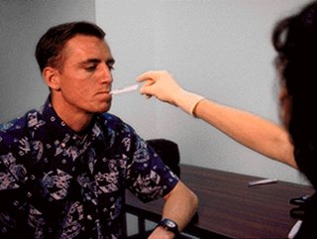
Credit for Evaluations
Drug
Alcohol
Medical
Not Impaired
Notes:
Credit for Drug, Alcohol, Medical, or Not Impaired Evaluations
There must have been some reasonable grounds for suspecting drug impairment, other than alcohol
In the case of an alcohol impaired opinion (i.e., where the evaluator concludes the subject is under the influence of alcohol alone), the evaluation must have been completed in its entirety
In the case of medical impairment, the evaluation need not be completed in its entirety, but should be terminated if the subject needs immediate medical attention
If the subject is determined to be not impaired, the candidate may not receive credit for the evaluation.
To receive credit for any of the above-listed evaluations when an opinion is rendered, a Drug Influence Evaluation report and narrative must be completed.
_________________________________________________________________________________
_________________________________________________________________________________
_________________________________________________________________________________
_________________________________________________________________________________
_________________________________________________________________________________
_________________________________________________________________________________
_________________________________________________________________________________

Slide 10
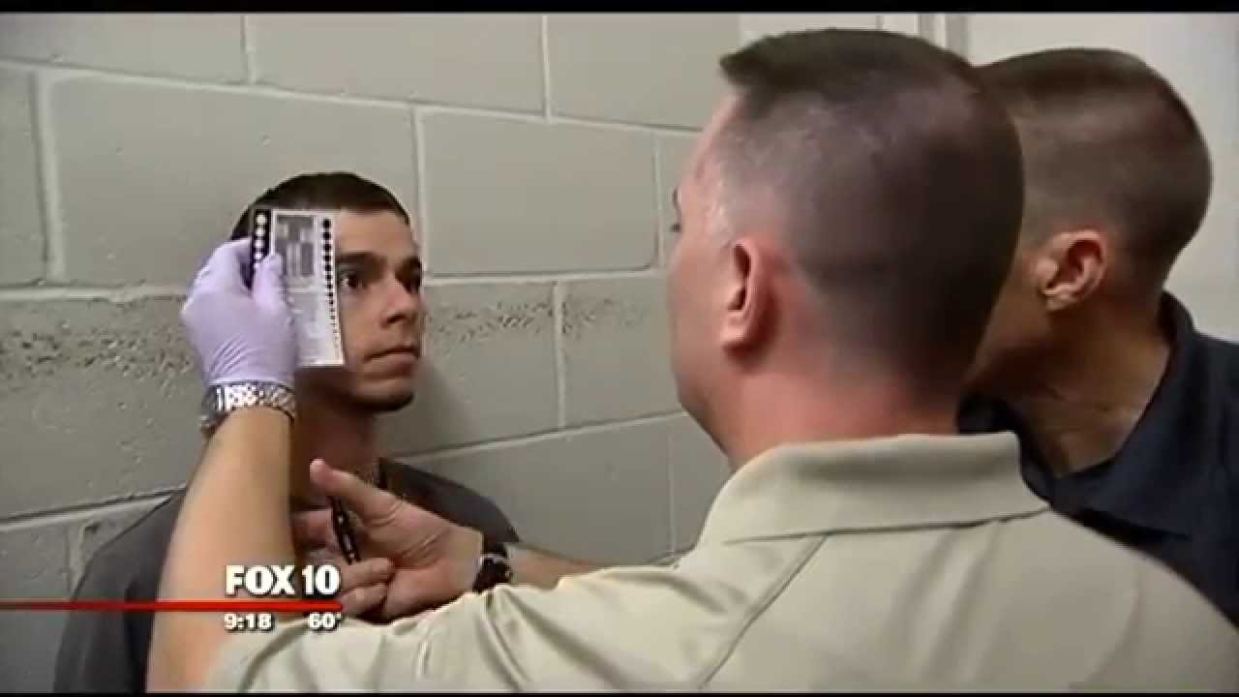
Conducting Practice Sessions
Notes:
B. Conducting Practice Sessions During Certification Training
“Down Time” will occur during field certification training. DON’T WASTE THE TIME: Use it for practice opportunities.
Four kinds of practice opportunities may be given to the candidates during “down time” if time allows. Examples include:
Darkroom Examinations – Candidates can take turns estimating each others’ pupil sizes under the lighting conditions in the darkroom
Nystagmus, convergence, and psychophysical testing on alcohol-impaired subjects – A subject known to be strictly under the influence of alcohol could provide a useful opportunity for practice. Candidates could practice administering HGN, VGN, lack of convergence, and the four divided attention tests to alcohol-impaired subjects when no drug-impaired subjects are available.
Test interpretation – The exemplars can be given to the candidate teams whenever time permits. Team members should work together to form opinions about the drug categories for each exemplar. Additional exemplars can be created from the DRE Instructors’ own files.
As time permits, candidates may also work on developing and updating their Curriculum Vitae
___________________________________________________________________________________
___________________________________________________________________________________
___________________________________________________________________________________
___________________________________________________________________________________

Slide 11
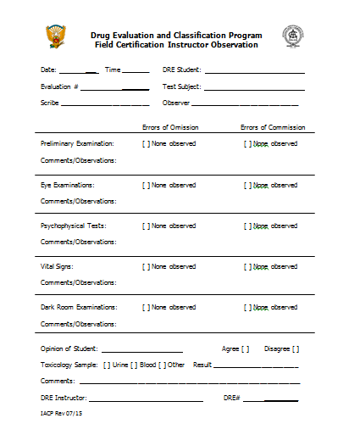
Instructor Observation Form
Notes:
C. Evaluating and Documenting CANDIDATE’S Progress
Whenever a team of candidates completes an evaluation during the Field Certification Training, the supervising instructor must complete a Field Certification Instructor Observation Form.
Hand out copies of the “Field Certification Instructor Observation” form
Preparing Field Certification Instructor Observation form
The form must address the three basic skills required of DREs:
Did the candidate properly administer all tests and estimates/measurements of the evaluation?
Did the candidate properly document the evaluation and record the results of all tests and estimates/measurements?
Did the candidate properly interpret the information and form appropriate opinions about the category of drugs affecting the subject?
Direct participants’ attention to the top segment of the “Field Certification Instructor Observation” form.
The instructor should complete the form noting errors of omission and errors of commission in the following areas:
Preliminary Examination
Eye Examinations
Psychophysical Tests
Vital Signs
Darkroom Examinations

Slide 12
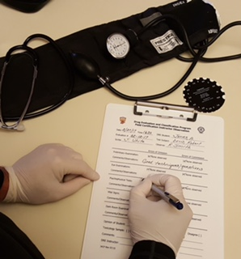
Instructor Observation Form
Notes:
C. Evaluating and Documenting CANDIDATE’S Progress (continued)
The instructor comments should also address how the candidates handled the subject, i.e., the demeanor they showed to the subject and their observance of officer safety issues.
Examples of Errors:
Errors of Omission: What did the candidate fail to do during the evaluation?
Emphasize the instructor must specify exactly what the candidate left out of the evaluation. Examples: “Neglected to demonstrate the proper turn for the Walk and Turn test;” “Forgot to take the third pulse measurement.”
Errors of Commission: What did the candidate do wrong during the evaluation?
Emphasize the instructor must specify exactly what the candidate did improperly. Examples: “Used the right radial artery to measure pulse rate;” “Administered Walk and Turn before the Modified Romberg Balance.”
Comments/Observations: Anything else -- positive or negative -- the instructor feels deserves comment.
Examples: “Continues to exhibit lack of confidence in using the sphygmomanometer;” “Gives flawless instructions for the divided attention tests.”
___________________________________________________________________________________
___________________________________________________________________________________
___________________________________________________________________________________

Slide 13

Instructor Evaluation Form
Notes:
C. Evaluating and Documenting CANDIDATE’S Progress (continued)
The IACP International Standards for the DEC Program regarding completion of the Certification phase are listed below: (The entire standards are included in the Appendices of the Administrator Guide)
To be considered for certification as a DRE, the candidate must satisfactorily complete a minimum of 12 drug influence evaluations, during which the candidate must encounter and identify subjects under the influence of at least three of the drug categories as described in the DRE training. Of the evaluations required for certification, the candidate shall administer a minimum of six evaluations. The candidate may observe the remaining evaluations.
The opinion of the DRE candidate regarding drug categories must be supported by forensic testing and/or toxicology. In the case of influence from some drug categories, such as inhalants, it may not be possible to acquire confirming toxicology. In these situations, the concurrence from a certified DRE instructor regarding the drug category will be required. Certification training evaluations will be conducted in accordance with the current procedures and guidelines established in the DEC Program training curriculum.
All evaluations, administered or observed, and documented for certification purposes, shall be observed, supervised, and reviewed by at least one certified DRE instructor and shall be performed on subjects suspected of drug impairment.
The DRE instructor who starts the “DRE evaluation observation” shall observe the entire DRE evaluation for the candidate and instructor to receive credit.
For a candidate to receive credit for an administered or observed evaluation, the candidate shall independently write his own narrative based on his observations. The evaluation must also be recorded on the candidate’s Rolling Log and Progress Log. The evaluation shall include the Face Sheet and a complete narrative identifying the category(ies) of the drug(s) affecting the subject.

Slide 14
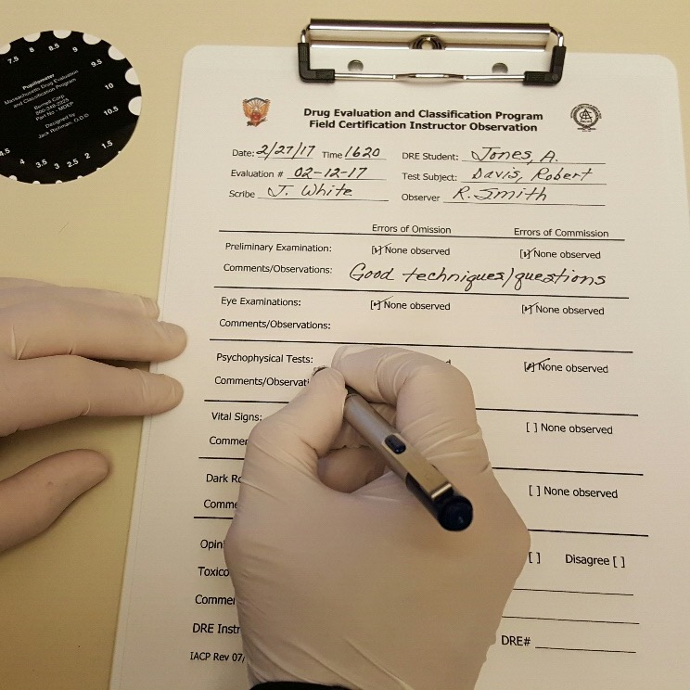
Instructor Evaluation Form
Notes:
C. Evaluating and Documenting CANDIDATE’S Progress (continued)
If the DRE instructor who observed and supervised the candidate’s evaluation is not available in person to review and approve the Face Sheet and narrative, the candidate should prepare a copy or scan of the completed Face Sheet and narrative and send it to the DRE instructor who observed the evaluation for review and approval. After the DRE instructor reviews and approves the candidates evaluation the DRE instructor should return any documentation, feedback and/or comments to the DRE candidate. (The recommended way will be by e-mail so a date and time is recorded on the correspondence.) If the DRE instructor will not be available in person to sign the candidate’s Progress Log, they should indicate in their correspondence to the DRE candidate that they authorize another DRE instructor to sign the candidate’s Progress Log on their behalf. The candidates should keep any returned correspondence with the original evaluation in case any future review is necessary for certification purposes.
As a reminder, if a DRE candidate is acting as a Scribe or an Observer, they will have to prepare a written report of the evaluation they participated in to receive credit for the evaluation.
___________________________________________________________________________________
___________________________________________________________________________________
___________________________________________________________________________________
___________________________________________________________________________________
___________________________________________________________________________________

Slide 15
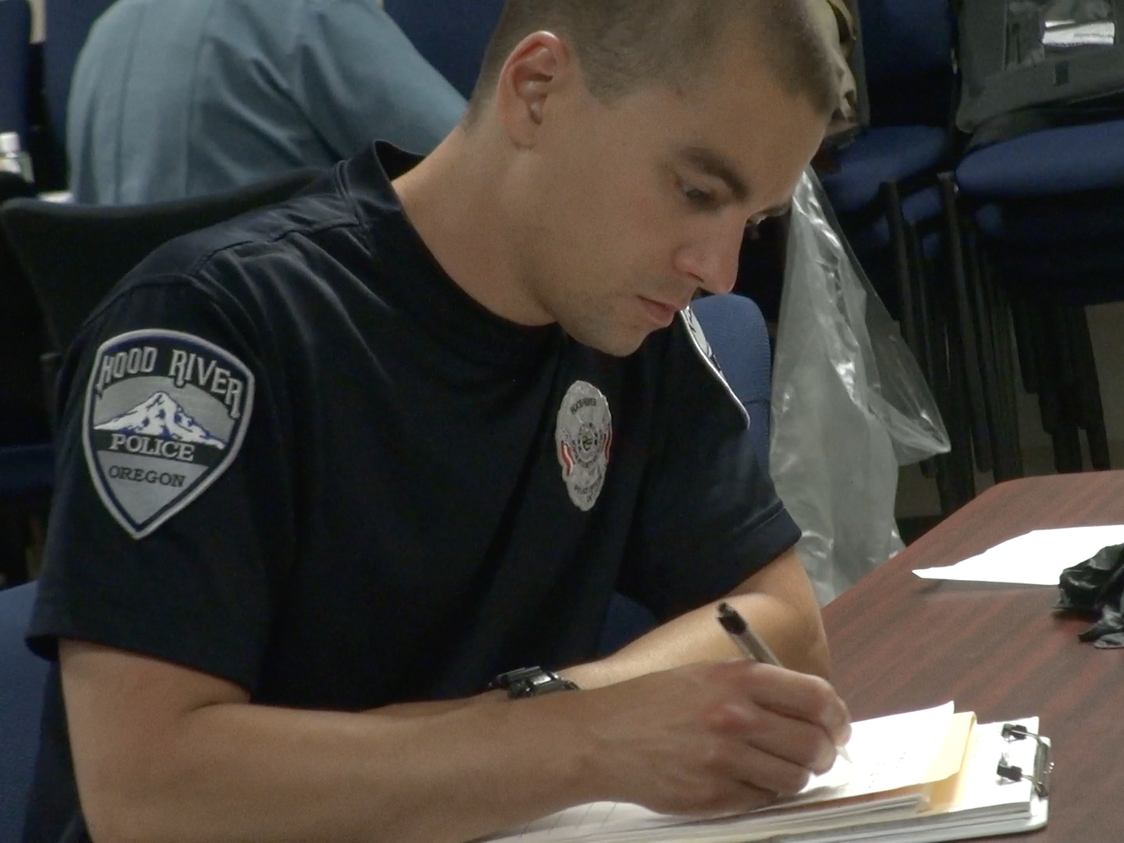
Documenting the Assessment
Notes:
Documenting the assessment of the candidates’ performance in interpreting the results of the evaluation.
Direct participants’ attention to the “OPINION OF STUDENT” line of the “Field Certification Instructor Observation” form.
You must ask yourself: Would I reach exactly the same conclusion the candidate reached in this evaluation?
EMPHASIZE the instructor must not answer “YES” to this question unless his or her opinion does not differ at all from the candidate’s opinion. Example: If the candidates conclude the subject is under the influence of a CNS Stimulant and Cannabis, but you feel -- while Stimulant impairment is evident -- there is insufficient evidence of Cannabis, you must answer “NO” to this question.
If you disagree in any way with the candidates’ opinion, you must record exactly how and why you disagree.
Example: “No articulable indicators of Cannabis were found; all vital and eye indicators can be accounted for due to a Stimulant alone”.
Solicit participants’ questions about the “OPINION OF STUDENT” line of the “Field Certification Instructor Observation” form.
Direct participants’ attention to the “COMMENTS” line of the “Field Certification Instructor Observation” form.
___________________________________________________________________________________
___________________________________________________________________________________

Slide 16
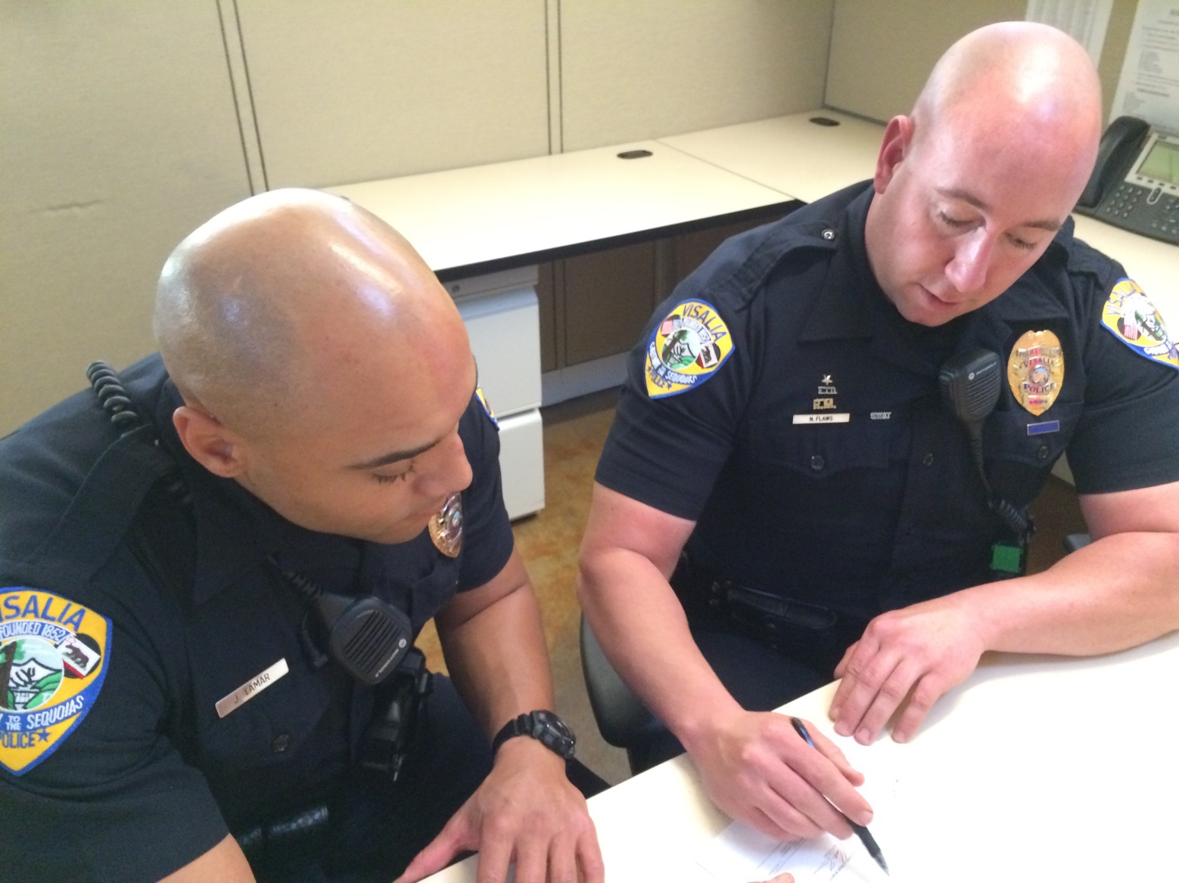
Documenting the Assessment
Notes:
Record any problems associated with the candidates’ demeanor in dealing with the subject on the “Comments” line.
Ask participants to suggest some demeanor problems they might observe Examples:
Needless derogatory comments made to the subject
Refusing to answer the subject’s questions, when doing so might have helped to build rapport
Being overly brusque or aggressive in giving instructions to the subject
Failing to “warn” the subject about portions of the evaluation that might cause stress or anxiety (e.g., the lights are about to be turned off, you will touch his or her face with the pupillometer, etc.)
Record anything the candidates did or failed to do that might jeopardize their safety.
Ask participants to suggest officer safety problems they might observe with their candidates. Examples: turning the back toward the subject when demonstrating the Walk and Turn; closing the eyes when demonstrating the Modified Romberg Balance .
Solicit participants’ questions about the “Field Certification Instructor Observation” form.
___________________________________________________________________________________
___________________________________________________________________________________
___________________________________________________________________________________
___________________________________________________________________________________

Slide 17

Evaluation Performance Review
Notes:
Evaluation Performance Review
The instructor must document his or her overall assessment of the quality of the evaluation.
Record positive comments, when appropriate.
Examples: “These candidates exhibit confidence in their ability to identify drug impairment;” “The report is a model of clarity and accuracy.”
Record constructive criticisms, as appropriate.
Examples: “These candidates need to pay closer attention to the checklist to ensure examinations are conducted in the standard sequence;” “Their opinion suggests a tendency to ‘see things that are not necessarily there’ -- a more conservative and prudent approach would be preferable.”
Record your first and last names on the Instructor’s line.
Record your IACP DRE number.
Solicit participants’ questions about the “Field Certification Instructor Observation” form.
Filing the “Field Certification Instructor Observation” form.
Ask participants: Who should receive copies of the “Field Certification Instructor Observation” form?
The instructor -- YOU -- should retain a copy of every “Field Certification Instructor Observation” form you complete.
Point out other instructors may wish to discuss a candidate’s progress and it may prove helpful to refer to these forms and/or narrative reports during those discussions.

Slide 18
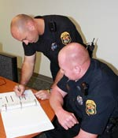
Correcting Learning Deficiencies
Counseling
Clarifying
Coaching
Notes:
D. Correcting Learning Deficiencies
When an instructor identifies a learning deficiency during certification training, he or she must work with the candidate to correct the deficiency.
One form of corrective action is counseling, which basically means pointing out to the candidate he or she has made a mistake
Another form of corrective action involves clarifying, which means explaining to the candidate how to do correctly whatever it is the candidate is doing wrong
The third form is coaching, which means observing and guiding the candidate as he or she tries to do it the right way
Point out when a candidate makes a mistake, it is often necessary to use all three kinds of corrective action.
___________________________________________________________________________________
___________________________________________________________________________________
___________________________________________________________________________________
___________________________________________________________________________________
___________________________________________________________________________________
___________________________________________________________________________________

Slide 19

Notes:
When should the instructor counsel a candidate?
Solicit participants’ responses to the “when to counsel?” question. Gently guide the discussion toward the conclusion that it all depends on the situation.
Sometimes it is appropriate -- or even essential -- to point out the mistake immediately.
Ask participants for examples of mistakes that should be pointed out immediately. Some plausible examples of immediate counseling situations:
The candidate is about to examine the subject physically but isn’t yet wearing protective gloves
The candidate administers the Modified Romberg Balance test but neglects to tell the subject to estimate the passage of 30 seconds
Comment on other examples supplied by participants.
Sometimes it may be acceptable to delay in pointing out the mistake to the candidate.
Example: It is a candidate’s first certification training and he or she is examining the very first subject. The candidate reaches for the subject’s right wrist and begins to count the pulse. What should the instructor do? Solicit participants’ responses to this question. Probe for ideas by asking these follow-up questions:
What advantages might be gained if the instructor allows the candidate to proceed with the right-wrist pulse measurement?
What disadvantages might be created if the instructor immediately jumps in and tells the candidate to shift to the left wrist?
It can be very frustrating – and unnerving – to the candidate if the instructor always “pounces” right away on every mistake. It might be better to delay mentioning a relatively minor mistake to allow the candidate to focus on more important elements of the skill being practiced.
Example: Let the candidate go ahead and concentrate on finding the pulse point and counting the beats and point out later he or she used the wrong wrist.

Slide 20
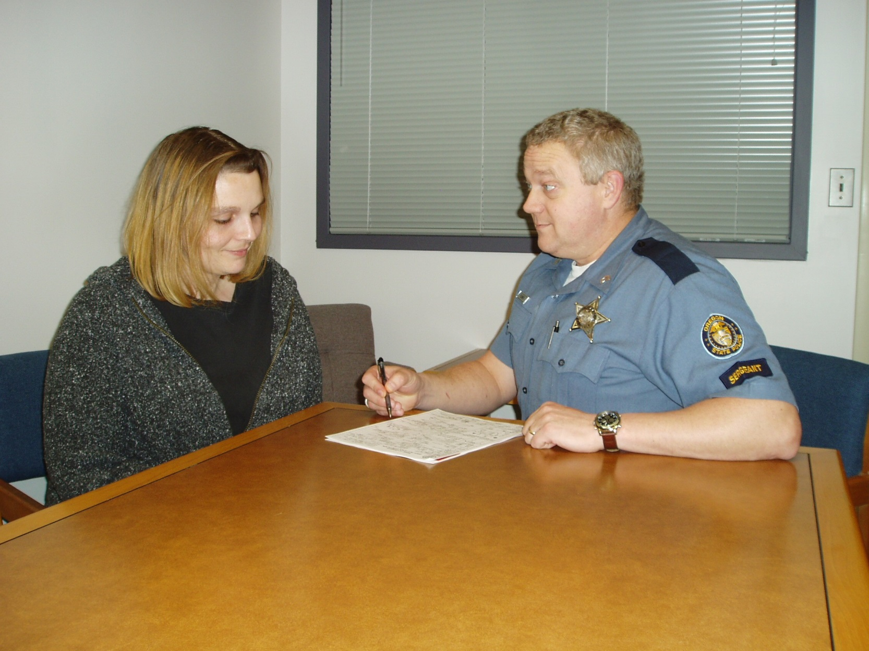
Notes:
The basic idea is to make certification training as productive as possible for the candidate.
This is especially important during the first few nights of certification training, when most mistakes are likely to occur.
However, the instructor always must make certain the candidate becomes aware of his or her mistakes. One technique of counseling that can be effective when a minor mistake has been made is to ask the candidate what he or she did wrong
Example: When the candidate used the right wrist, the instructor could wait until the pulse measurement was made and recorded, then say “Jim, you seemed to do a good job locating and counting the pulse. But think about exactly how – and where – you did it; is there something you should have done differently?”
As the instructor, you have to make the “judgment call” about whether you should point out a mistake immediately to the candidate. Sometimes you’ll have to counsel them right away; sometimes it’s best to wait a minute or two; sometimes you can even wait until the evaluation is completed before pointing out a mistake
ALWAYS REMEMBER: At some point you need to tell the candidate about each mistake he or she made.
Solicit participants’ questions about counseling. Ask participants: “What is the second type of corrective action mentioned earlier?” Clarify (reveal next slide)
___________________________________________________________________________________
___________________________________________________________________________________

Slide 21
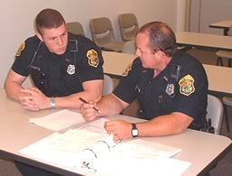
Clarify
Verbal clarification first
Physical demonstration
Notes:
It is also the instructor’s responsibility to clarify for the candidate what he or she is doing wrong, and how to do it right.
Always try a verbal clarification first, i.e., explain to the candidate what he or she did incorrectly and verbally remind the candidate how to do it right.
Example: Suppose the candidate positions the penlight too far from the subject’s face when performing the direct-light estimation of pupil size. The instructor might clarify the problem by saying the following: “You’re holding the penlight too far from his eye. See how the circle of light is spread out onto his forehead and down onto his cheek? Remember, we want to have the light just fill the eye socket. So move the penlight a bit closer to his eye.”
If a verbal clarification doesn’t correct the problem, you must give a physical demonstration, i.e., you will have to show the candidate how to do it.
___________________________________________________________________________________
___________________________________________________________________________________
___________________________________________________________________________________
___________________________________________________________________________________
___________________________________________________________________________________
___________________________________________________________________________________
___________________________________________________________________________________

Slide 22
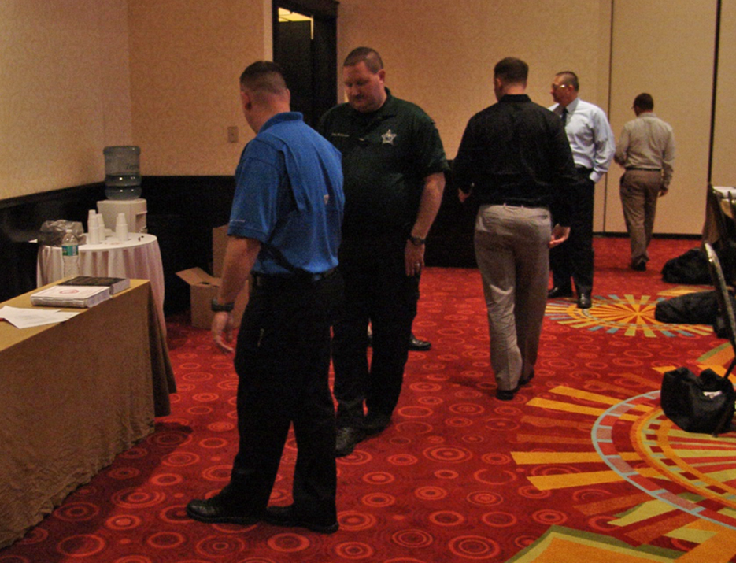
Procedures for Clarifying
Give a step-by-step verbal overview
Demonstrate “by the numbers”
Demonstrate more than once
Involve the candidate
Notes:
Procedures for Clarifying
Follow the same procedures you would use to give a classroom demonstration:
First, give a step-by-step verbal overview of what you are about to show the candidate
Next, demonstrate “by the numbers,” i.e., perform each step in the proper way and in the correct sequence
Be sure to demonstrate more than once
Finally, involve the candidate. Have him or her try to perform the skill under your guidance
___________________________________________________________________________________
___________________________________________________________________________________
___________________________________________________________________________________
___________________________________________________________________________________
___________________________________________________________________________________
___________________________________________________________________________________
___________________________________________________________________________________
___________________________________________________________________________________

Slide 23

Two Important Rules
Notes:
Two Important Rules
Two important rules for clarifying things to candidates:
NEVER let the candidate sense you are exasperated or angry because you have to explain or show something to him or her again, i.e., never let the candidate feel you think he or she is stupid.
DON’T BE TOO QUICK to “jump in” with a physical demonstration: first try simply to explain verbally what he or she needs to do to correct a problem, i.e., don’t immediately react to a candidate’s mistake by saying “Stop. Watch me do it one more time.” Doing that can make the candidate feel he or she is totally inept.
___________________________________________________________________________________
___________________________________________________________________________________
___________________________________________________________________________________
___________________________________________________________________________________
___________________________________________________________________________________
___________________________________________________________________________________
___________________________________________________________________________________
___________________________________________________________________________________

Slide 24
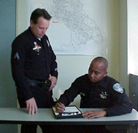
Coach
Notes:
Coach
Finally, as an instructor in certification training, it is always your duty to coach your candidates.
During a candidate’s first few evaluations of real, live subjects, you can coach by talking the candidate through the evaluation.
“Talking through” means reminding the candidate what to do and how to do it at each step of the evaluation. As the candidate progresses, you should stop “talking through” but you must continue to monitor his or her work.
A MOST IMPORTANT RULE: It is just as important to give positive feedback as it is to offer constructive counseling.
Each time you observe a candidate conduct an evaluation, try to find something positive you can say about his or her performance
Tell the candidate
Solicit questions and comments about the instructor’s role in counseling, clarifying, and coaching.
___________________________________________________________________________________
___________________________________________________________________________________
___________________________________________________________________________________
___________________________________________________________________________________

Slide 25
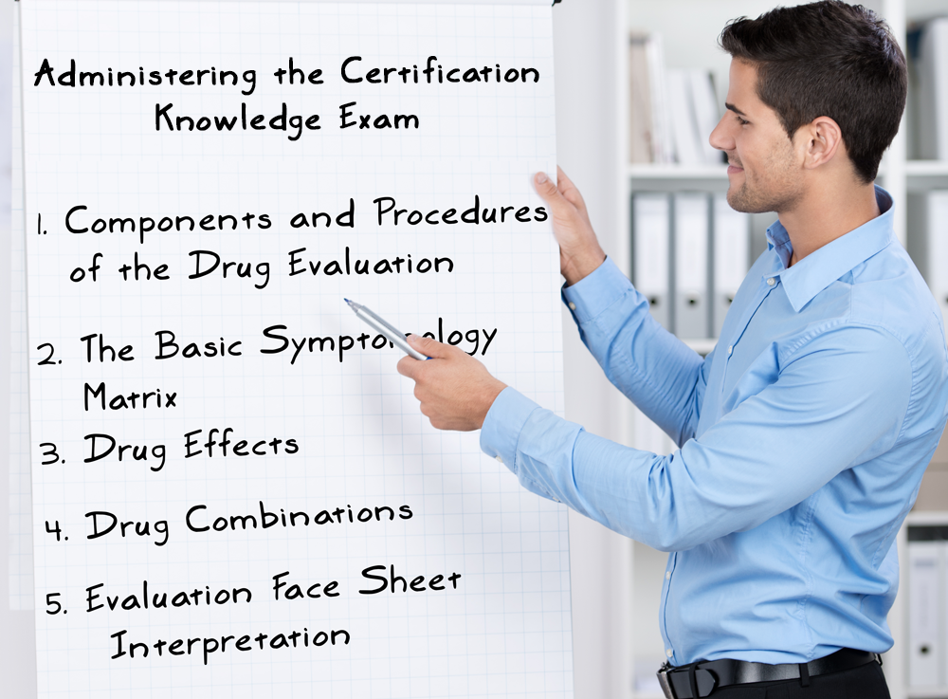
Notes:
E. Administering the CERTIFICATION Knowledge Exam
Hand out a copy of the Certification Knowledge Examination to the candidates.
The purpose of the Certification Knowledge Examination is to verify the candidate is fully conversant with drug signs and symptoms and fully understands the concepts of drug combinations.
It is only a Knowledge examination
It is not a test of the candidate’s ability to conduct evaluations
It is a milestone the candidate must reach before he or she can be considered for certification
Passing this knowledge exam does not automatically or immediately result in certification
The Certification Knowledge Examination must not be administered before the candidate has participated in at least six evaluations of persons suspected of drug impairment.
Note: Individual States may impose more restrictive limits concerning when the Certification Knowledge Exam may be taken. Instructors should consult the State or Agency DRE coordinators before administering the exam.
If you are not satisfied the candidate has made sufficient progress to be ready for the exam, feel free to delay it for one, two, or several nights. In order to “pass” the milestone of the Certification Knowledge Exam, the candidate must “acceptably” answer every question on it.
Hand out the Instructor version of the exam with the criteria for “acceptable answers”.
The exam is not scored numerically. Each part of the exam must be completed correctly before the candidate can become certified.

Slide 26
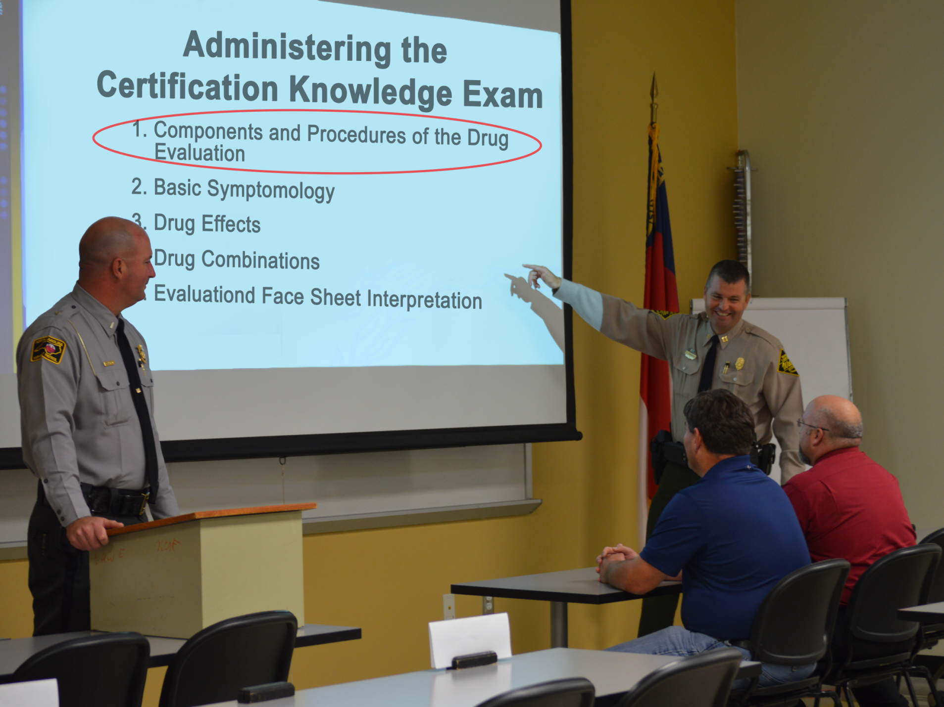
Notes:
Acceptable answers for Part One: Components and Procedures of the Drug Influence Evaluation
Direct participants’ attention to the end of their session. Review the “acceptable answers” to the 15 questions of Part One.
List the three Standardized Field Sobriety Tests. (HGN; WAT; OLS)
How many times do we take the suspect’s pulse? (Three)
In a blood pressure measurement, the Higher and Lower figures are _____? (systolic; diastolic)
List the tests used to assess divided attention. (Modified Romberg Balance; Walk and Turn; One Leg Stand; Finger to Nose)
When do we evaluate internal clock? (During the Modified Romberg Balance test)
During the Walk and Turn, the subject must take ______. (nine and nine)
Under what three lighting conditions do we check pupils? (room light; near-total darkness; direct)
Which categories cause lack of convergence? (CNS Depressants; Dissociative Anesthetics; Inhalants; Cannabis)
What are the signs of a fresh puncture? (red dot; oozing fluid; raised skin surface)
What is the DRE average range of blood pressure? (120-140/70-90)
What is the DRE average range of pulse rate? (60-90)
What is the DRE range of human pupil size in room light? (2.5 mm - 5.0 mm)
What is considered average body temperature? (98.6 + or - one degree)
What is lack of convergence is described as? (Inability to cross eyes)
Rebound dilation is described as? (A period of constriction followed by a period of dilation)
___________________________________________________________________________________
___________________________________________________________________________________

Slide 27
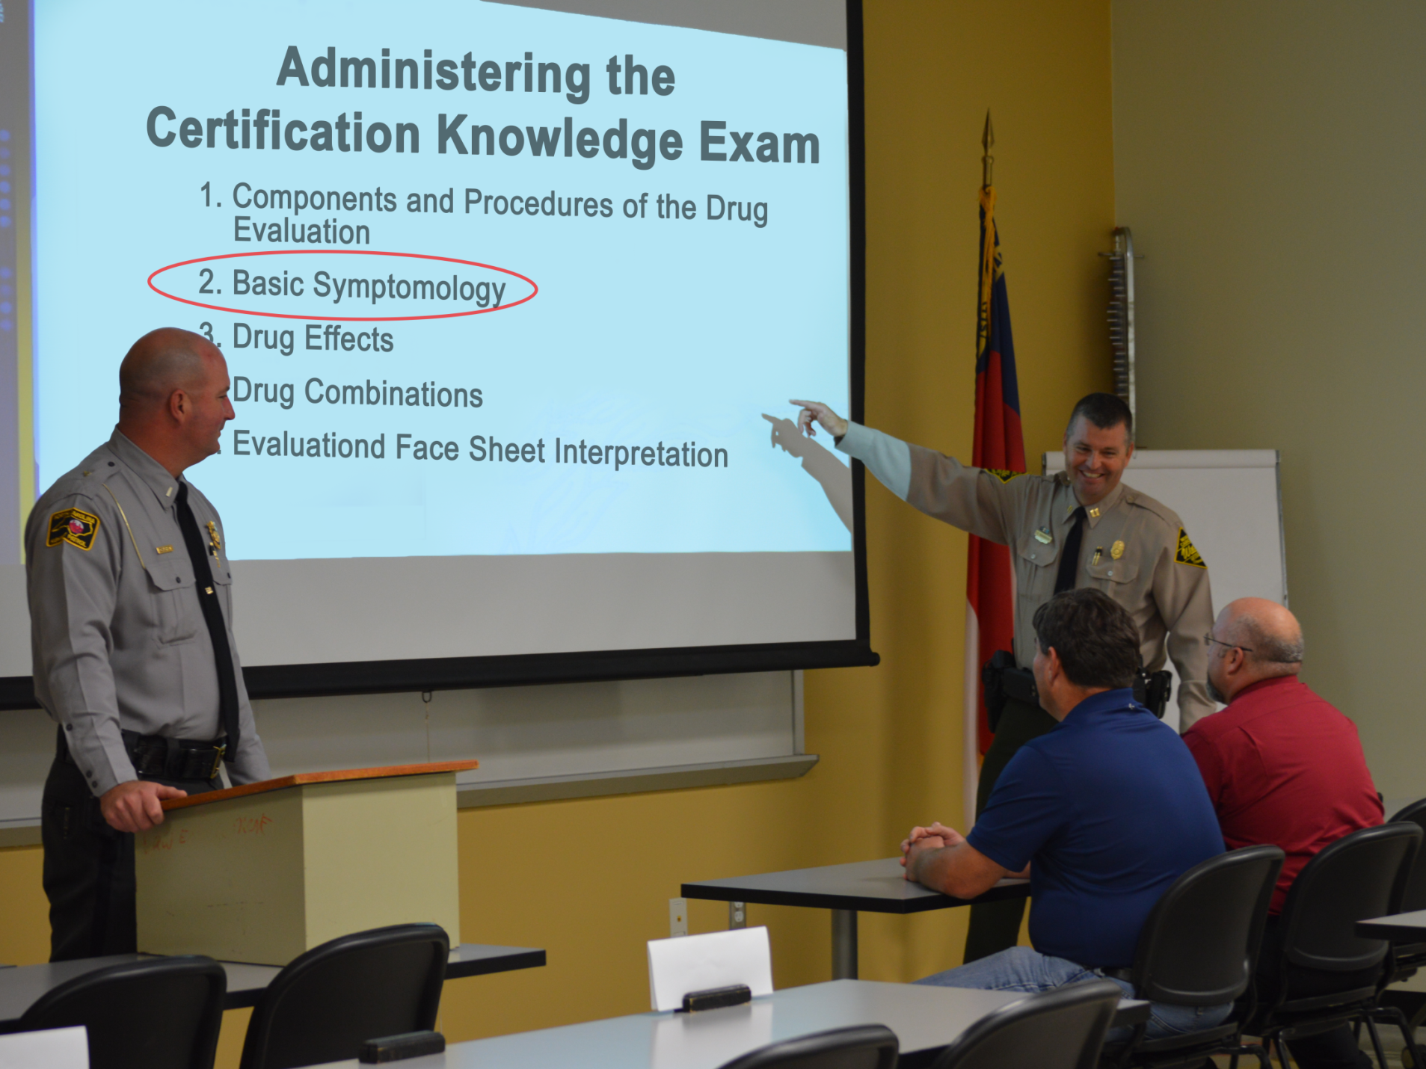
Notes:
Acceptable answers for Part Two: the Basic Symptomatology Matrix.
The candidate should be able to reproduce the basic symptomatology matrix without any significant errors.
Errors:
An “error” would be a failure to indicate an eye sign or vital sign that is usually associated with the particular category
For example, if the candidate indicates HGN is “not present” with CNS Depressants or pupil size is “near normal” with CNS Stimulants, those would be errors.
An “error” would also be indicating a category causes an effect that it really doesn’t
For example, if the candidate indicates Cannabis causes HGN or a Dissociative Anesthetic slows the reaction of the pupils to light, those would be “errors”.
Once the candidate manages to reproduce the basic Symptomatology Matrix without any errors, they will have “passed” Part Two of the examination.
___________________________________________________________________________________
___________________________________________________________________________________
___________________________________________________________________________________
___________________________________________________________________________________
___________________________________________________________________________________

Slide 28

Notes:
Acceptable answers to Part Three: Drug Effects
Responses can appear in any order as long as all four effects are accurately described.
Part Three is in two sections. Section one provides the definitions to each drug effect and section two provides that the candidate give examples of the drug combinations that would produce each of the four effects.
Null Effect (Combination of no action plus no action equals no action)
Overlapping Effect (Action plus no action equals action)
Additive Effect (Action plus the same action produces reinforced action)
Antagonistic Effect (Action versus opposite action; cannot predict the outcome)
___________________________________________________________________________________
___________________________________________________________________________________
___________________________________________________________________________________
___________________________________________________________________________________
___________________________________________________________________________________
___________________________________________________________________________________
___________________________________________________________________________________
___________________________________________________________________________________

Slide 29

Notes:
Acceptable answers to Part Four: Drug Combinations
The candidate should be able to write a detailed description of what would be observed in an evaluation of a subject under the influence of each of the four drug combinations
Point out the first combination listed in the exam is “Hallucinogen and Alcohol”. Write “Hallucinogen and Alcohol” on the dry erase board or easel/easel pad.
The description must include eye signs; vital signs; psychophysical signs; and, expected duration of effects
Ask participants: “What eye signs would we expect to see in a Hallucinogen and alcohol combo?” Write participants’ responses on the dry erase board or easel/easel pad.
Eye signs for Hallucinogen & Alcohol:
HGN Present, due to alcohol
Vertical Nystagmus Possibly Present, due to alcohol
Lack of Convergence Present, due to alcohol
Pupils Dilated, due to the Hallucinogen
Reaction to Light Slowed, due to alcohol
Vital Signs for Hallucinogen and Alcohol:
Ask participants: “What vital signs would we expect to see in a Hallucinogen and alcohol combo?” Write participants’ responses on the dry erase board or easel/easel pad.
Pulse Rate elevated, due to Hallucinogen
Blood Pressure –up/down or normal
Temperature elevated, due to Hallucinogen

Slide 30

Notes:
Acceptable answers to Part Four: Drug Combinations
Psychophysical Signs for Hallucinogen and Alcohol:
Ask participants: “What kinds of indications would we expect to see during the psychophysical tests in a Hallucinogen and alcohol combo?” Write participants’ responses on the dry erase board.
Impaired Divided Attention, due to both drugs
Muscle Tone – near normal
Body Tremors possible, due to Hallucinogens
Expected Duration of Effects for Hallucinogen and Alcohol
Ask participants: “What comments would you offer about the expected duration of effects?” Write participants’ responses on the dry erase board
Point out this is the kind of detailed, accurate information candidates are expected to provide on Part Three of the exam.
Pupil size may return to near normal, while vitals remain elevated and nystagmus continues to be observed.
___________________________________________________________________________________
___________________________________________________________________________________
___________________________________________________________________________________
___________________________________________________________________________________
___________________________________________________________________________________

Slide 31
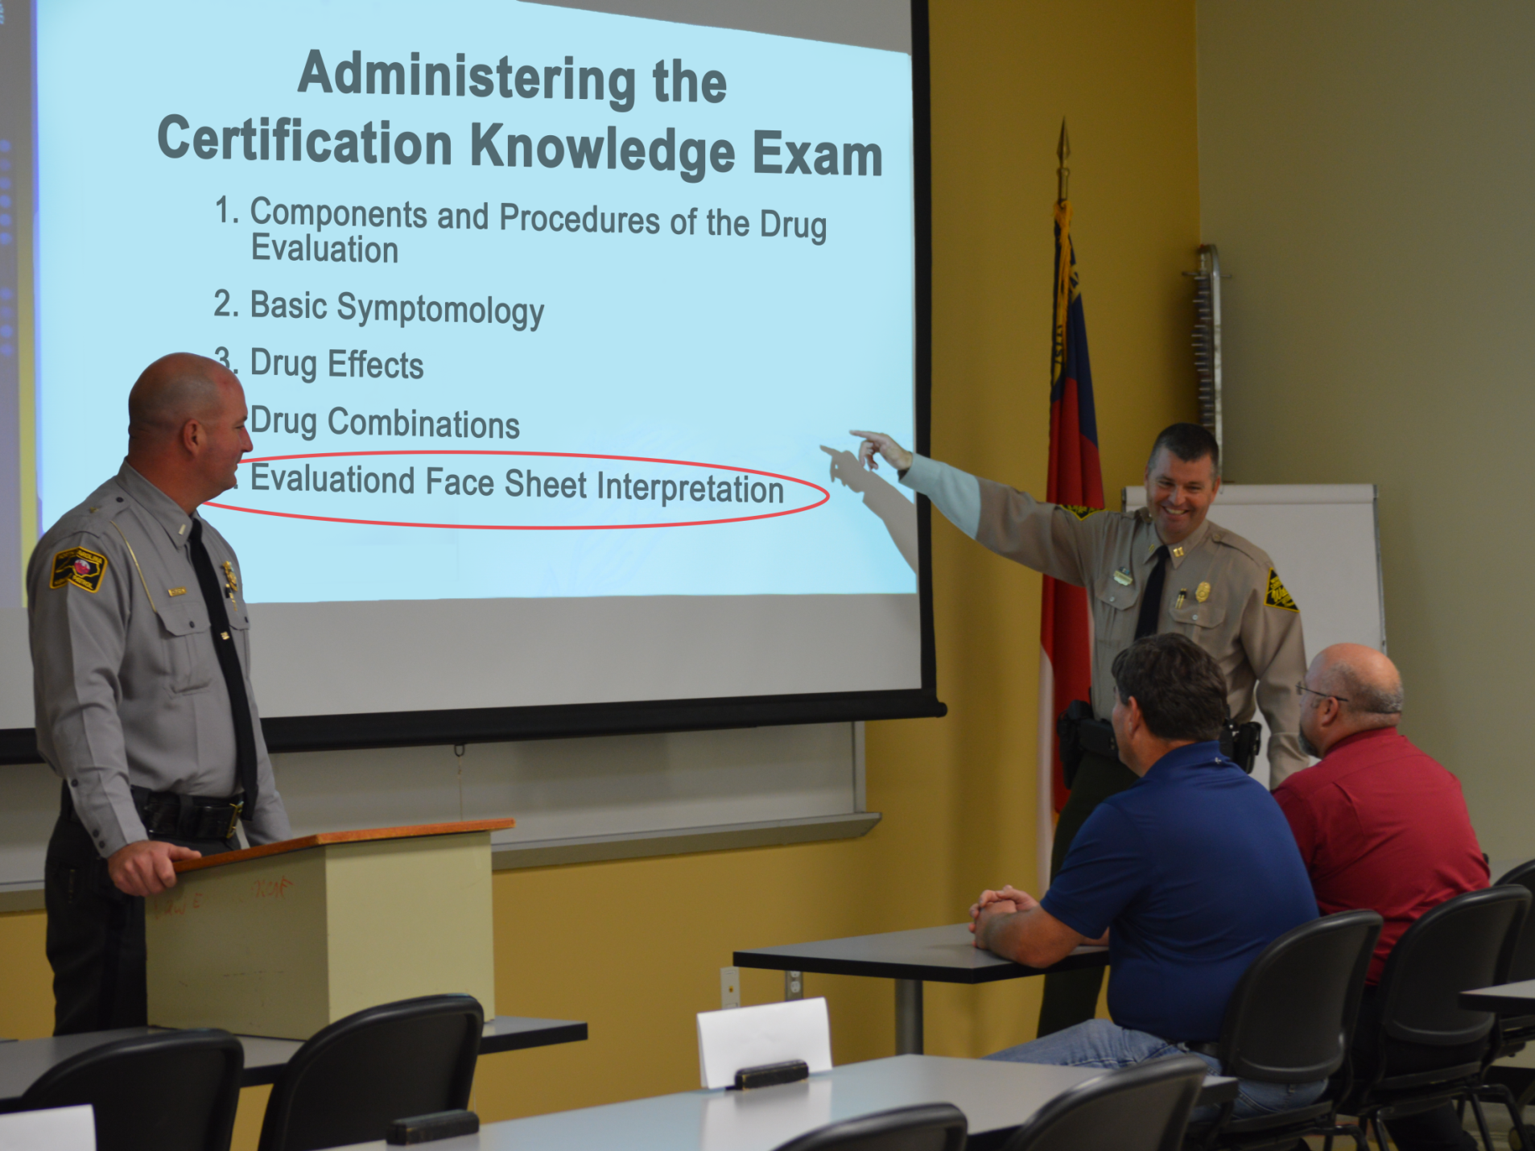
Notes:
Acceptable answers to Part Five: Evaluation Face Sheet Interpretation
The candidate is asked to review five evaluation Face Sheets and list the category or categories causing impairment. The candidate must write a complete detailed narrative report for one of the five evaluations.
Subject “Michael” – CNS Depressant and ETOH (Alcohol)
Subject “Harlon” – Inhalant
Subject “David” – Narcotic Analgesic
Subject “Alice” – CNS Stimulant
Subject “Arnold” – Cannabis
Point out the importance of the candidate writing a detailed report similar to what they would complete on an actual DRE evaluation.
Solicit participants’ questions about the Certification Knowledge Examination.
___________________________________________________________________________________
___________________________________________________________________________________
___________________________________________________________________________________
___________________________________________________________________________________
___________________________________________________________________________________

Slide 32

Signing Off on the Candidates’ Certification Progress Logs
Notes:
F. Signing Off on the Candidates’ Certification Progress Logs
As a DRE Instructor you have the authority to place your signature on various lines of a Candidate’s Certification Progress log
The candidate receives a copy of the log, totally blank, in the candidate Pre-School manual
The candidate should bring the Progress Log to the DRE School and every certification training.
The candidate brings the log to all subsequent DRE training events
Each time the candidate achieves a milestone in the training, an instructor must sign the line on the log signifying the milestone was reached.
___________________________________________________________________________________
___________________________________________________________________________________
___________________________________________________________________________________
___________________________________________________________________________________
___________________________________________________________________________________
___________________________________________________________________________________
___________________________________________________________________________________
___________________________________________________________________________________

Slide 33
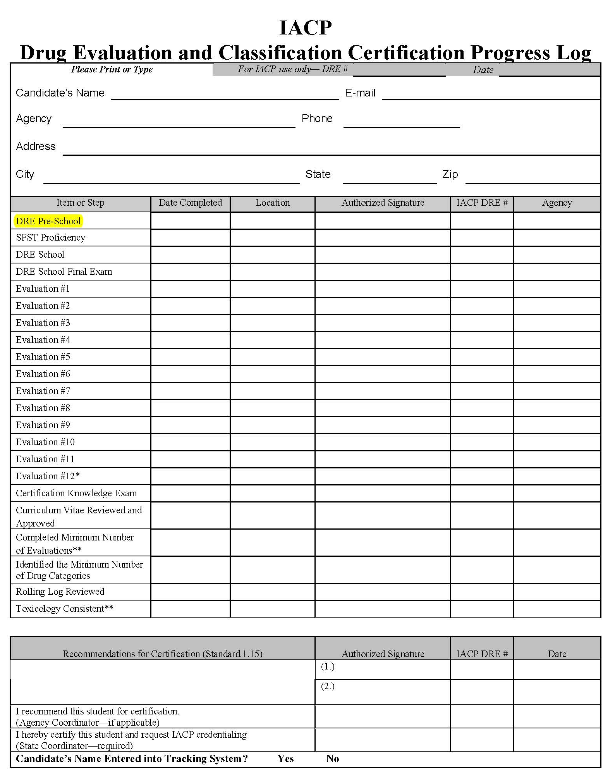
Line #1 – Pre-School
Certification Progress Logs
Notes:
G. Certification Standards
The IACP International Standards guide you in determining whether you can and should “sign off” on each line of the log.
Line #1: Pre-School: Sign this line only if you are satisfied the candidate has achieved the learning objectives of the Pre-School. Achievements would include:
Defining the term “drug” as it is used in the DEC Program
Identifying the 12 steps in the drug influence evaluation
Demonstrating proficiency in the administration of the psychophysical tests
Conducting the eye examinations that are part of the drug influence evaluation
Measuring vital signs
Listing the signs, symptoms, and indicators of impairment for each of the seven drug categories
Describing the history and physiology of alcohol as a drug
If you are not satisfied the candidate has met all of the objectives, do not sign the first line of his or her Progress Log
Emphasize: It is entirely the instructor’s responsibility to verify the candidate has in fact met the objectives listed above.
Usually a candidate qualifies for your signature on line one by attending and performing successfully during all sessions of the Pre-School
However, the IACP International Standards allow for the possibility of a candidate achieving the Pre-School learning objectives through some other approved means

Slide 34
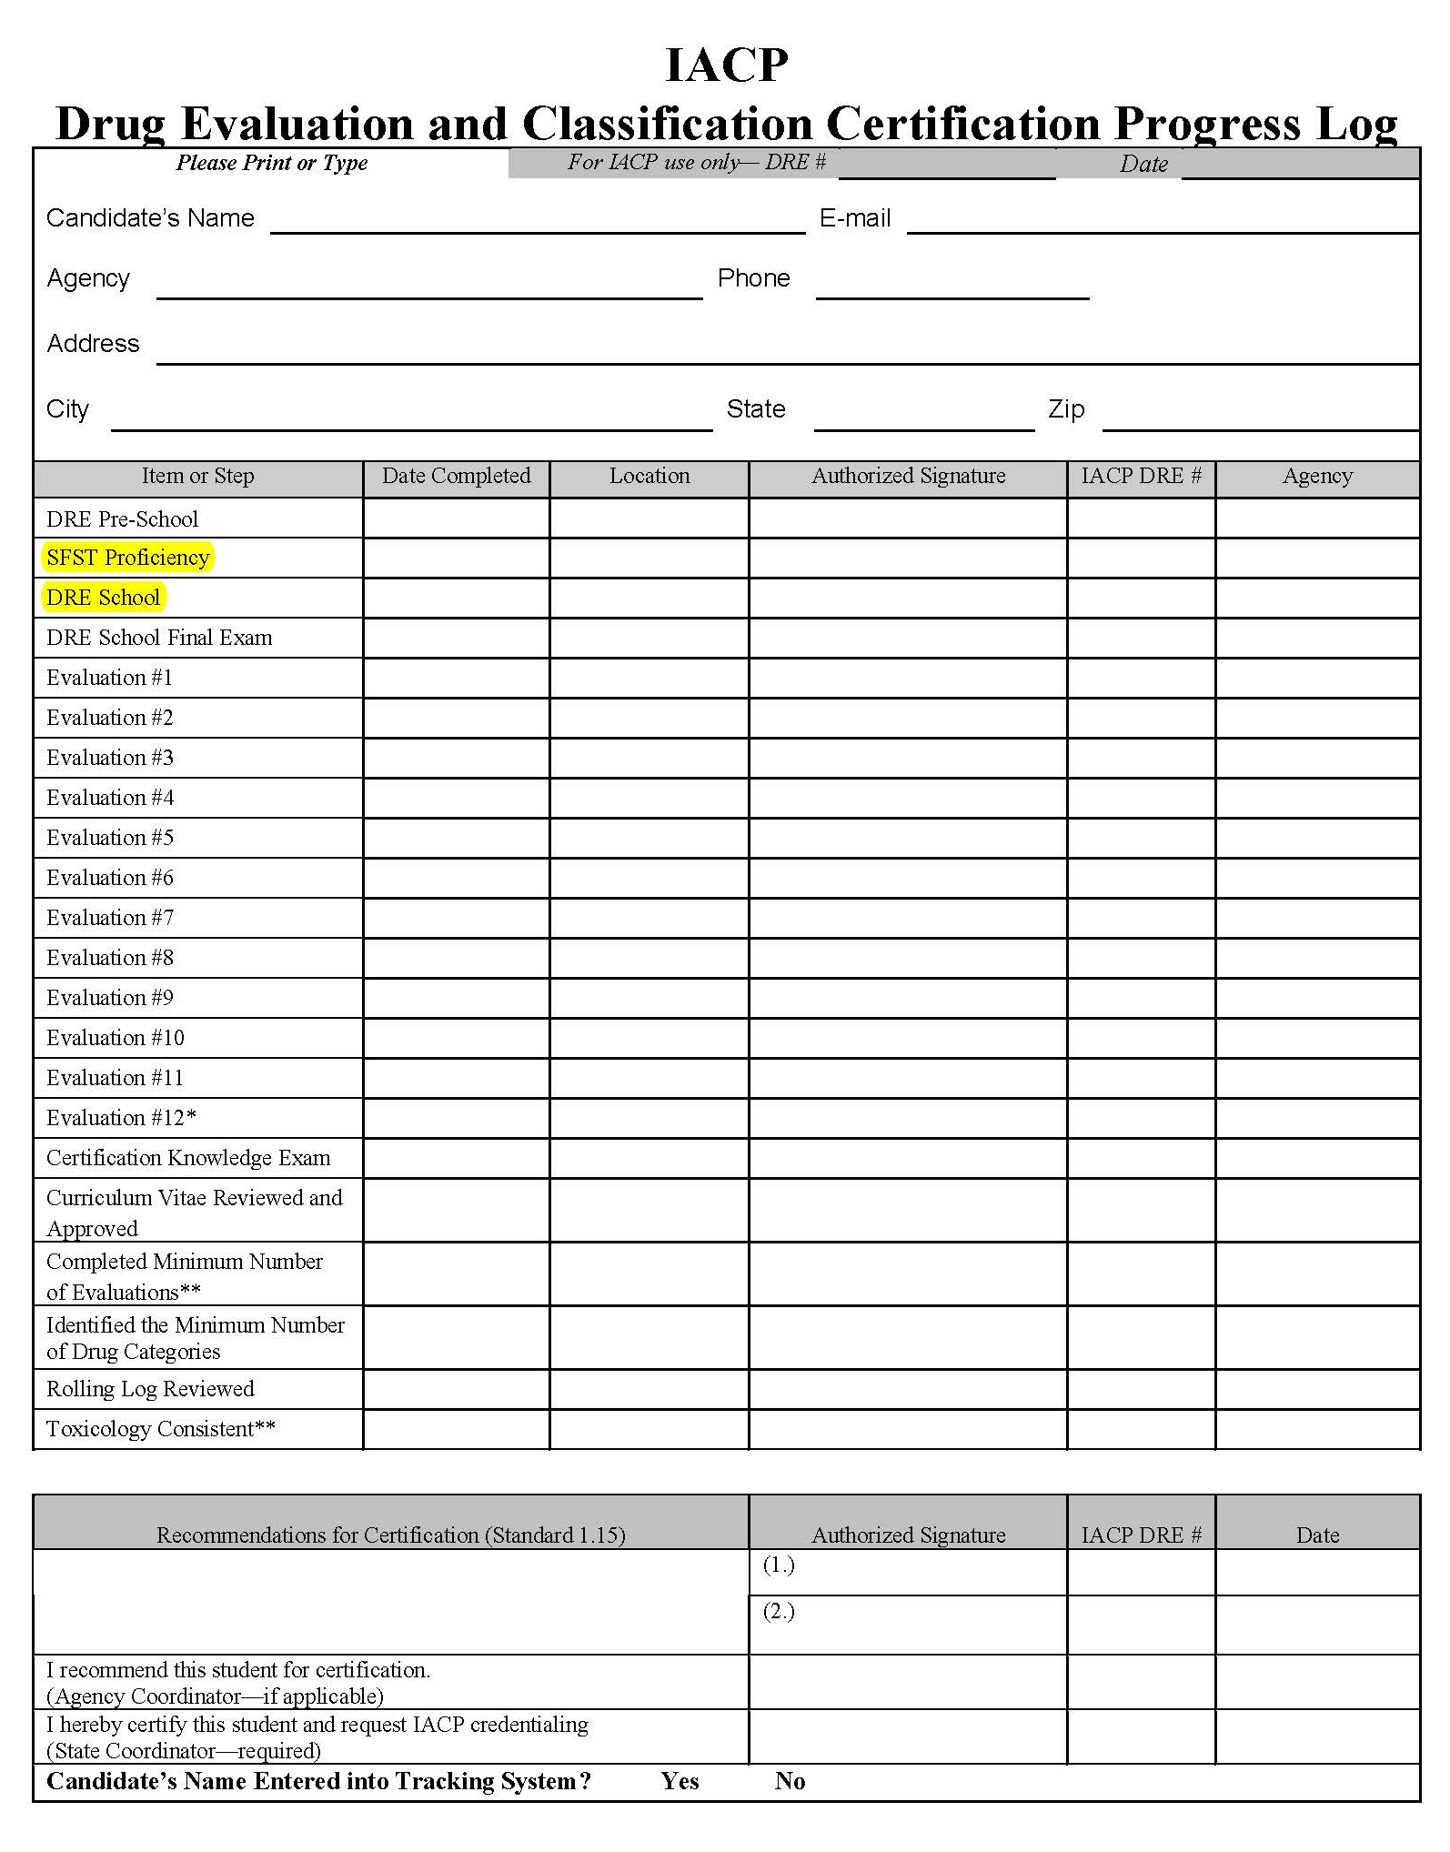
Line #2 – SFST Proficiency
Line #3 – DRE School
Certification Progress Logs
Notes:
G. Certification Standards
Line #2 SFST Proficiency
Emphasize: Under the IACP International Standards for the DEC Program, all DRE candidates must attend and complete the NHTSA/IACP-approved course of instruction in SFSTs or an equivalent curriculum approved by the IACP. No one can progress to DRE School as a candidate unless an instructor has signed off on the second line of his or her Certification Progress Log.
No candidate is permitted to progress to the 7-Day DRE School until he or she has demonstrated proficiency in administering and interpreting the:
Horizontal Gaze Nystagmus Test
Walk and Turn Test
One Leg Stand Test
You must explicitly test the candidate to verify proficiency by having the candidate demonstrate exactly how he or she administers each of these three tests
The candidate must also be able to articulate the validated clues of impairment
Sign the second line only if you are confident the candidate is in fact proficient with the SFSTs
Line #3 DRE School
You will sign the third line only if the candidate has attended all sessions of the 7-Day DRE School or all sessions of some other school that has been explicitly recognized by IACP as equivalent to the DRE School
If a candidate has been enrolled in a school but for whatever reason missed a portion of it, you cannot sign the third line until the candidate makes up the missed portions Example: Court appearance, etc.
Note: The missed portion can be made up through remedial classes conducted after normal hours of the school. Note: Your signature on the third line does not signify the candidate has passed the DRE School, but simply attests he or she has attended the entire school.

Slide 35
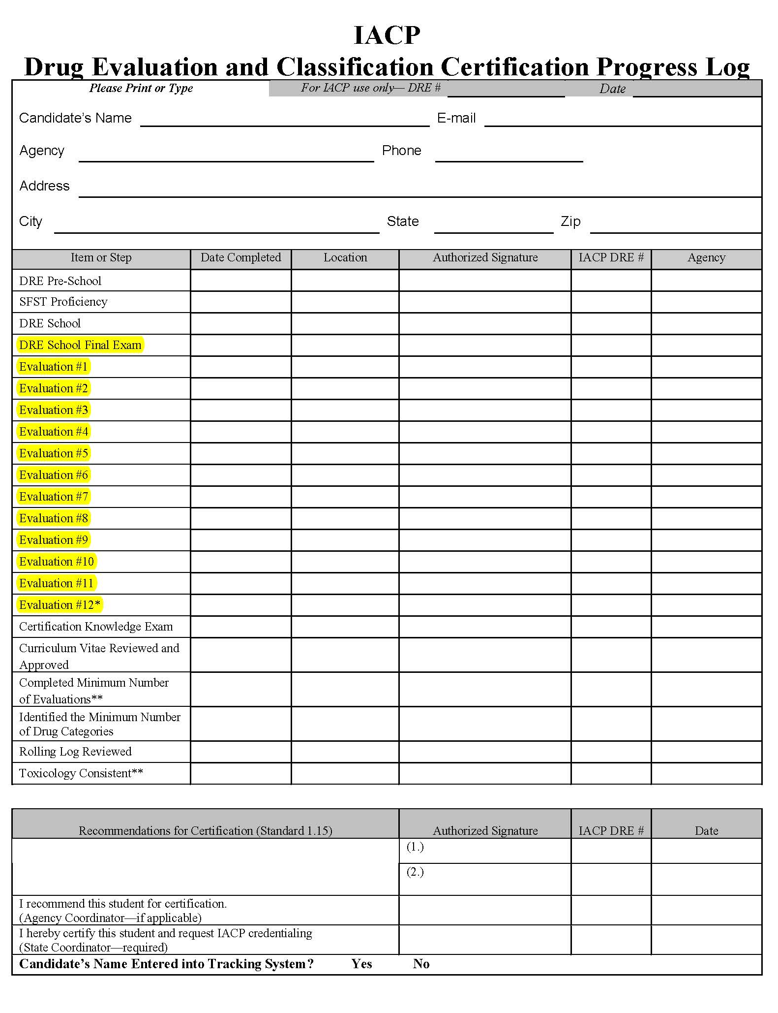
Line #4 – Final Exam
Lines #5-12 – Evaluations
Certification Progress Logs
Notes:
Line #4: Final Exam
Your signature on the fourth line verifies the candidate has passed the DRE School final exam
If the candidate attempts the exam and fails, the IACP International Standards allow the candidate one more try
Point out to pass the candidate must take the IACP-approved 100-question final examination and achieve a grade of 80% or better.
The second attempt must also involve an IACP-approved 100-question exam. (Form B)
The exam cannot be taken any sooner than two weeks following the first attempt and it must be taken within four weeks of the completion of the DRE School
If the candidate fails the second attempt, he or she will have to repeat the entire 7-day DRE School or drop out of the program
Lines #5 - 12 Evaluations
You will sign each line:
every time a candidate participates in conducting an evaluation you personally have observed in its entirety, and
have approved the narrative
You will document the candidate’s performance on the Field Certification Instructor Observation Form for every evaluation you supervise and observe
Note: A Field Certification Instructor Observation Form is to be used with each evaluation. A form is provided in Session 30 of the 7-Day School.
Additional spaces for as many as 20 evaluations are provided on the back of the Progress Log Form.

Slide 36
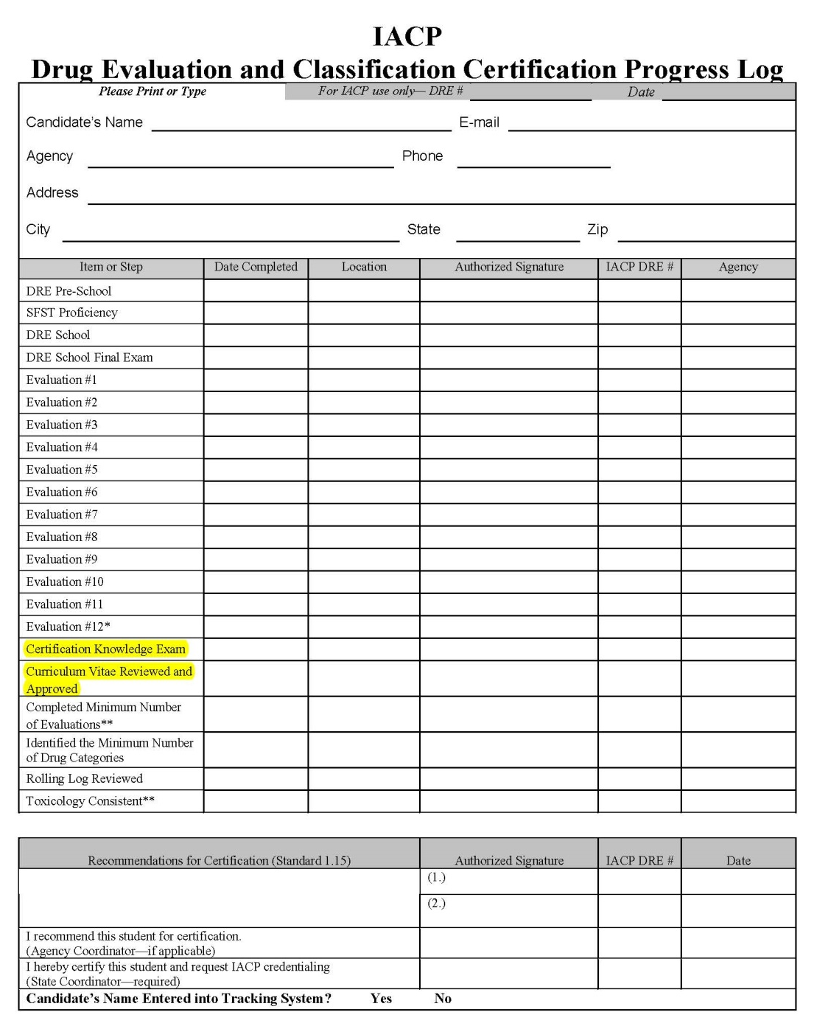
Lines #17-18 – CKE
Line #19 – Curriculum Vitae
Certification Progress Logs
Notes:
The same instructor should not sign off on 12 evaluations. (A minimum of two DRE Instructors shall observe certification evaluations in order to recommend a candidate for DRE certification.) The International Standards for the DEC Program establish this criteria. Note: Some agencies require the candidate to conduct more than 12 evaluations before being certified as a DRE.
To receive credit for a certification evaluation, the evaluation must be observed in its entirety by you, the instructor. You cannot sign for a partially observed evaluation. Signing off on an evaluation means you observed it from start to finish, reviewed the evaluation with the candidate, completed an observation form, concurred with the candidate’s opinion, and reviewed the candidate’s report.
Line #17-18: Certification Knowledge Exam
The criteria for determining whether a candidate has passed the Certification Knowledge Examination was detailed earlier in this training
Sign this line only when the candidate has satisfactorily completed the exam demonstrating a comprehensive understanding of the DRE process, procedures, and material. The exam must be administered and reviewed by two instructors (refer to International Standard 1.12)
Line #19: Curriculum Vitae
Reviewed and Approved
You will sign this line only after you have personally reviewed the candidate’s written Curriculum Vitae (C.V.)
Verify it contains information that actually describes his or her education, training, and experience of relevance to the DEC Program
___________________________________________________________________________________
___________________________________________________________________________________

Slide 37
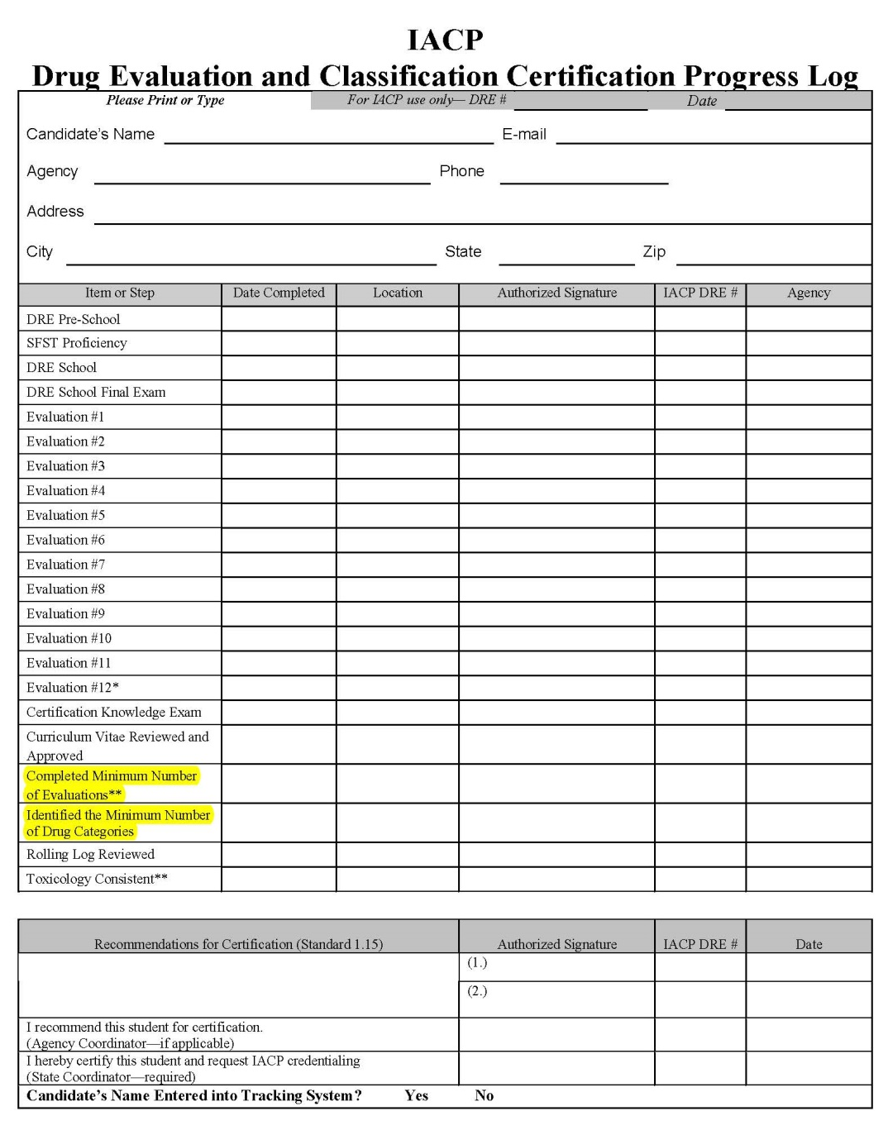
Line #20 – Completed Minimum Number of Evaluations
Line #21 – Identify Minimum Drug Categories
Certification Progress Logs
Notes:
Line #20: Completed Minimum Number of Evaluations
No candidate can be considered for certification until he or she has participated in at least 12 evaluations of persons suspected of drug impairment
However, an alcohol and/or medical impairment evaluation can count toward the 12 evaluations for Line #19.
No candidate can be considered for certification until he or she has participated in at least 12 evaluations of persons suspected of drug impairment
The candidate must have served as the evaluator in at least six evaluations
You must not sign line #19 unless both of those conditions have been met
Some agencies participating in the DEC Program have adopted standards more stringent than IACP’s
NOTE: If the State has adopted more stringent standards, do not sign Line #19 until they have been met.
When you sign Line #19, you are only attesting the candidate has participated in the minimum number of evaluations required for certification
Line #21: Identify Minimum Drug Categories
A candidate cannot be considered for certification until he or she has identified the effects of at least three different drug categories
Alcohol does not count as one of the categories, and cannot be considered toward a signature on Line #20
The candidate actually has to identify the category, not the drug
A subject’s refusal to submit to the chemical test does not count towards this requirement. (Refer to International Standard 1.11)

Slide 38
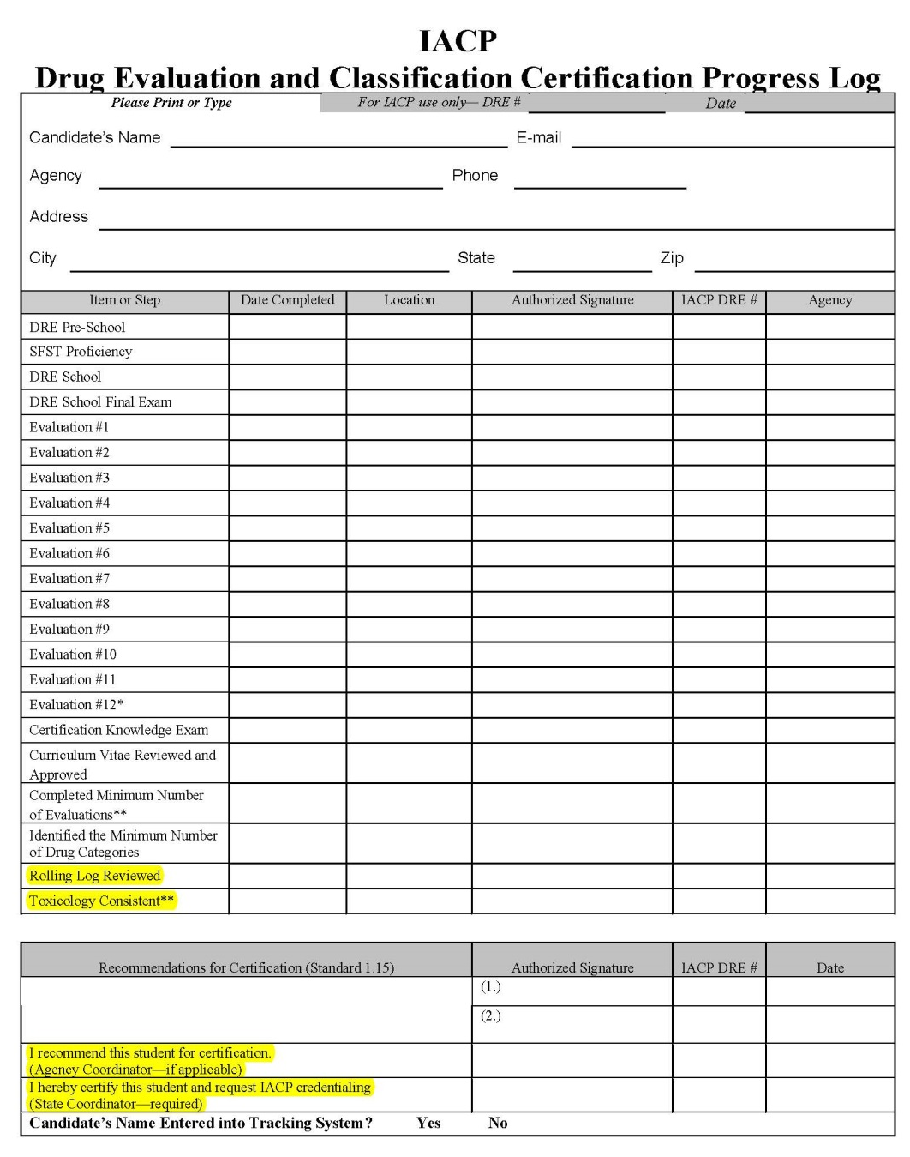
Line #22 – Rolling Log Review
Line #23 – Toxicology Consistent
Recommendations for Certification Signatures
Final Certification Signatures
Certification Progress Logs
Notes:
Line #22 Rolling Log Review
Review the Rolling Log of each candidate you supervise at every certification session
You should conduct a critical review of the Rolling Log when the candidate is very close to qualifying for certification. Verify the Log is up to date and complete, then sign Line #26
Line #23: Toxicology Consistent
Toxicological analysis must confirm the candidate’s opinion
No candidate can be considered to have achieved “consistent toxicology” with less than 75% confirmation. The following rules apply:
The candidate must submit appropriate biological samples supported by forensic testing for at least nine of the subjects he or she has examined (International Standard 1.11)
A “confirmation” means the testing procedure found evidence the subject used a drug belonging to at least one of the identified categories
If the candidate concludes three drug categories are involved, the toxicology will be considered consistent only if two categories are confirmed
Recommendations for Certification Signatures
When the candidate DRE has satisfactorily completed all requirements of the classroom and field certification portions of training, at least two certified DRE instructors who have observed the candidate during the field certification process will verify the candidate meets all requirements for certification as a DRE. (Refer to International Standard 1.15)
Final Certification Signatures
Following completion of the certification requirements, copies of all relevant documents required— including test results, evaluation logs, and drug evaluation reports—shall be forwarded to the agency coordinator (if applicable) who shall forward all documents to the DRE State Coordinator. The DRE State Coordinator will then sign off on the Certification Log and forward a copy to the IACP who will then credential and register each applicant as a certified DRE. (Refer to International Standard 1.16)

Slide 39

DRE Certification Standards
Line #1: Pre-School
Line #2: SFST Proficiency
Line #3: DRE School
Line #4: DRE School Final Exam
Lines #5-#16: Evaluations
Lines #17-#18: Certification Knowledge Exam
Line #19: Curriculum Vitae
Line #20: Minimum Number of Evaluations
Line #21: Identify Minimum Drug Categories
Line #22: Rolling Log
Line #23: Toxicology
Notes:
Review of the DRE Certification Standards
Line #1: Pre-School
Line #2: SFST Proficiency
Line #3: DRE School
Line #4: DRE School Final Exam
Lines #5-16: Evaluations
Line #17-18: Certification Knowledge Exam (two instructor signatures)
Line #19: Curriculum Vitae Reviewed and Approved
Line #20: Completed Minimum Number of Evaluations
Line #21: Identify Minimum Drug Categories
Line #22: Rolling Log Reviewed
Line #23: Toxicology Consistent
DRE National Tracking System
Either during the certification process or immediately after certification, the DRE shall be entered into the DRE National Tracking System and/or a local State database. The DRE National Tracking System is a database that records all evaluations completed by certified DREs. The DRE National Tracking System can be accessed at https://dredata.nhtsa.gov
___________________________________________________________________________________
___________________________________________________________________________________
___________________________________________________________________________________
___________________________________________________________________________________

Slide 40
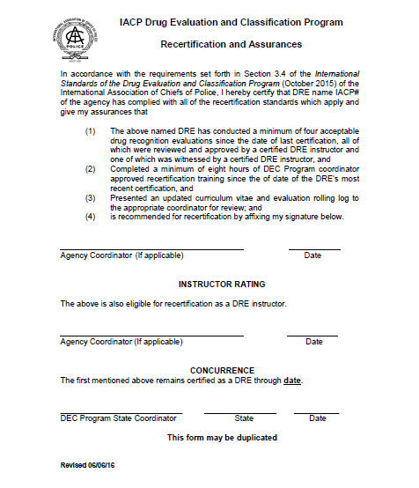
Recertification Guidelines
Notes:
Review of the DRE Recertification Standards
One of the important roles of a DRE instructor is to ensure DREs complete recertification requirements as set forth in the International Standards for the DEC Program or your local State standards.
Local State DRE standards cannot be less stringent than the International Standards for the DEC Program.
DREs are certified by the State for two years and must complete the following requirements to recertify:
Perform four acceptable evaluations since the date of last certification, all of which shall be reviewed and approved by a certified DRE instructor and one of which shall be witnessed by a certified DRE instructor. These evaluations may be performed on subjects suspected of drug and/or alcohol impairment or during classroom simulations; and
Complete a minimum of eight hours of DEC Program state coordinator-approved recertification training since the date of the DRE’s most recent certification, which may alternatively be presented in two sessions of no less than four hours each and which shall be consistent with any IACP standards for such training; and
Present an updated curriculum vitae and evaluation Rolling Log to the appropriate coordinator (or his designee) for review.
___________________________________________________________________________________
___________________________________________________________________________________
___________________________________________________________________________________

Slide 41

Questions and/or Concerns
Notes:
H. QuestionS AND/OR CONCERNS
Solicit questions and comments from participants regarding the certification process. Point out the IACP International Standards for the DEC Program are in the Appendices in the Administrator Guide.
They are also available online at the IACP DRE section website: www.iacp.org/drug-recognition-expert-section
___________________________________________________________________________________
___________________________________________________________________________________
___________________________________________________________________________________
___________________________________________________________________________________
___________________________________________________________________________________
___________________________________________________________________________________
___________________________________________________________________________________
___________________________________________________________________________________
___________________________________________________________________________________
___________________________________________________________________________________

