Slide 1



Drug Recognition Expert
Condensed Instructor
Development
Course
Additional Activity – Participant Presentations and Feedback
February 2017

Slide 2
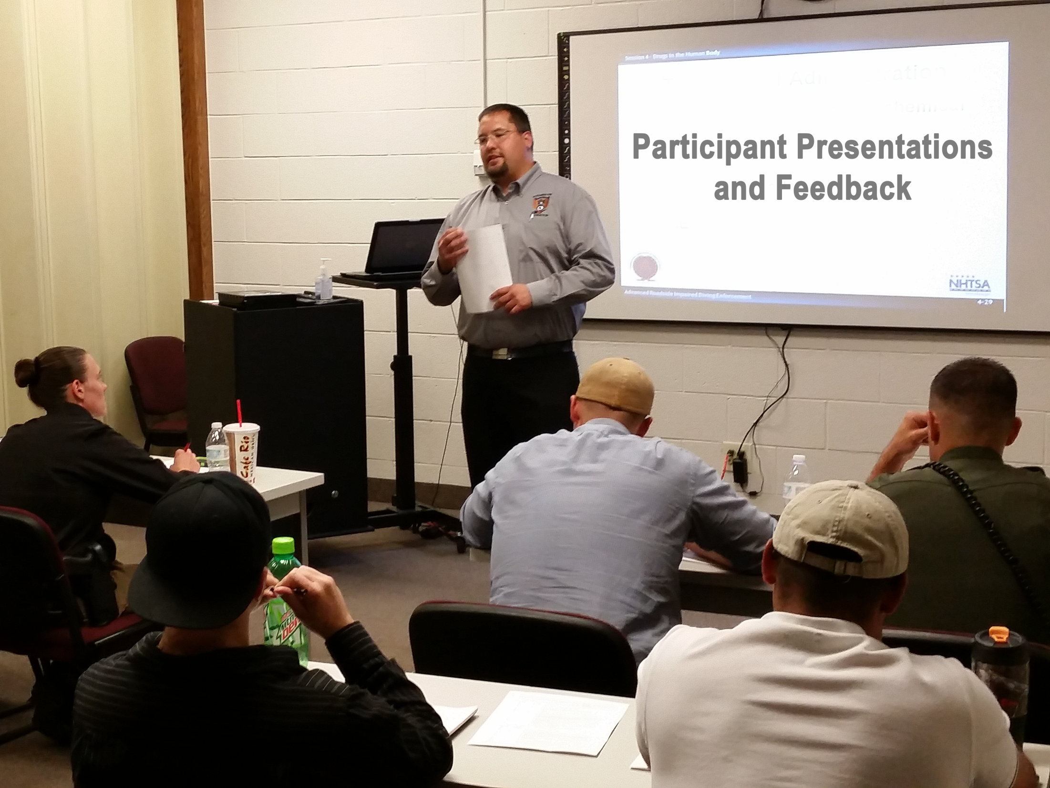
Participant Presentations and Feedback
Notes:
Additional Activity – Participant Presentations and Feedback
Estimated time for Additional Activity: 6 Hours (depending on class size)
Session Objectives
Demonstrate familiarity with the DRE Instructor Guide
Demonstrate command of the DRE Training Material
Demonstrate ability to effectively team teach the DRE Curriculum
Demonstrate effective teaching strategies and techniques
Materials
Projector and screen
Easel/Easel Pads
Markers
DRE Equipment
Instructional Notes are presented in bold italic throughout the sessions.

Slide 3

Objectives
DRE Instructor Guide
DRE Training Material
Team teaching
Teaching strategies and techniques
Notes:
Session Objectives
At the conclusion, participants should be able to:
Demonstrate familiarity with the DRE Instructor Guide
Demonstrate command of the DRE Training Material
Demonstrate ability to effectively team teach the DRE Curriculum
Demonstrate effective teaching strategies and techniques
__________________________________________________________________________
__________________________________________________________________________
__________________________________________________________________________
__________________________________________________________________________
__________________________________________________________________________
__________________________________________________________________________
__________________________________________________________________________
__________________________________________________________________________
__________________________________________________________________________

