Slide 1



Drug Recognition Expert
Instructor
Development
Course
Session 11 – Course Review, Examination, Evaluation, and Wrap-Up
February, 2017

Slide 2

Content Segments
Review
Final Exam
Closing Remarks
Course Completion Certificates
Course Evaluation
Questions
Notes:
Session 11: Course Review, Examination, Evaluation, and Wrap-Up
Estimated time for Session 11: 2 Hours, 30 Minutes (depending on class size)
Contents
Review
Final Exam
Closing Remarks
Course Completion Certificates
Course Evaluation
Questions
Materials
Presentation slides
DRE Pre-School and 7-Day School Administrator Guide
Post test
Instructional Notes are presented in bold italic throughout the sessions.

Slide 3

Drug Recognition Expert
Instructor Development Course
Session 11:
Course Review, Examination, Evaluation, and Wrap-Up
Notes:
Session 11: Course Review, Examination, Evaluation, and Wrap up
Estimated time for Session 11: 2 Hours, 30 Minutes
Review: 1 Hour, 30 Minutes
Examination: 30 Minutes
Evaluation and Wrap-Up: 30 Minutes
Materials:
Presentation slides
DRE Pre-School and 7-Day School Administrator Guide
Post test
__________________________________________________________________________
__________________________________________________________________________
__________________________________________________________________________
__________________________________________________________________________
__________________________________________________________________________
__________________________________________________________________________
__________________________________________________________________________

Slide 4

Notes:
A. Review
What is learning?
At its core, the learning process is about change. Learning is a natural process through which lasting physical changes are made to the human brain and nervous system resulting in new knowledge, skills, and attitudes.
__________________________________________________________________________
__________________________________________________________________________
__________________________________________________________________________
__________________________________________________________________________
__________________________________________________________________________
__________________________________________________________________________
__________________________________________________________________________
__________________________________________________________________________
__________________________________________________________________________
__________________________________________________________________________

Slide 5
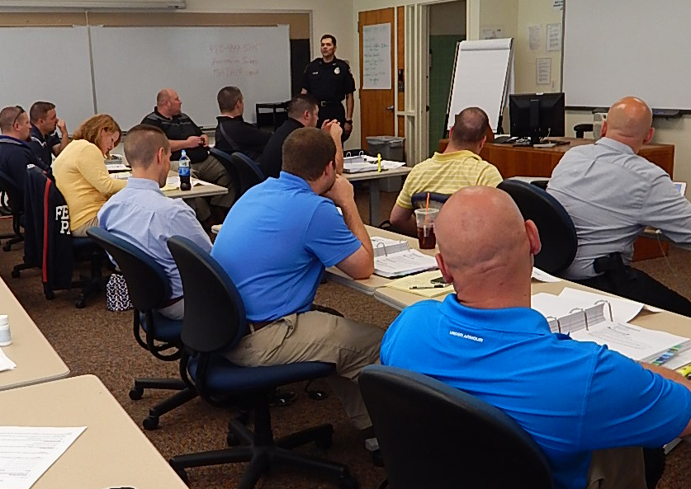
What is Instruction?
Notes:
What is instruction?
Definition: A conversational process engaged in by mutual consent by two or more agents for the purpose of promoting learning by one or both of the agents. (Gibbons, 2014)
__________________________________________________________________________
__________________________________________________________________________
__________________________________________________________________________
__________________________________________________________________________
__________________________________________________________________________
__________________________________________________________________________
__________________________________________________________________________
__________________________________________________________________________
__________________________________________________________________________
__________________________________________________________________________
__________________________________________________________________________

Slide 6

Cycle of Instruction
?
?
TASK / PROBLEM CENTERED
?
?
Notes:
Describe the Cycle of Instruction.
Problem-Centered Principle: Learning is promoted when learners acquire skill in the context of real-world problems
Activation Principle: Learning is promoted when learners recall existing knowledge and skill as a foundation for new skills
Demonstration Principle: Learning is promoted when learners are shown the skill to be learned
Application: Learning is promoted when learners use their newly-acquired skill to solve problems
Integration: Learning is promoted when learners reflect on, discuss, and defend their newly acquired skill
__________________________________________________________________________
__________________________________________________________________________
__________________________________________________________________________
__________________________________________________________________________
__________________________________________________________________________
__________________________________________________________________________
__________________________________________________________________________

Slide 7

Primacy
Notes:
Describe Primacy.
We recall what we hear first and last, but the middle is more readily forgotten.
Open and close each presentation with attention grabbers and your most important points.
Ask: how do you plan on applying Primacy in your presentations?
_________________________________________________________________________________
_________________________________________________________________________________
_________________________________________________________________________________
_________________________________________________________________________________
_________________________________________________________________________________
_________________________________________________________________________________
_________________________________________________________________________________
_________________________________________________________________________________
_________________________________________________________________________________
_________________________________________________________________________________

Slide 8

Team Teaching
Notes:
Describe the advantages and disadvantages of Team Teaching.
Advantages
The second instructor can serve as a secondary resource of subject matter knowledge
Two instructors can better assess participant reaction to course material
Shared workload
Disadvantages
Varying levels of authority or management within the organization
Varying levels of subject matter knowledge or training delivery experience
Individual differences in personality or training delivery
__________________________________________________________________________
__________________________________________________________________________
__________________________________________________________________________
__________________________________________________________________________
__________________________________________________________________________
__________________________________________________________________________
__________________________________________________________________________

Slide 9

Administrator Guide
Notes:
What is the purpose of the Administrator Guide?
Describe the contents of the DRE Pre-School and 7-Day School Administrator Guide.
Note: Have a copy of the complete DRE Pre-School and 7-Day School Administrator Guide available for discussion.
The Administrator Guide is intended to provide an introduction to and an overview of the course.
__________________________________________________________________________
__________________________________________________________________________
__________________________________________________________________________
__________________________________________________________________________
__________________________________________________________________________
__________________________________________________________________________
__________________________________________________________________________
__________________________________________________________________________

Slide 10

Lesson Plan
Notes:
What are the purposes of the Lesson Plan?
Help you get ready to teach
To help you stay on track while you are teaching the lesson
Ensure consistency of training
__________________________________________________________________________
__________________________________________________________________________
__________________________________________________________________________
__________________________________________________________________________
__________________________________________________________________________
__________________________________________________________________________
__________________________________________________________________________
__________________________________________________________________________
__________________________________________________________________________
__________________________________________________________________________

Slide 11

Qualities of a Good Instructor
Notes:
What are the qualities of a good instructor?
Basic qualities are required for a good DWI instructor:
The instructor must be able to present the tasks being taught
Instructor must be able to coach participants to perform the task correctly
The instructor must be able to evaluate the participants performing the tasks
__________________________________________________________________________
__________________________________________________________________________
__________________________________________________________________________
__________________________________________________________________________
__________________________________________________________________________
__________________________________________________________________________
__________________________________________________________________________
__________________________________________________________________________
__________________________________________________________________________
__________________________________________________________________________

Slide 12

What is Feedback?
Notes:
What is feedback?
Feedback can be defined as any shared information that helps instructors and learners:
Understand how well they are performing their assigned roles or tasks in the conversation
Know what is needed to make progress towards the goal(s) of the conversation
Why is feedback important?
In general, feedback is important to:
Prompt the exchange of information
Generate or revise the shared purpose of the conversation
Facilitate engagement between people
Help people listen, think, and respond to one another until the shared purpose is achieved
__________________________________________________________________________
__________________________________________________________________________
__________________________________________________________________________
__________________________________________________________________________
__________________________________________________________________________

Slide 13

Questioning Methods
Notes:
What are the three types of questions?
Ask the participants for examples of each.
Describe and review the questioning methods
Overhead/undirected
Pre-directed
Overhead/directed
__________________________________________________________________________
__________________________________________________________________________
__________________________________________________________________________
__________________________________________________________________________
__________________________________________________________________________
__________________________________________________________________________
__________________________________________________________________________
__________________________________________________________________________
__________________________________________________________________________

Slide 14

Participants’ Answers
Notes:
What should an instructor do when a participant gives a correct answer?
Review the following with the participants:
Commend participant
React with positive reinforcement
Don’t give bland acknowledgement
Don’t fail to give any reaction at all
What should an instructor do when a participant gives an incorrect answer?
Review the following with the participants:
Convey answer is incorrect
Do not react with frustration or anger
Do not embarrass the participant
Acknowledge partially correct answers
What should an instructor do if participants do not offer an answer?
Review the following with the participants:
Provide the answer yourself
Redirect the question to another learner
Defer the question
__________________________________________________________________________
__________________________________________________________________________

Slide 15

Problem Situations
Notes:
What are some key considerations for problem situations?
The key considerations to responding to problem situations created by participants are:
Eliminate or minimize the problem behavior
Maintain the participant’s self-esteem
Avoid further disruption to learning
Emphasize: Instructors should avoid harming a participant’s self-esteem; however, on rare occasions it may be more important to avoid further disruption to learning.
__________________________________________________________________________
__________________________________________________________________________
__________________________________________________________________________
__________________________________________________________________________
__________________________________________________________________________
__________________________________________________________________________
__________________________________________________________________________
__________________________________________________________________________
__________________________________________________________________________

Slide 16

Purposes of Training Aids
Notes:
Describe the purposes of training aids?
Training aids are essential for effective instruction.
Training aids may appeal to multiple senses, including: sight, hearing, smell, taste, and touch
Training aids serve to emphasize key points and help to reinforce participants’ understanding and retention of the material covered
__________________________________________________________________________
__________________________________________________________________________
__________________________________________________________________________
__________________________________________________________________________
__________________________________________________________________________
__________________________________________________________________________
__________________________________________________________________________
__________________________________________________________________________
__________________________________________________________________________
__________________________________________________________________________

Slide 17
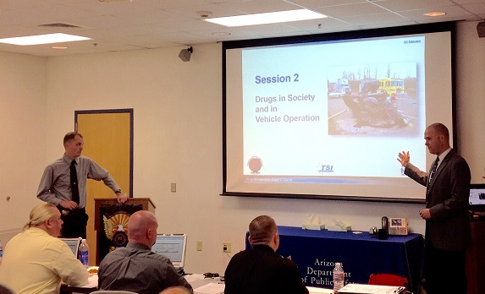
Commonly Used Training Aids
Notes:
What are commonly used training aids?
Prepared wall charts
Are very useful for summarizing basic or fundamental information that applies broadly to the entire course of instruction or major segments of it
Can be prepared in advance
Are typically left on display for an extended period of time
Should be large enough to be easily seen by all participants
Usually should not occupy the center of visual attention in the classroom; the center should be reserved for the screen and easel/easel pad
Audio/video
Always preview audio/video before showing them to participants
Ensure compatibility of audio/video playback equipment with media format
Ensure the format can be seen and heard by all participants in all parts of the room
All instructors must be conscious of how the audio or video may affect participants. If the content is potentially disturbing, instructors may want to provide an advisory warning regarding the content. Give participants the option to leave the room during the playing of the audio or video
Always discuss the presentations: do not simply show them and move on
Make sure the audio/video is relevant to the instruction/topic. As a reminder, any outside videos/DVDs not provided as part of the NHTSA/IACP-approved curriculum must be pre-approved by the course manager or training coordinator
Other commonly used training aids:
Whiteboard or easel/easel pad
Presentation slides
Handouts
Props

Slide 18

Alcohol Workshops
Notes:
Describe some of the considerations for planning an alcohol workshop.
Advanced planning should begin prior to the alcohol workshop.
Select the volunteer drinkers
Prepare the volunteers
Secure the supplies
Select and assign monitors for the volunteers
Select and assign bartenders
Select and arrange facilities for the volunteer drinkers
Arrange transportation for the volunteer drinkers
Arrange for breath testing
What are the quantity and qualifications for volunteer drinkers?
It is suggested there be one volunteer drinker for every three to five participants. They must be at least 21 years old and should be physically capable of performing the SFSTs. It is preferred police officers not be used as volunteer drinkers and is strongly recommended drinkers be alcohol and drug free.
__________________________________________________________________________
__________________________________________________________________________
__________________________________________________________________________
__________________________________________________________________________

Slide 19
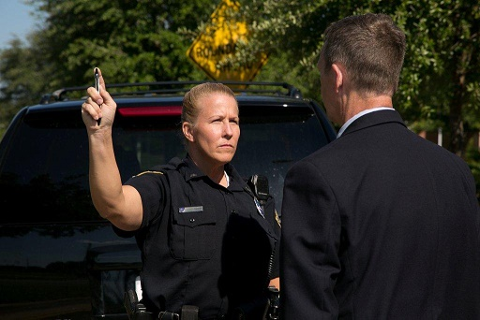
Eye Examinations
Notes:
Eye Examinations: Horizontal Gaze Nystagmus
What are the three validated clues of impairment established for HGN?
Lack of Smooth Pursuit
Distinct and Sustained Nystagmus at Maximum Deviation
Angle of Onset of Nystagmus
What formula expresses the approximate statistical relationship between BAC and the angle of onset of nystagmus? BAC = 50 – Angle of Onset
What categories of drugs usually will cause HGN?
CNS Depressants
Dissociative Anesthetics
Inhalants
What categories of drugs usually will cause LOC?
CNS Depressants
Dissociative Anesthetics
Inhalants
Cannabis
Review of the Darkroom Examinations
What are the three lighting conditions under which we must estimate the size of the suspect’s pupils?
Room Light
Near Total Darkness
Direct Light
How long should we wait in the Darkroom before beginning to check the suspect’s pupils? At least 90 seconds
Name the device we use to estimate the size of the suspect’s pupils. Pupillometer
What do the numbers on the Pupillometer refer to? The diameters of the dark circles/semi-circles
In what units of measurement are those numbers given? In millimeters

Slide 20
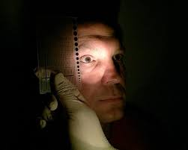
General Review Questions
Notes:
General Review Questions
What is the medical or technical term for “droopy eyelids”? Ptosis
What does “Piloerection” mean? What drug often causes piloerection? “Piloerection” means “Hair Standing Up”, or “Goose Bumps”. It is often caused by LSD
What is the medical or technical term for Heroin? Diacetyl Morphine
Explain the terms “Null”, “Additive”, “Antagonistic” and “Overlapping” Effect as they apply to polydrug use. Give examples
“Null”: neither drug affects some specific indicator
“Additive”: the two drugs produce some identical effects
“Antagonistic”: the two drugs produce some directly opposite effects
“Overlapping”: one drug affects some symptom that the other doesn’t affect, and vice versa
What is “Rebound Dilation”? “Rebound Dilation” is a period of pupillary constriction followed by a period of pupillary dilation where the pupil steadily increases in size and does not return to its original size.
What is pupillary unrest? The continuous change in the size of the pupils that may be observed under room or steady light conditions.
What does “Bruxism” mean? Grinding the teeth
What does the number denoting the size of a hypodermic needle refer to? The inside diameter of the needle
What does “Synesthesia” mean? A mixing of senses, i.e., hearing colors or seeing sounds
What is “Sinsemilla”? A variety of marijuana with a high concentration of THC

Slide 21
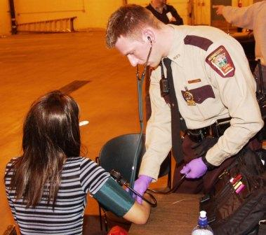
12-Step Process
Notes:
General Review Questions
What are the twelve major components of the DRE drug influence evaluation?
Breath Alcohol Test
Interview of Arresting Officer
Preliminary Examination
Examinations of the Eyes
Divided Attention Tests
Vital Signs Examinations
Dark Room Examinations
Examination for Muscle Tone
Examination for Injection Sites
Suspect’s Statements
Opinion of the Evaluator
Toxicological Exam
Review of Physiology
M is for Muscular System
U is for Urinary System
R is for Respiratory System
D is for Digestive System
E is for Endocrine System
R is for Reproductive System
S is for Skeletal System
I is for Integumentary System
N is for Nervous System
C is for Circulatory System

Slide 22

DRE Curriculum
Notes:
General Review Questions
What is the distinction between the “Smooth” muscles and the ”Striated” muscles? We consciously control the Striated; we don’t consciously control the Smooth
What do we call the chemicals produced by the Endocrine System? Hormones
What is a neuron? A nerve cell
Which two categories of drugs can most appropriately be called sympathomimetic? CNS Stimulants and Hallucinogens
Which category can most appropriately be called parasympathomimetic?
Narcotic Analgesics - Clarification: Cannabis, Dissociative Anesthetics, and Inhalants have some sympathomimetic characteristics, but not as many as do the Stimulants and Hallucinogens. CNS Depressants have parasympathomimetic characteristics, but not as many as the Narcotic Analgesics.
Review of Physiology
What is an artery? Strong, elastic blood vessel that carries blood from the heart to the body’s tissues and organs
What is a vein? Blood vessel that carries blood back to the heart from tissues and organs

Slide 23

Certification Training
Notes:
When can you, as an instructor, sign off on a candidate’s drug influence evaluation?
To receive credit for a certification evaluation, the evaluation must be observed in its entirety by you, the instructor. You cannot sign for a partially observed evaluation. Signing off on an evaluation means you observed it from start to finish, reviewed the evaluation with the candidate, completed an observation form, concurred with the candidate’s opinion, and reviewed the candidate’s report.
Who is authorized to recommend a DRE for certification to the DRE State Coordinator?
Only DRE instructors who have personally observed the candidate performing certification evaluations and have signed the Certification Progress Log.
How many instructors must administer and approve the Certification Knowledge Examination and what is required for approval?
Two instructors are required to approve and sign and only when the candidate has satisfactorily completed the exam, demonstrating a comprehensive understanding of the DRE process, procedures, and materials.
_________________________________________________________________________________
_________________________________________________________________________________
_________________________________________________________________________________
_________________________________________________________________________________
_________________________________________________________________________________

Slide 24
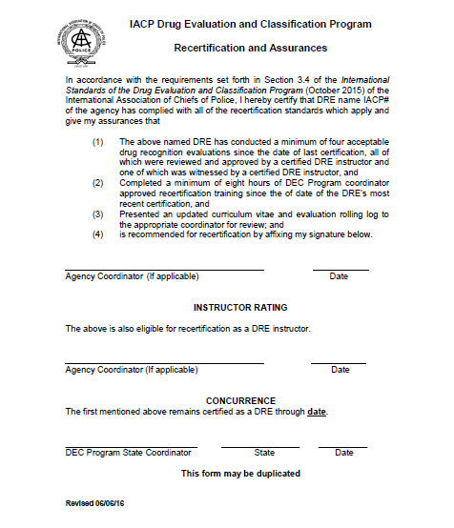
Recertification Guidelines
Notes:
What are the DRE instructor’s two primary roles in assisting another DRE in satisfying their certification requirements?
Review and approve four acceptable evaluations since the date of last certification
Supervise one drug influence evaluation conducted by the recertifying DRE
_________________________________________________________________________________
_________________________________________________________________________________
_________________________________________________________________________________
_________________________________________________________________________________
_________________________________________________________________________________
_________________________________________________________________________________
_________________________________________________________________________________
_________________________________________________________________________________
_________________________________________________________________________________
_________________________________________________________________________________

Slide 25

Final Examination
Notes:
B. Final Exam
Distribute. Allow 30 minutes for completion. Passing grade is 80%.
If time allows, go over and review the final exam with the participants.
__________________________________________________________________________
__________________________________________________________________________
__________________________________________________________________________
__________________________________________________________________________
__________________________________________________________________________
__________________________________________________________________________
__________________________________________________________________________
__________________________________________________________________________
__________________________________________________________________________
__________________________________________________________________________
__________________________________________________________________________

Slide 26
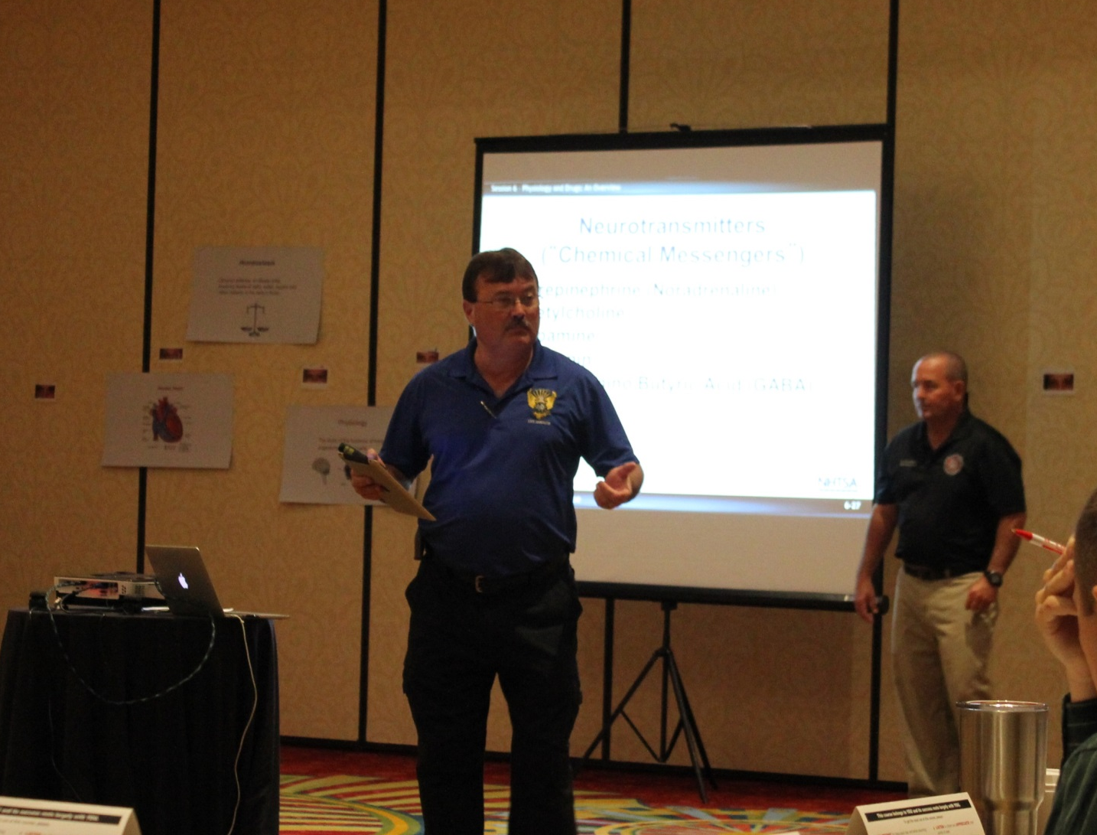
Closing Remarks
Notes:
C. Closing Remarks
D. Course Completion Certificates
Hand out completion certificates (if certificates are used).
__________________________________________________________________________
__________________________________________________________________________
__________________________________________________________________________
__________________________________________________________________________
__________________________________________________________________________
__________________________________________________________________________
__________________________________________________________________________
__________________________________________________________________________
__________________________________________________________________________
__________________________________________________________________________
__________________________________________________________________________

Slide 27
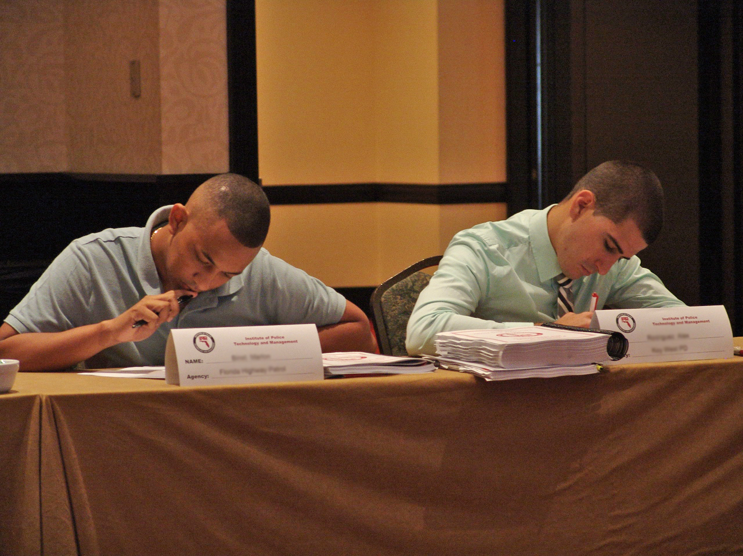
Course Evaluation
Notes:
E. Course Evaluation
Distribute evaluation forms and request the participants be honest in providing their input. If they feel the course can be improved, solicit their recommendations for improvement.
Distribute critique forms and then collect them.
__________________________________________________________________________
__________________________________________________________________________
__________________________________________________________________________
__________________________________________________________________________
__________________________________________________________________________
__________________________________________________________________________
__________________________________________________________________________
__________________________________________________________________________
__________________________________________________________________________
__________________________________________________________________________

Slide 28

Questions and/or Concerns
Notes:
F. QuestionS AND/OR CONCERNS
Allow for participants to ask any final questions.
__________________________________________________________________________
__________________________________________________________________________
__________________________________________________________________________
__________________________________________________________________________
__________________________________________________________________________
__________________________________________________________________________
__________________________________________________________________________
__________________________________________________________________________
__________________________________________________________________________
__________________________________________________________________________
__________________________________________________________________________

