Slide 1



Drug Recognition Expert
Instructor
Development
Course
Session 2 – Starting the Learning Conversation
February, 2017

Slide 2

Content Segments
Starting the Learning Conversation
Introduction to Learning and Instruction
Creating the Learning Environment
Cycle of Instruction
Questions and/or Concerns
Notes:
Session 2: Starting the Learning Conversation
Estimated time for Session 2: 2 Hours (depending on class size)
Session Objectives
Recall from experience your definition of learning and instruction
Construct your new definition of learning and instruction
Create an effective learning environment
Explain and demonstrate the Cycle of Instruction
Contents
A. Starting the Learning Conversation
B. Introduction to Learning and Instruction
C. Creating the Learning Environment
D. Cycle of Instruction
E. Questions and/or Concerns
Materials
Presentation slides
Easel/Easel Pad
Markers
Content delivery cards (for each group)
Copy of Cycle of Instruction Chart (wall size recommended)
Computer speakers (for embedded videos)
Instructional Notes are presented in bold italic throughout the sessions.

Slide 3

Drug Recognition Expert
Instructor Development Course
Session 2:
Starting the Learning Conversation
Notes:
Session 2: Starting a Learning Conversation
Estimated time for Session 2: 2 Hours
Materials:
Presentation slides
Easel/Easel Pad
Markers
Content-delivery cards (for group activity)
Copy of Cycle of Instruction chart (wall size recommended)
Computer speakers (for embedded videos)

Slide 4

Session Objectives
Recall your definition of learning and instruction
Construct new definition of learning and instruction
Create an effective learning environment
Explain and demonstrate Cycle of Instruction
Notes:
Session Objectives
At the conclusion of this session, participants should be able to:
Recall from experience your definition of learning and instruction (Activation)
Construct your new definition of learning and instruction (Application)
Create an effective learning environment (Demonstration and Application)
Explain and demonstrate the Cycle of Instruction (Activation and Demonstration)
________________________________________________________________________________
________________________________________________________________________________
________________________________________________________________________________
________________________________________________________________________________
________________________________________________________________________________
________________________________________________________________________________
________________________________________________________________________________
________________________________________________________________________________
________________________________________________________________________________
________________________________________________________________________________

Slide 5
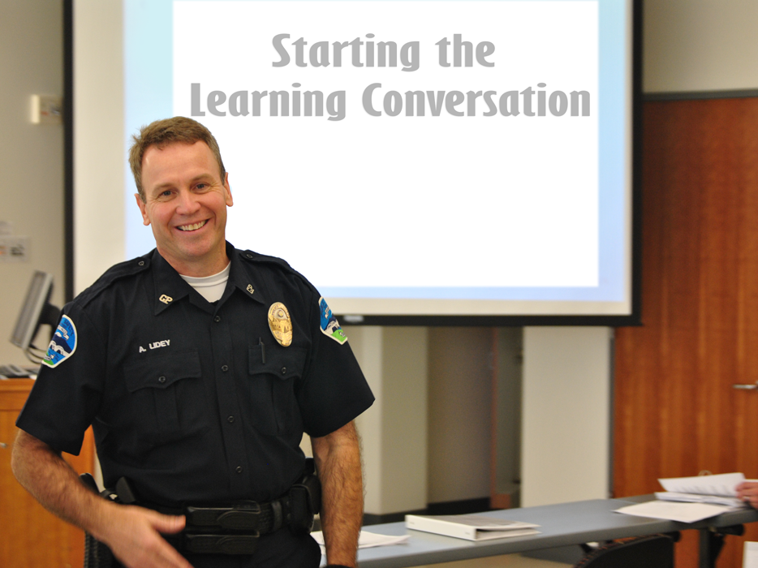
Notes:
A. Starting the Learning Conversation
Complete the steps in this Session to prepare participants and activate their prior learning.
Step 1: Give a brief example of a time when you (the instructor) learned something very important or exciting from an instructor/teacher in the past. You should relate your positive experience with the subject matter, the instructor, and with the learning environment in general. Tell how this high-quality instruction made you feel and the benefits you received from it.
Step 2: Explain in this session, participants will learn key information about the nature of learning and the Cycle of Instruction to help them design and deliver the kind of high-quality instruction they experienced in the example you just shared.
Step 3: Tell the participants they will achieve the following learning objectives by the end of this session:
Recall from experience your definition of learning and instruction
Construct your new definition of learning and instruction
Create an effective learning environment
Explain and demonstrate the Cycle of Instruction
________________________________________________________________________________
________________________________________________________________________________
________________________________________________________________________________
________________________________________________________________________________

Slide 6

Starting the Learning Conversation
Notes:
Step 4: Invite the participants to prepare for the rest of the Session by forming a partnership with one (or two) other people. Explain to the participants they will work with their partners to complete a number of tasks in this Session.
Step 5: Each pair will briefly share an example like the one you just shared. In the next five minutes, they should each take turns sharing their own example by doing the following:
Team Activity
Share a brief example of a time when you learned something important or exciting
Relate how you had a positive experience with the subject matter, the instructor, and with the learning environment in general
Tell how this high-quality instruction made you feel
State some of the benefits received from it
Step 6: After four minutes or so have passed, or when the conversations start to wind down, invite the participants to conclude their examples in the next minute.
Step 7: After they have concluded sharing their examples, invite them to prepare for the next learning activity in this Session by getting out a single sheet of paper and a pen or pencil.
Ask the participants to close their manuals in preparation for the next activity.
________________________________________________________________________________
________________________________________________________________________________
________________________________________________________________________________

Slide 7

Notes:
B. Introduction to Learning and Instruction
Discussion Questions: Ask participants to keep their manuals closed and not refer to them during this activity. They need to do this in order to generate true responses, as opposed to reciting what they see in the manual.
Once manuals are closed, ask participants to reflect on the example they just shared with their partner and think about how they know they really “learned” something from the experience. What kind of evidence or proof could they provide to someone to convince the person “learning” actually occurred?
Invite the participants to take two minutes to write down how they would define the word “learning.” Their definitions should be applicable to the type of “learning” that occurred in the example they shared.
Instruct the participants take two minutes to discuss their respective definitions with their partner. If the definitions are the same, have them discuss some reasons why they think the definition is applicable to both of their experiences. If the definitions are different, see if they can work together to come up with a new definition they both can agree with.
Engage the participants in a group discussion in which the group responds to the question: “What is learning?”
Possible responses:
Facts, ideas, concepts, etc.
Ability to do something
Ability to apply knowledge
Ability to comprehend what is being taught

Slide 8

Learning
The activity or process of gaining knowledge or skill by studying, practicing, being taught, or experiencing something: the activity of someone who learns.
Notes:
Did their conversation change their mind about what learning is? Document responses.
After the discussion, have the participants rewrite their definition of “learning.”
Explain you will now talk about one possible definition of learning, which is not the only correct definition, but one they may find very useful.
Definition of “Learning.” Read the definition of learning and display the definition slide.
What is learning?
Definition: The activity or process of gaining knowledge or skill by studying, practicing, being taught, or experiencing something: the activity of someone who learns.
At its core, the learning process is about Change .
Learning is a natural process through which lasting physical changes are made to the human brain and nervous system resulting in new knowledge, skills, and attitudes.
State “At its core, the learning process is about change. Learning is a natural process through which lasting physical changes are made to the human brain and nervous system resulting in new knowledge, skills, and attitudes.”
Explain together we will build upon this definition of “learning” to see if we can generate a definition of the word “instruction.”
________________________________________________________________________________
________________________________________________________________________________

Slide 9

Notes:
Domains of Learning
The three DOMAINS OF LEARNING are:
Cognitive Domain
Psychomotor Domain
Affective Domain
Every job requires learning in all three Domains and involves:
Knowledge
Skills
Attitude
________________________________________________________________________________
________________________________________________________________________________
________________________________________________________________________________
________________________________________________________________________________
________________________________________________________________________________
________________________________________________________________________________
________________________________________________________________________________

Slide 10

Notes:
Ask the participants what knowledge is required in order to hammer a nail into a piece of wood.
Every job, no matter how basic, requires the person who performs the job have some basic knowledge that can be used. If you don’t possess that knowledge, you won’t perform the job very well.
You won’t do a very good job of driving the nail into the wood if you can’t perform the simple skill of swinging the hammer so it hits the nail squarely.
Every job, no matter how simple, requires the job performer be able to carry out some type of skills. If you don’t have some skills, you won’t perform the job well.
If you don’t care whether the nail goes into the wood straight, you will probably do a poor job of driving the nail.
Every job requires the person doing it has some particular attitudes. If you don’t have those attitudes, you simply won’t do a job very well.
For every job you can perform well, somewhere along the way you learned the knowledge the job requires, and you learned the skills it requires, and you learned the attitudes it requires.
DRE’s need special knowledge, special skills, and special attitudes to be proficient at what they do. DRE instructors must also have special knowledge, skills, and attitudes to impart their instructing abilities to others.
________________________________________________________________________________
________________________________________________________________________________

Slide 11
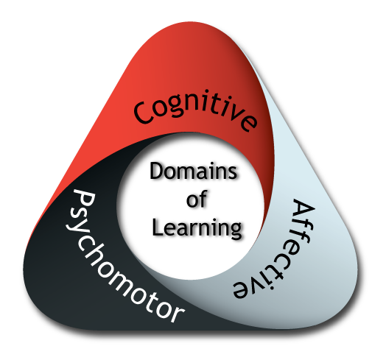
Domains of Learning Exercise
Notes:
Group Exercise
Divide the participants into three groups: 1) Cognitive Group, 2) Psychomotor Group, and 3) Affective Group. Ask each group to identify what a good DWI enforcement officer must have (Knowledge, Skills, and Attitudes) in order to be effective. Allow the groups 5 minutes to write down their ideas. Allow 1-2 minutes per group to present their findings to the class.
Objective: Initiate discussion with participants regarding what was accomplished through this exercise. Elicit these points:
All participants took part in group exercises and class discussions to discover key concepts
An exercise was conducted to assist with learning
Most participants presented in front of the class
Remind the participants, as instructors we can appeal to all three dominant senses in learning by using a combination of verbal, visual, and hands-on training methods.
________________________________________________________________________________
________________________________________________________________________________
________________________________________________________________________________
________________________________________________________________________________
________________________________________________________________________________
________________________________________________________________________________

Slide 12

Maximizing Efficiency in Learning
Notes:
Group Exercise: Assign participants into groups of four. Each group should be given a set of Content Delivery cards with categories of learning. Examples of the cards are listed in the Appendices. For example, one card says “Verbal Symbols,” another says “Verbal and Visual Symbols,” and so on. Groups are asked to place the cards in order from least to most effective method of learning. Examples of each method should be provided by the instructor. Allow participants two to three minutes to prioritize the cards.
Discussion: Have each group explain their prioritization.
Objective: Initiate discussion with participants regarding what was accomplished through this exercise. Elicit these points:
All participants took part in group exercises and class discussions to discover key concepts
A game (or exercise) was conducted to assist with learning
Most participants presented in front of the class
________________________________________________________________________________
________________________________________________________________________________
________________________________________________________________________________
________________________________________________________________________________
________________________________________________________________________________
________________________________________________________________________________

Slide 13
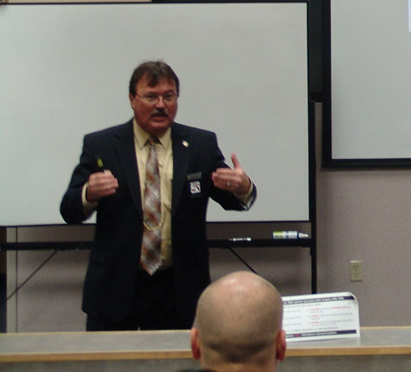
What is Instruction?
Notes:
Ask the participants to take two minutes to write their own definition of the word “instruction.” Their definitions should be applicable to the type of instruction that occurred in the example they shared previously.
Instruct participants to take several minutes to discuss their respective definitions with their partner. If the definitions are the same, discuss the reasons why they think the definition is applicable to both of your experiences. If the definitions are different, see if they can work together to come up with a new definition they both agree with.
Engage the participants in a group discussion in which the group responds to the question: “What is instruction?”
Document responses on a flip chart or dry erase board. Guide the participants toward these responses:
First, instruction is a conversation
Second, instruction involves two or more agents (e.g., participant and instructor)
Third, the purpose of instruction is to promote learning (change)
Instruct the participants to rewrite their definition of instruction then introduce the following definition of instruction. (Again, this is not the only correct definition, but it is one they may find very useful).
What is instruction?
Definition: A conversational process engaged in by mutual consent by two or more agents for the purpose of promoting learning by one or both of the agents.

Slide 14

Key Components of Instruction
Conversation
Two or more agents
Promotes learning (change)
Notes:
Ask the participants, based on the definition, what are the key components of instruction?
Review this definition and examine some of the key assumptions in it. Advise the participants this will help see why the definition may be useful as we design and develop instruction. Encourage the participants to fill in the blanks in their manuals.
“At its core, instruction is a learning conversation.” We have explored the difference between learning and instruction. Next, we are ready to consider some of the ways the physical environment can impact learning.
The three key components in the definition of instruction are:
_________________________________________________________________
_________________________________________________________________
_________________________________________________________________
________________________________________________________________________________
________________________________________________________________________________
________________________________________________________________________________
________________________________________________________________________________
________________________________________________________________________________
________________________________________________________________________________

Slide 15

Key Assumptions of Instruction
Learn more
Learn faster
Learn with fewer resources
Notes:
Instruction is NOT a natural process. It is an artificial process designed by human beings to help people:
Learn more
Learn faster
Learn with fewer resources
Point out effective instruction can also help us do tasks correctly and avoid mistakes, which is extremely important when conducting SFSTs and DRE drug influence evaluations.
________________________________________________________________________________
________________________________________________________________________________
________________________________________________________________________________
________________________________________________________________________________
________________________________________________________________________________
________________________________________________________________________________
________________________________________________________________________________
________________________________________________________________________________
________________________________________________________________________________

Slide 16



Key Assumptions of Instruction
Instruction helps people:
Notes:
In addition, instruction helps people by:
Remembering what has been learned longer
Applying what has been learned to achieve a goal
Having a more enjoyable learning experience
Ask participants about some other ways instruction helps people.
Suggested responses may include:
Helps gain confidence
Allows them to help others
Rewarding
________________________________________________________________________________
________________________________________________________________________________
________________________________________________________________________________
________________________________________________________________________________
________________________________________________________________________________
________________________________________________________________________________
________________________________________________________________________________

Slide 17
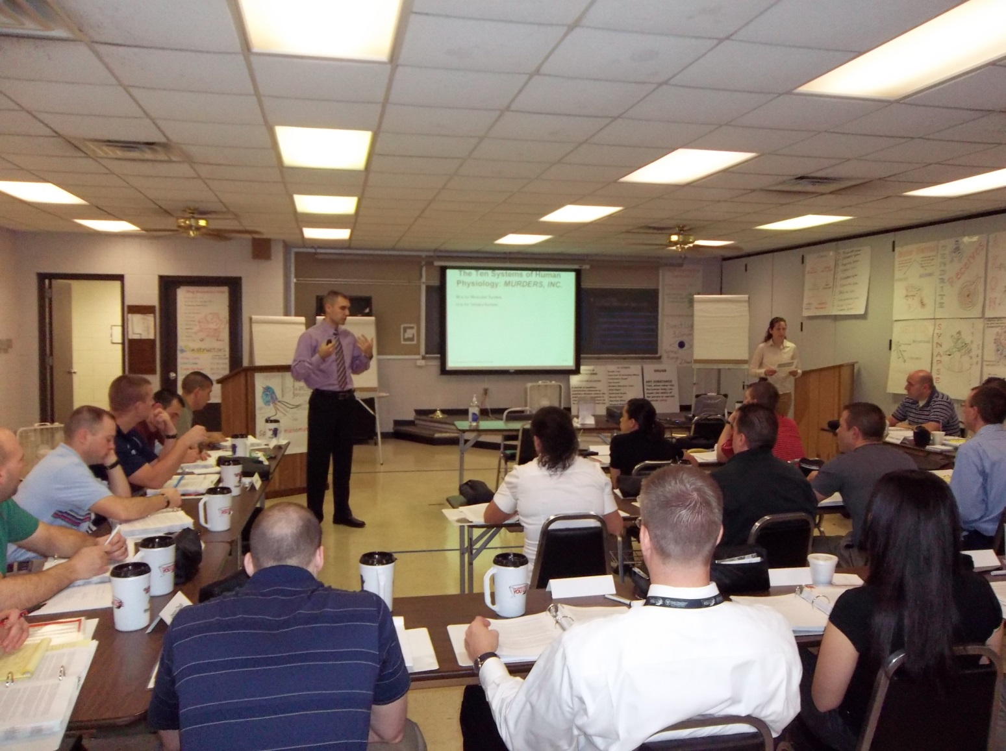
Creating the Learning Environment
Notes:
C. Creating the Learning Environment
Have the participants close their manuals and not refer to them during this activity. They need to do this in order to generate true responses as opposed to reciting what they see in the manual.
Take a minute to comment on the physical and psychological environment of the experience you (the instructor) shared at the beginning of this Session. Talk about what elements in the learning environment you think had the greatest impact on your learning and talk about how these elements affected your ability to learn.
Ask participants to reflect on the example they shared and think about the physical and psychological environment in which the learning occurred. Then ask them to take one minute to write down as much information as they can about the environment and the way it affected their ability to learn. After they’ve had some time to record their thoughts, invite them to briefly share what they’ve written.
Document responses on to easel/easel pad or dry erase board.
Take approximately 10 minutes to engage the whole group in a discussion about the learning environment. Begin by pointing out how training may not always occur in a traditional classroom setting. For example, when teaching a segment on darkroom examinations, the best training location would be a darkened room rather than a classroom. Explain instructors often need to adapt their instruction so it can be effective within various types of settings.
________________________________________________________________________________
________________________________________________________________________________

Slide 18
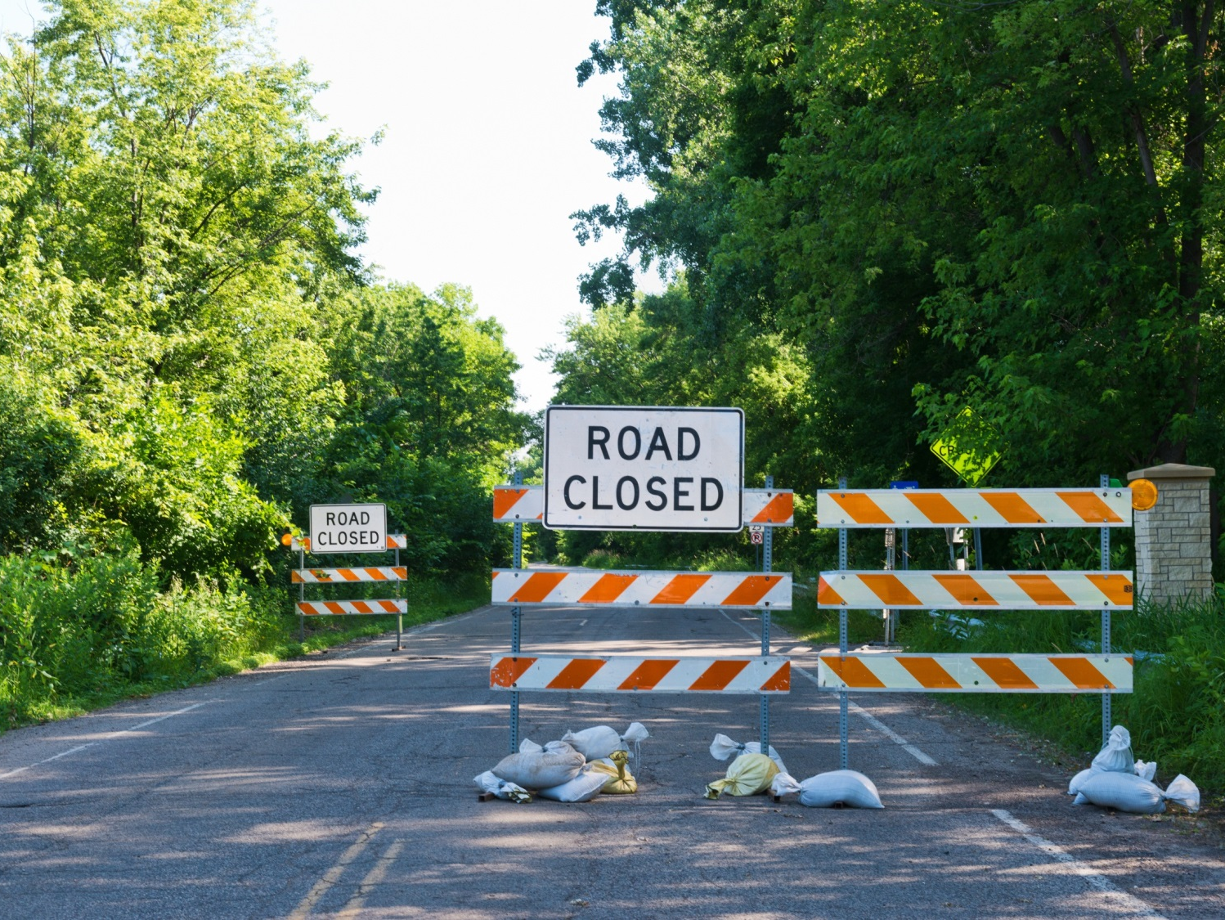
Impediments to a Good Learning Environment
Notes:
Solicit and document responses of impediments to a good learning environment, possible answers may include:
An instructor who appears unprepared
Non-functioning equipment
An instructor who does not engage the participants
It is the instructor’s responsibility to create, within reason, an effective learning environment. The physical environment may include:
Training location (academy vs. a hotel)
Safety concerns (exits, fire alarms, medical equipment)
Safety protocols
Room size
Room temperature
Seating arrangement (U-shaped vs. classroom style)
Audio visual equipment
Training materials
Visibility of visual aids
Break areas
Restrooms
Availability of food and refreshments
The psychological environment may include elements to make it:
Friendly
Encouraging
Helpful
Non-Intimidating
Limiting distractions

Slide 19
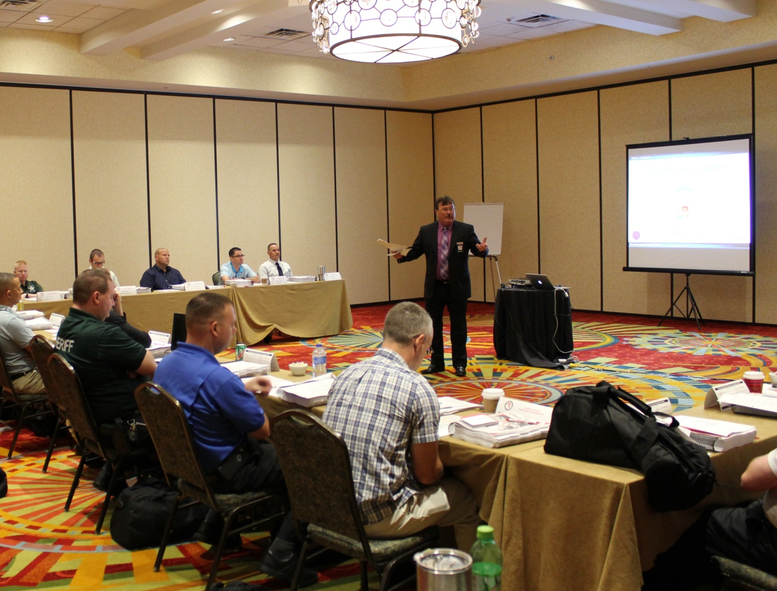
Learning Environment Activity
Notes:
Learning Environment Activity
State you would like to explore one particular element of the learning environment—the seating arrangement—in a little more detail. Explain how in traditional classroom settings, the physical seating arrangement can have a big impact on the quality of the psychological environment.
If the participants are seated in rows (classroom style), ask them to re-arrange their seats or tables in groups. Explain how the new seating arrangement is more conducive to instruction (conversational, promoting change).
If the seats were pre-arranged in groups, explain to the participants why you made this choice.
Engage in a whole-group discussion in which participants consider the psychological impact of various seating arrangements and determine when they would be most appropriate, including:
Fixed seating in rows (e.g., a computer lab or lecture hall) or traditional rows
Rows in a V-shape or facing two opposite directions
Multiple small-group circles or groups sitting around tables
One large circle with all participants able to see one another
Single small group circle of active participants surrounded by a larger group circle of observers
Partners side by side or facing each other
No seats at all—everyone stands and may move around the room
Conclude by stating it is the instructor’s responsibility to determine which seating arrangement will be most likely to facilitate a particular type of learning conversation. We will now explore some additional responsibilities of the instructor to set up an environment that is conducive to learning.

Slide 20
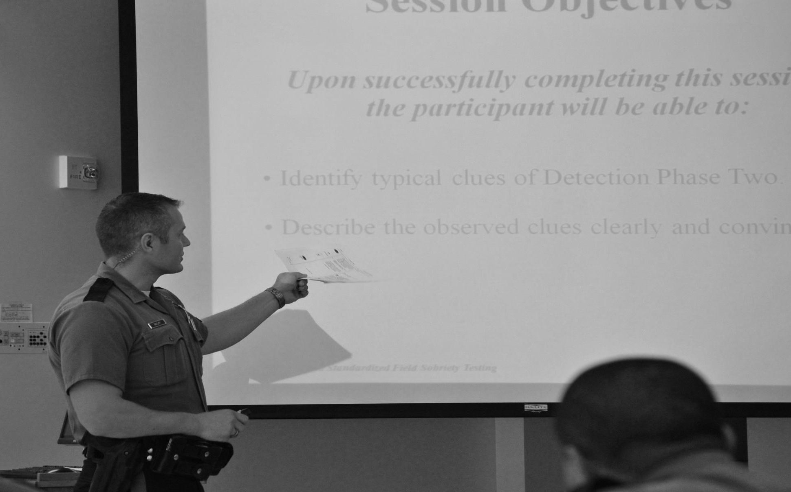
Instructor’s Responsibilities
Safe learning environment
Familiar with training content
Learning process
Participants’ motivations
Effectiveness of learning environment
Notes:
Discuss how an instructor’s basic responsibility is to create a good learning environment.
An instructor’s basic responsibilities for creating an effective learning environment include:
Ensure the learning environment is safe and participants follow all safety protocols
Design or be familiar with the full content of the training to ensure overall quality and cohesiveness
Manage and coordinate the learning process so the participants are focused and free of distractions, i.e., enhance maximum comprehension
Understand the participant’s motivations and help them to participate fully in the learning activities
Review and evaluate the effectiveness of the learning environment
________________________________________________________________________________
________________________________________________________________________________
________________________________________________________________________________
________________________________________________________________________________
________________________________________________________________________________
________________________________________________________________________________
________________________________________________________________________________
________________________________________________________________________________

Slide 21
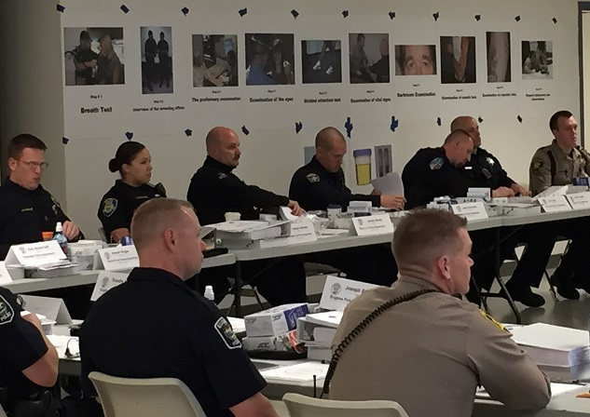
Participant Responsibilities
Safety protocols
Cooperate and participate
Stay focused
Provide information for an effective learning environment
Notes:
Discuss the participant’s basic responsibilities for creating an effective learning environment.
The participant’s basic responsibilities for creating an effective learning environment include:
Assist the instructor in keeping the learning environment safe and follow all safety protocols
Cooperate with the instructor and participate fully in the planned activities
Stay focused on the assigned instructional tasks and do not do anything that keeps others from learning (Don’t be a distraction)
Provide the instructor with information that can be used to evaluate the effectiveness of the learning environment
Engage in a discussion about any additional specific responsibilities the instructor and participants may have.
________________________________________________________________________________
________________________________________________________________________________
________________________________________________________________________________
________________________________________________________________________________
________________________________________________________________________________
________________________________________________________________________________
________________________________________________________________________________

Slide 22

The 6 Adult Learning Principles
Notes:
Click to play video (approx. 4 mins.) then proceed to the next slide.
Six Adult Learning Principles:
Adults are internally motivated and self-directed
________________________________________________________________________________
________________________________________________________________________________
2 . Adults bring life experience and knowledge to learning experiences
________________________________________________________________________________
________________________________________________________________________________
3. Adults are goal-oriented
________________________________________________________________________________
________________________________________________________________________________
4. Adults are relevancy-oriented
________________________________________________________________________________
________________________________________________________________________________
5. Adults are practical
________________________________________________________________________________
________________________________________________________________________________
6. Adult learners like to be respected
________________________________________________________________________________
________________________________________________________________________________

Slide 23
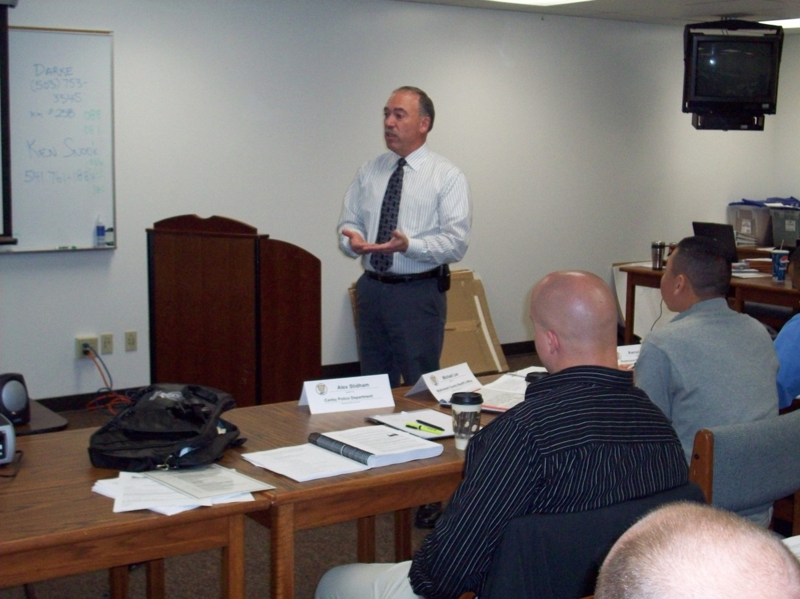
Effective Instruction
May include:
Focus
Relate to past
Relate to future
Emphasize
Permit
Listen
Encourage
Notes:
Explain all participants may have similar responsibilities.
Everyone has different life experiences that can affect how they learn. In order to embrace those experiences, effective instruction may include these points:
Focus on real world problems
Relate the materials to the participants’ past experiences
Relate the lesson to the participants’ goals and experiences
Emphasize how the lessons can be applied
Permit participants to challenge ideas
Listen to and respect the participant
Encourage participants to be resources to the instructors and to each other
In addition, there are some basic principles and instructional strategies instructors can follow to make the instruction more effective. In the next part of this Session, we will explore a basic cycle of instruction based on five key principles.
________________________________________________________________________________
________________________________________________________________________________
________________________________________________________________________________
________________________________________________________________________________
________________________________________________________________________________

Slide 24
Influence on Learning
More
MOST!
Little to None
Negative
Notes:
D. Cycle of Instruction
Explain the graphic in the slide represents the result of a research study on over 130 different factors that influence learning. As you can see, almost everything studied showed a positive effect on learning.
Throughout human history, people have invented thousands of different instructional processes. Some work very well; some work only a little bit or not at all; and, some actually make people less receptive to learning!
Research has shown over 130 different factors influencing achievement for students of all ages (see Appendices for reference). This graph represents findings from over 900 different meta-analyses of these factors involving thousands of research studies and millions of people. As you can see, most of the things we do will have some effect on learning. If you are looking for an instructional process that is guaranteed to increase learning and your only question is “What works?” the answer is “Almost everything!” You can select almost any instructional process that has been invented and you will find it will help people learn more than if you just left them to try to learn something on their own. But “What Works?” is really the wrong question to ask. What you want to know is “What works best?”
________________________________________________________________________________
________________________________________________________________________________
________________________________________________________________________________

Slide 25

What Works Best?
It Depends…
Notes:
Explain the answer to “What works best?” is “It depends.”
As you might imagine, learning researchers and instructional theorists have many different opinions about which instructional process works best. That’s because the answer to “What works best?” is “It depends.” It depends upon hundreds of factors, including:
The participant’s present level of knowledge and skill
The participant’s level of motivation
The types of knowledge, skills, or attitudes that need to be learned
These factors may change from moment to moment. What works best for participants one day may not work for them at all a year from now. This means it is up to you to analyze your particular training situation and determine which instructional process will work best.
________________________________________________________________________________
________________________________________________________________________________
________________________________________________________________________________
________________________________________________________________________________
________________________________________________________________________________
________________________________________________________________________________
________________________________________________________________________________

Slide 26

Cycle of Instruction
INTEGRATION
ACTIVATION
TASK/
PROBLEM CENTERED
APPLICATION
DEMONSTRATION
Notes:
Introduce the Cycle of Instruction by briefly explaining the following information.
After a careful study of many different instructional design theories and after a thorough review of the research supporting these theories, most of the instructional design theories was found to have five principles in common. These “First Principles of Instruction” include:
Problem-Centered Principle: Learning is promoted when participants acquire skill in the context of real-world problems
Activation Principle: Learning is promoted when participants recall existing knowledge and skill as a foundation for new skills
Demonstration Principle: Learning is promoted when participants are shown the skill to be learned
Application: Learning is promoted when participants use their newly-acquired skill to solve problems
Integration: Learning is promoted when participants reflect on, discuss, and defend their newly-acquired skill
These first principles provide us with a new answer to the question “What works best?” The answer is “It still depends, but it will most likely include the first principles of instruction.”
These principles may be applied to create a 4-phase cycle of instruction in which the participant identifies the Problem and then proceeds from Activation to Demonstration to Application and finally to Integration. Of course, it is possible to mix these phases in different sequences, but they are generally followed in this order. We will use these five principles during this training and refer to them as the “Cycle of Instruction.”
We will now review each of these principles in more detail.

Slide 27
Cycle of Instruction
INTEGRATION
ACTIVATION
TASK/
PROBLEM CENTERED
APPLICATION
DEMONSTRATION
Notes:
Provide the following information about the Problem-Centered Principle.
Example: In teaching the Drug Evaluation Process, the goal is to train the officers to follow the systematic and standardized procedures, verbal and physical tasks, each and every time they conduct an evaluation. A simple task in the Horizontal Gaze Nystagmus (HGN) test is to hold the stimulus 12 to 15 inches from the subject’s nose. The task or problem is estimating the 12 to 15 inches.
At the center of every learning conversation, there needs to be a goal, a task to be performed, a problem to be solved, or a concept to be learned. There is something to be changed. In the Cycle of Instruction, that component is referred to as the Problem-Centered principle.
This principle states learning is promoted when it occurs within the context of real-world tasks or problems. Participants increase their knowledge and skills best when they progress through a sequence of related tasks or problems. In most cases, they start with simple tasks or problems and gradually advance to more complex tasks or problems.
________________________________________________________________________________
________________________________________________________________________________
________________________________________________________________________________
________________________________________________________________________________
________________________________________________________________________________

Slide 28
Cycle of Instruction
INTEGRATION
ACTIVATION
TASK/
PROBLEM CENTERED
APPLICATION
DEMONSTRATION
Notes:
Define the Activation Principle in your own words. Include these points:
In this phase, the participants answer the question “What do I already know about this task, problem, or goal?”
The participants activate relevant prior knowledge or personal experience related to the learning goal. This can be a story, video, demonstrative aid, or other tools.
Provide the following example of the Activation Principle and document the participants’ answers:
Example: The first time an officer learns how to estimate 12 to 15 inches from the nose as needed in the HGN test. The instructor could activate prior knowledge of how to estimate 12 to 15 inches by asking for examples of other items that are 12 to 15 inches.
Answers may include:
Length of a sheet of notebook paper
Length of a grade school ruler
________________________________________________________________________________
________________________________________________________________________________
________________________________________________________________________________
________________________________________________________________________________

Slide 29
Cycle of Instruction
INTEGRATION
ACTIVATION
TASK/
PROBLEM CENTERED
APPLICATION
DEMONSTRATION
Notes:
Explain the purpose of the activation principle. Include this point: This can be done by asking participants to recall or describe something they have previously learned
The Activation Principle states learning is promoted when it activates relevant prior knowledge or experience. In this phase, the participant answers the question “What do I already know about this task, problem, goal?” The participants activate relevant prior knowledge or personal experience related to the learning goal.
Trainers may tell a story, show a video, use a demonstrative aid, or use other teaching tools in order to activate prior knowledge or experience. The Activation Principle allows the instructor to do the following:
Gives the participants a “hook” on which they can “hang” the new learning. This can be done by asking participants to recall or describe something they have previously learned.
Gives participants an opportunity to demonstrate a skill they have previously mastered
Participants can also share their prior knowledge or experience with others
It can be extremely helpful if you help the participant activate some kind of organizational structure or framework they have previously learned and then use it as a foundation upon which you continue to build new knowledge, skills, and attitudes.
________________________________________________________________________________
________________________________________________________________________________
________________________________________________________________________________
________________________________________________________________________________

Slide 30
Cycle of Instruction
INTEGRATION
ACTIVATION
TASK/
PROBLEM CENTERED
APPLICATION
DEMONSTRATION
Notes:
Define the Demonstration Principle in your own words. Include the points outlined in the Participant Manual. Provide an example of the Demonstration Principle. Ask a participant to assist you. Utilizing the HGN example from earlier, demonstrate the estimation of 12 to 15 inches by holding your finger in front of the participant’s face as if administering the HGN test. Instructor should use a piece of paper and/or ruler to judge accuracy. Explain the purpose of the Demonstration Principle.
The purpose of the Demonstration Principle includes:
Learning is faster and easier when participants are guided by a demonstration
Information may be shared in this phase, but it is important to provide specific portrayals of the information so participants can see how the information can be applied in the context of a real-world task or problem
Demonstrations or worked examples make later practice activities more effective. People learn more from examples AND practice than they do from practice alone. Research shows in almost every training situation, guided instruction works better than non-guided “discovery” learning.
The Demonstration Principle should be incorporated in the design of every learning conversation due to the following:
The Demonstration Principle states learning is promoted when participants can observe a demonstration of the task or see a worked example of how to solve the problem
A “worked example” is an observable example of a problem that has already been solved. Participants can study the worked example and use it as a model to follow as they try to solve a similar problem.
Demonstrations should also provide sufficient information and guidance to help the participant focus on key elements of the task or problem
In addition, participants may be given information on how the knowledge and skills may be applied to other types of tasks or problems

Slide 31
Cycle of Instruction
INTEGRATION
ACTIVATION
TASK/
PROBLEM CENTERED
APPLICATION
DEMONSTRATION
Notes:
Define the Application Principle in your own words.
The Application Principle should be incorporated in the design of every learning conversation due to:
The Application Principle states learning is promoted when participants must apply knowledge, skills, and attitudes to carry out similar tasks or solve similar problems
Participants gain much more from this if they receive corrective feedback and coaching from the instructor
They may also receive feedback from other participants as they collaborate on the task or discuss various aspects of the problem
Provide an example of the Application Principle. Have all participants utilize the HGN example from earlier and practice estimating the distance of 12 to 15 inches as if they were administering the HGN test. They may use a piece of paper and/or ruler to judge accuracy as needed.
Explain the purpose of the Application Principle.
The purpose of the Application Principle includes the following points:
Participants need multiple practice opportunities before they will be able to perform a skill fluently. Without practice, they cannot effectively learn the skill, nor will they retain what they learn very long.
Novice participants will need guidance and corrective feedback, but the instructor’s support and coaching should fade away as expertise increases. The Application Principle ensures participants have opportunities to receive feedback that will make their learning more effective and efficient.

Slide 32
Cycle of Instruction
INTEGRATION
ACTIVATION
TASK/
PROBLEM CENTERED
APPLICATION
DEMONSTRATION
Notes:
Define the Integration Principle in your own words.
The Integration Principle should be incorporated in the design of every learning conversation:
Integration Principle states learning is promoted when the participant integrates their new knowledge, skills, or attitudes into their personal or professional lives in some meaningful way
Peer discussions or critiques can provide opportunities to reflect on what they have learned and explore new ways to use their knowledge and skills
If appropriate, participants may demonstrate what they have learned to more than just their classmates and their instructor
They may engage in public demonstrations or presentations of their knowledge and skills
Give an example of the Integration Principle. Explain one or two ways in which the participants will integrate their new skills in their professional work. Specifically include a discussion of how they will integrate estimating 12 to 15 inches as part of the administration of the HGN test. Ask the participants to come up with examples of how they may apply the same skills to other parts of their personal lives outside of the workplace.
Explain the purpose of the Integration Principle.
The purpose of the Integration Principle includes the following:
Purposeful integration of the new skills into regular work tasks ensures the skills will continue to be improved
Periodic reflection and review of previous learning increases the ability of the participants to retain their knowledge and skills in long-term memory. The integration of the skills into professional and personal activities will provide opportunities for reflection and review.
Knowing the skills will be performed before others in real-world situations increases motivation to continue to learn and become more fluent in the skill

Slide 33
Cycle of Instruction
INTEGRATION
ACTIVATION
2
5
1
TASK/
PROBLEM CENTERED
4
DEMONSTRATION
APPLICATION
3
Session 2 - Starting the Learning Conversation
2-33
Notes:
Provide a general summary of what has been covered in this Session. Emphasize the five principles may be used together to form a cycle of instruction in which participants engage in a Task or Problem as they advance from Activation to Demonstration to Application.
Instructor should mount on the wall a copy of the Cycle of Instruction Chart to be referenced throughout the remainder of the course.
These five principles may be used together to form a Cycle of Instruction in which participants engage in a Task or Problem as they advance from Activation to Demonstration to Application to Integration, in sequence. The Cycle of Instruction may continue the learning conversation when a more complex task or problem—one that is related to the first task or problem—is given to the participants, and they go through the cycle again.
________________________________________________________________________________
________________________________________________________________________________
________________________________________________________________________________
________________________________________________________________________________
________________________________________________________________________________
________________________________________________________________________________
________________________________________________________________________________

Slide 34

Questions and/or Concerns
Notes:
E. QuestionS AND/OR CONCERNS
Give the participants an opportunity to ask questions. If appropriate, you may defer answering them until a later time in a one-on-one conversation.
After the summary and questions, ensure the Cycle of Instruction Chart (if used) is visibly placed on the wall to be referenced throughout the remainder of the course.
________________________________________________________________________________
________________________________________________________________________________
________________________________________________________________________________
________________________________________________________________________________
________________________________________________________________________________
________________________________________________________________________________
________________________________________________________________________________
________________________________________________________________________________
________________________________________________________________________________
________________________________________________________________________________

