Slide 1



Drug Recognition Expert
Instructor
Development
Course
Session 3 – Effective Strategies in Learning and Instruction
February, 2017

Slide 2

Content Segments
Effective Strategies in Learning and Instruction
Primacy
Increase Retention by Decreasing Stress
Paint a Picture
Repetition
10-Minute Rule
Color
Impact
Hands-on Instruction
Recency
Closing
Notes:
Session 3: Effective Strategies in Learning and Instruction
Estimated time for Session 3: 2 Hours (depending on class size)
Session Objectives
Analyze the effective strategies of learning and instruction
Apply the effective strategies of learning and instruction
Integrate the effective strategies into participants’ final presentations
Contents
Effective Strategies in Learning and Instruction
Primacy
Increase Retention by Decreasing Stress
Paint a Picture
Repetition
10-Minute Rule
Color
Impact
Hands-on Instruction
Recency
Closing
Materials
Presentation slides
Easel/Easel Pad
Markers
Impromptu topic cards for 30-second talk; Impromptu DRE cards for 1-minute talk
Computer speakers (for embedded videos)
Instructional Notes are presented in bold italic throughout the sessions.

Slide 3

Drug Recognition Expert
Instructor Development Course
Session 3:
Effective Strategies in
Learning and Instruction
Notes:
Session 3: Effective Strategies in Learning and Instruction
Estimated time for Session 3: 2 Hours
Materials:
Presentation slides
Easel/Easel Pad
Markers
Impromptu topic cards for 30-second talk
Impromptu DRE cards for 1-minute talk
Computer speakers (for embedded videos)

Slide 4

Session Objectives
Analyze and apply effective strategies of learning and instruction
Integrate effective strategies into participants’ final presentations
Notes:
Session Objectives
At the conclusion of this session, participants should be able to:
Analyze the effective strategies of learning and instruction
Apply the effective strategies of learning and instruction
Integrate the effective strategies into participants’ final presentations
Class activity: Each participant will present for approximately 30 seconds on an impromptu topic. Suggested topics are listed in the Appendices.
_________________________________________________________________________________
_________________________________________________________________________________
_________________________________________________________________________________
_________________________________________________________________________________
_________________________________________________________________________________
_________________________________________________________________________________
_________________________________________________________________________________
_________________________________________________________________________________
_________________________________________________________________________________

Slide 5

Effective Strategies in
Learning and Instruction
Notes:
A. Effective Strategies in Learning and Instruction
Session 3: Effective Strategies in Learning and Instruction
Discussion Questions:
Who has had a problem during or after a presentation where participants did not understand or retain it?
How about with a jury? How many people have had a juror say the jury would have convicted the defendant if you had testified to certain evidence when you knew you actually did?
If either of these things has happened to you, have you ever been able to determine why?
Explain participants must apply effective strategies in learning and instruction based on their learners’ background and level of experience.
Instructors should reference and point out where the following strategies fit within the Cycle of Instruction. The strategy may be used in more than one of the stages of the cycle.
As learned in Session 2, many different instructional processes increase learning. What works best in designing courses is utilizing all of the principles in the Cycle of Instruction.
This Session introduces effective strategies the instructor can use within the Cycle of Instruction to deliver content. As an instructor, there are a myriad of effective strategies to present material that will increase participants’ motivation, participation, and retention. Nine effective strategies will be presented in this Session.
_________________________________________________________________________________

Slide 6

Primacy
Notes:
B. Primacy
Activity: Primacy. Call out a list of 10 major cities from around the world (tell the participants to not write down the list.) For example:
Paris 6. Washington, D.C.
New York 7. Athens
Rome 8. Tel Aviv
Berlin 9. Moscow
London 10. Hong Kong
Ask the participants what the first city you mentioned was. Ask them what the third city was. Ask them what the last city was. Most people will remember the first and the last city because people usually remember best the first and last things they hear.
Discussion: Point out many people begin presentations with boring announcements and/or self-introductions. Ask them if they think this is a good strategy in light of the value of primacy.
Remind the participants the strongest point in your presentation should be given first.
An effective strategy is to grab and keep attention. The primacy principle helps you do this. We recall what we hear first and last, but the middle is more readily forgotten. Open and close each presentation with attention grabbers and your most important points. Primacy is a strategy that can be incorporated into each segment of the Cycle of Instruction.

Slide 7

Increase Retention by
Decreasing Stress
Notes:
C. Increase Retention by Decreasing Stress
Advise the participants people have difficulty making decisions or learning when they feel uncomfortable or stressed. Ask participants to give examples of a stressful situation that led to difficulty in learning or making a decision.
Note: The instructor should identify where this strategy fits within the Cycle of Instruction. Decreasing stress is a very effective strategy during the Activation stage in the Cycle of Instruction. Use the Activation principle by telling a story of when you learned to drive. Include a description of the stress of learning to drive a car for the first time. Did the instructor (or parent) increase or decrease your stress? How did it affect learning?
Emphasize instructors must continually work to reduce their participants’ stress if they want their participants to learn.
Stress inhibits learning, thinking, memory, and retention. Research shows our brains are only built to deal with short bursts of stress. This is the fight or flight principle. Our brains are built to deal with stress that lasts only 30 seconds. If stress continues, you lose your participants. If you want to increase retention, then decrease stress. Stress may be induced by:
Actions of the Instructor and Participants
The environment
Uncertainty
Instructors must continually work to reduce their participants’ stress if they want their participants to learn. Ways to reduce participants’ stress may include:
Being friendly (smile) and using humor
Give appropriate praise
Use relevant video clips or appropriate stories
Reward people who participate (candy, gifts or other items)

Slide 8
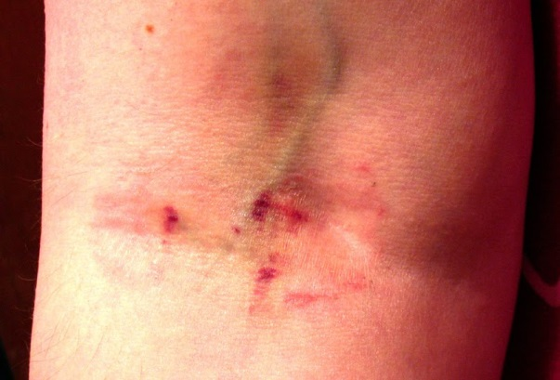
Paint a Picture
Notes:
D. Paint a Picture
Discussion: Ask the class what they see when you say intoxicated. Ask similar questions using relevant geographical examples such sports teams or landmarks that resonate with your audience. Animals also work well. Emphasize pictures are an effective learning strategy. Other senses may be incorporated into this segment i.e., sound, smell, taste ,and touch.
We learn and remember best through pictures not through written or spoken words. The rule of thumb is you will get three times better recall for visual information than for oral alone. However, you will get six times better recall for information that is simultaneously oral and visual.
For example, a picture of injection sites may resonate better with the participant than the words “injection sites” alone. Putting the two together simultaneously can make the learning event even stronger in the brain.
A picture is worth a 1000 words
People think in pictures
People remember stories
People believe and understand what they visualize
Discussion: Just because vision is so important does not mean it should be the only channel of your message. Discuss with the participants the advantages and disadvantages of visuals. The instructor should identify where this strategy may be used within the Cycle of Instruction. Painting a picture is a very effective strategy during the Demonstration stage in the Cycle of Instruction.
_________________________________________________________________________________
_________________________________________________________________________________

Slide 9

Notes:
E. Repetition
Discuss repetition with the class.
Repetition Activity: Hand out a piece of paper with questions below on it. Allow the participants time to answer. Tell them the answers. Instructor will then give the participants the quiz again within 1.5 hours to 2 hours later in the course.
Question #1: What was President Lincoln’s middle name? Answer: No middle name
Question #2: What was the first product to have a bar code? Answer: Wrigley’s gum
Question #3: What is a group of frogs called? Answer: Army
Question #4: What is the plastic cover at the end of a shoelace called? Answer: Aglet
Emphasize simply repeating something six times is not an effective technique. You must find different ways to repeat, present, and emphasize the information to increase retention. Some effective repetition tools are quizzes, tests, practice exercises, flash cards, corrective feedback, etc.
An example may be the process by which we recall the name of a new acquaintance. At the time of introduction, we may repeat their name internally or externally in hopes of assigning it to our memory. When we have to recall the name at a later time, we may have forgotten it. The name will then have to be repeated to enable us to encode it into long-term memory.
_________________________________________________________________________________
_________________________________________________________________________________
_________________________________________________________________________________

Slide 10

Notes:
Repetition at specifically-timed intervals is best for learning. A great deal of research shows thinking or talking about an event immediately after it has occurred enhances memory for that event.
Learning requires memory; however, memory is not realized by mere repetition. Retrieval practice - recalling facts, concepts, or events from memory is a more effective learning strategy than rapid-fire repetition or simply repeating things numerous times in a row. Retrieval is harder and feels less productive, but this retrieval practice produces longer lasting results. It makes you far more effective and enables you to be more versatile in the application of that knowledge or skill.
Note: The instructor should identify where this strategy may be used within the Cycle of Instruction. Accurate repetition is a very effective strategy during the Integration segment in the Cycle of Instruction.
You must find different ways to repeat, present, and emphasize the information to increase retention. For example, you may repeat information using visual aids, auditory aids, demonstrations, questions, and group activities. Some effective repetition tools are quizzes, tests, practice exercises, flash cards, and corrective feedback. A good rule of thumb is to repeat important concepts in the first 30 seconds. Then at 90 minutes to 2 hours, revisit and repeat the concepts again.
_________________________________________________________________________________
_________________________________________________________________________________
_________________________________________________________________________________
_________________________________________________________________________________
_________________________________________________________________________________

Slide 11

Team Teaching
Second instructor- secondary resource | Varying levels- authority
Two heads are better than one | Varying levels- knowledge
Shared workloads | Individual differences- personality
Notes:
Definition of Team Teaching: team teaching is combining instructional skills, subject matter, and knowledge of two instructors to present course materials or training.
There are advantages and disadvantages to team teaching:
Advantages
The second instructor can serve as a secondary resource of subject matter knowledge
Two instructors can better assess participant reaction to course material
Shared workload
Disadvantages
Varying levels of authority or management within the organization
Varying levels of subject matter knowledge or training delivery experience
Individual differences in personality or training delivery
Instructor Roles in Team Teaching
Positive interpersonal relationship between instructors
Respect each other's experience levels
Address differences outside of the classroom.
Instructors should provide feedback to each other, focus on behaviors (not personalities), and be professional in giving and receiving feedback.
_________________________________________________________________________________
_________________________________________________________________________________

Slide 12
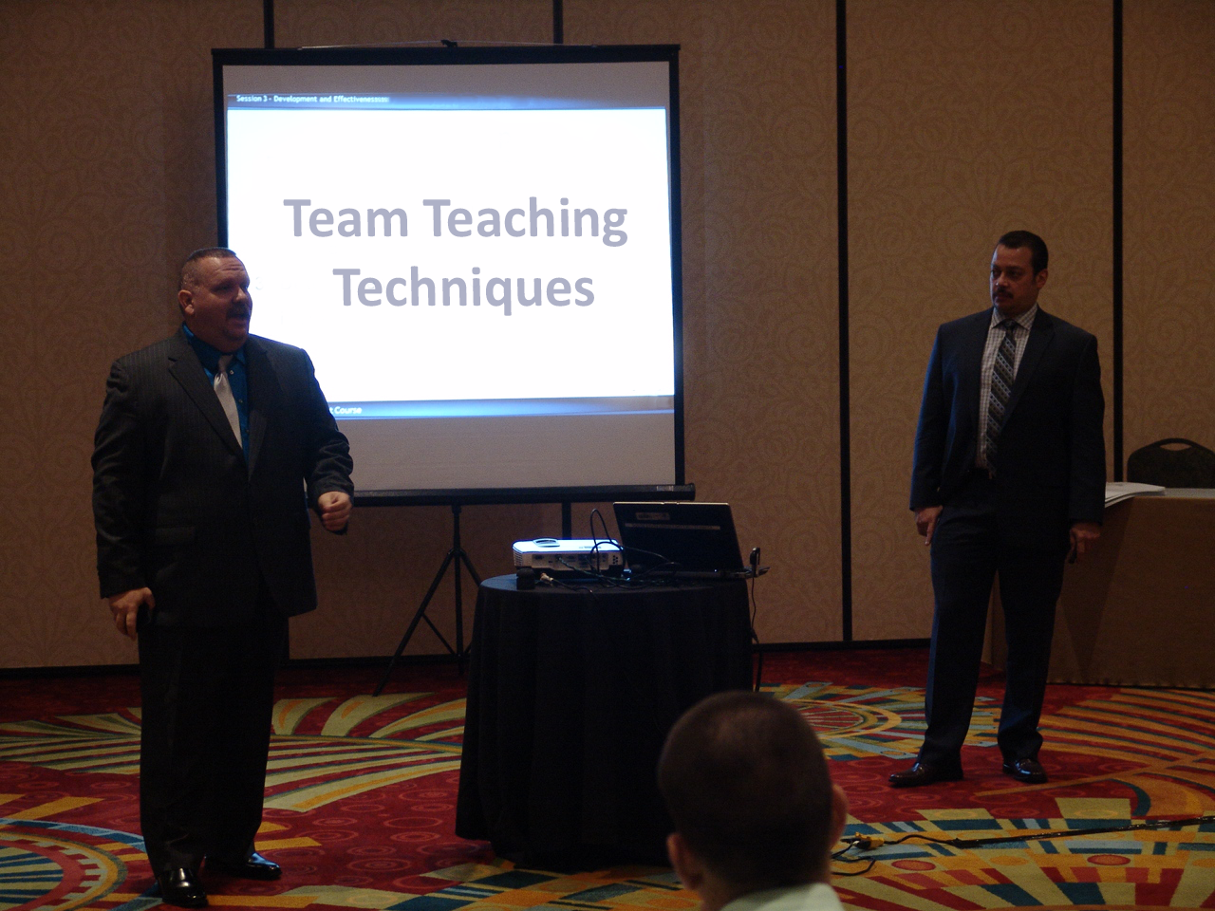
Notes:
Team Teaching Techniques
Prior to the class, instructors should coordinate and discuss individual delivery techniques and logistical requirements. They should establish guidelines for shared facilitation, interjection of supplemental information or material, etc.
During class, present a team-teaching approach, respect allotted time slots, and initiate discussions. The teaching instructor facilitates discussion in the classroom and involves the other instructor where appropriate. Both instructors are there to assist and support each other.
At the conclusion of the class, instructors should discuss the overall training program and annotate any required modifications. They should also review the delivery and presentation of the material to determine what was effective and what needed improvement.
_________________________________________________________________________________
_________________________________________________________________________________
_________________________________________________________________________________
_________________________________________________________________________________
_________________________________________________________________________________
_________________________________________________________________________________
_________________________________________________________________________________

Slide 13

10-Minute Rule
Notes:
F. 10-Minute Rule
Discuss the 10-minute rule with the participants.
In general, people can maintain their focus for approximately 10 minutes at a time. Instructors should do something different or change something every 10 minutes. Ideally, the instructor should include a brief hook that affects an emotional trigger in the participant (laughter, fear, compassion, nostalgia, etc.). Yet, this hook must also be relevant to the overall presentation. It is best when this hook connects the two, 10-minute segments.
For example:
Short Demonstration
Video
Activity
Discussion
Purposeful Movement
Tone of Voice
Remember the 10-minute rule:
Maximum concentration is 10 minutes
Break presentation into short segments
Remember primacy and recency
Reflect for a moment on how the media uses the ten-minute rule.
Note: The instructor should identify where this strategy may be used within the Cycle of Instruction. Timing is a very effective strategy during the Activation and Demonstration stages in the Cycle of Instruction.

Slide 14

Color
Notes:
G. Color
Discussion: Call out a color. Ask the participants to tell you what that color means to them. Document responses, typical answers will include:
Red: power, fun, danger
Green: money, growth
Blue: loyalty, tranquility, water, cool
Gold: riches, royalty
Brown: earthy, grounded
Note this could be different based on the participant’s cultural background. For example, in Eastern cultures red may symbolize prosperity or good fortune, in India red is the color of purity. Emphasize how their color choice may make people feel a certain way or remember certain information. Explain their choice of color should appropriately reflect the value or point they are attempting to convey. Note if you had an instructor fill out a windowpane using a hard to see color as recommended, point out how distracting it was to the presentation.
Effective use of color can increase communication speed, accuracy, and retention. However, it must be relevant to what is being learned. Overuse of colors, or choosing the wrong color can be distracting or lead to cognitive overload. Your color choice may make people feel a certain way or remember certain information. Your choice of color should appropriately reflect the value or point you are attempting to convey.
Color gains attention (Example: Use of color in traffic signs)
Color enables memory (Association of color with facts to improve recall)
Colors have meaning (Use appropriate colors to the culture of your audience)
Note the instructor should identify where this strategy may be used within the Cycle of Instruction. Color is a very effective strategy during the activation stage in the Cycle of Instruction.

Slide 15

Impact
Notes:
H. Impact
Discuss impact with participants. Remind the participants they must grab and keep their participants’ attention; effective use of tone, delivery, and style is impactful.
Impact Activity: Provide the class with words that have no positive impact and ask the class to come up with better words or descriptions. For example:
Word Better Description
Defendant’s name Defendant
Accident Crash, Collision, Wreck
Drift Swerve, Weave, Crossed the center line
Impaired Falling, Staggering
_________________________________________________________________________________
_________________________________________________________________________________
_________________________________________________________________________________
_________________________________________________________________________________
_________________________________________________________________________________
_________________________________________________________________________________
_________________________________________________________________________________

Slide 16
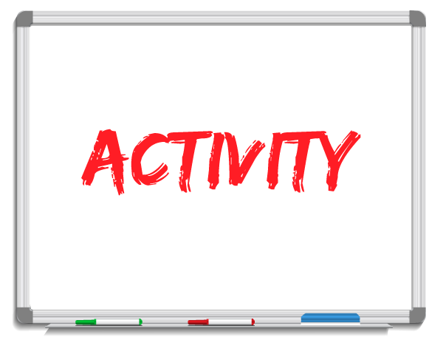
Notes:
Activity: Instructor chooses a participant and gives the participant a phrase. For example, “I’ve only had two.” Ask the participant to say the same phrase but convey a different emotion each time, for example, joy, sadness, urgency, anger, love, and excitement.
You must grab and keep your participants’ attention; effective use of tone, delivery, and style is impactful. You want to elicit emotion. Emotion motivates. There are certain stylistic principles that create greater impact with an audience. The brain remembers the emotional components of an experience better than any other aspect.
The whole range of emotions is effective.
Use words with impact
Use ideas with impact
Use controlled changes in the pace of your delivery
Use silence (pauses) to emphasize importance and to allow time for important points to sink in
Use controlled changes in voice inflection and volume
Use eye contact with your participants to personalize the instructor/participant relationship
Use controlled use of body movements and gestures
These gestures need to look and be natural
Note: The instructor should identify where this strategy may be used within the Cycle of Instruction. Impact is a very effective strategy during the demonstration segment in the Cycle of Instruction.
_________________________________________________________________________________
_________________________________________________________________________________
_________________________________________________________________________________

Slide 17
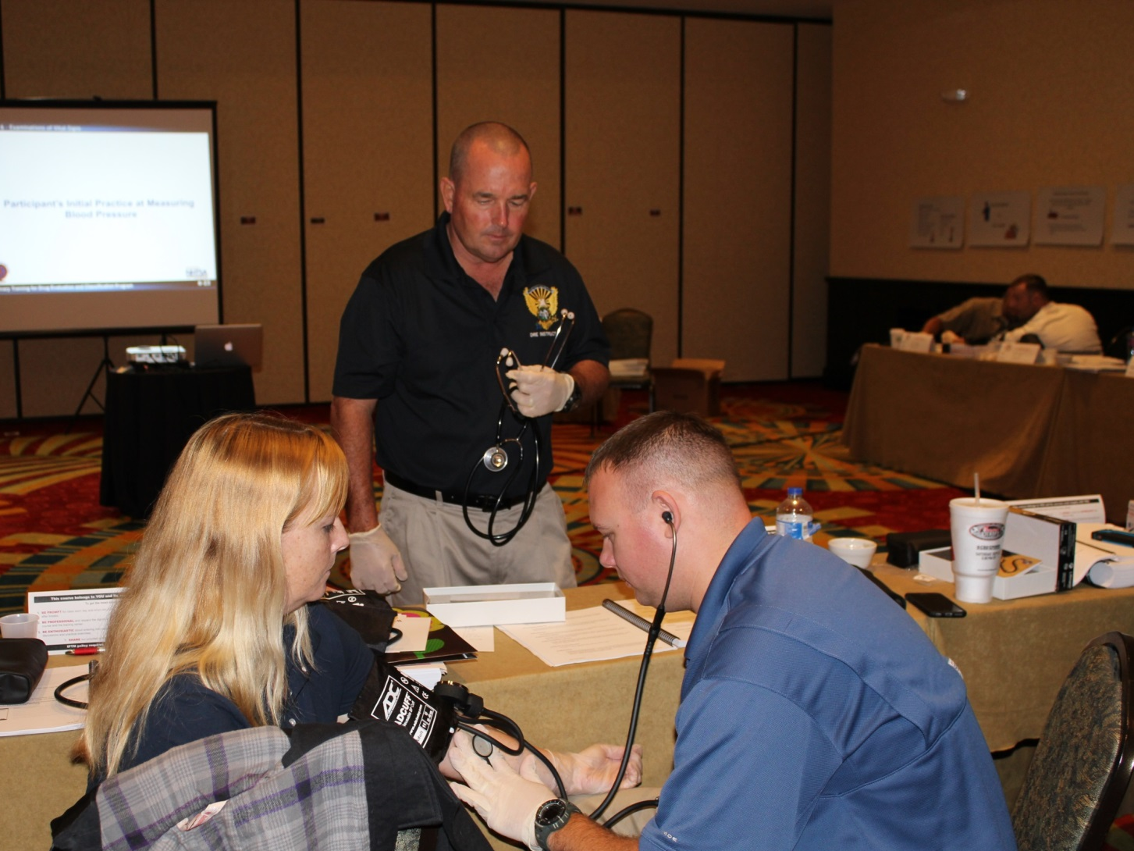
Hands-On Instruction
Notes:
I. Hands-on Instruction
Tell participants you are going to talk about hands-on instruction.
The basic premise behind interactive teaching is three-phase:
Tell me (instruct)
Show me (demonstrate)
Let me do it (practice in the real environment)
The instructor can relate a prior instructing experience to demonstrate , i.e., firearms training. The range master can teach how to shoot a gun by describing the process. He then actually demonstrates it for the class and then allows each participant to fire the gun based on what they have learned and seen.
The instructor can ask the participants to give an example of a similar effective hands-on teaching moment in their lives.
A hands-on approach requires participants to become active instead of passive participants. Hands-on instruction is learning by doing. It is the Application principle in the Cycle of Instruction. Learners in multisensory environments remember and internalize more. Hands-on learning helps eliminate the “illusion of knowing” wherein learners believe they know but later are not able to replicate it by doing. It often takes the attempt to apply the information to prove to us that we do not understand it yet.
_________________________________________________________________________________
_________________________________________________________________________________

Slide 18

Notes:
Note the instructor should identify where this strategy may be used within the Cycle of Instruction. Hands-on is a very effective strategy during the Application and Integration segments in the Cycle of Instruction.
An example of this hands-on instruction is how the SFSTs are effectively taught. Police officers are first introduced to the fundamental principles and studies behind the SFST protocol. The instructors then provide actual demonstration of the proper administration of each of the three tests. Next, participants are given opportunities to apply the tests in controlled environments. The optimal next step in their instruction phase is for the participants to implement the tests roadside with actual impaired drivers. In this way, they are integrating what they have learned in the actual working environment. The more hands-on application during the instruction leads to better integration in the working environment.
_________________________________________________________________________________
_________________________________________________________________________________
_________________________________________________________________________________
_________________________________________________________________________________
_________________________________________________________________________________
_________________________________________________________________________________
_________________________________________________________________________________
_________________________________________________________________________________

Slide 19

Recency
Notes:
J. Recency
We recall what we hear first and last. Information in the middle is lost due to the passage of time and the mind-wandering of the participant. Begin strong and end strong. Close each presentation by repeating and reemphasizing your most important points. Basically, reemphasize what you chose to begin with. Paint a picture using all of the senses, including color and impact. Use repetition to emphasize your points and engage your participants with hands-on experiences. Integrate all of the strategies discussed to help intensify the recency effect.
Recency has little effect if the participant does not value the information placed first and last. Using the strategies taught in this Session may help increase the participants’ perceived value of the instruction and increase their ability to retain what is taught during the learning conversation.
For example, in the organization of this Session, thought was given to the order of the effective strategies in learning and instruction. The concern was participants might presume the order in which these strategies were presented signifies level of importance. By designing the Session using the Cycle of Instruction and integrating the strategies being taught, each segment has its own primacy and recency moments. Recency is a strategy to be incorporated into each stage of the Cycle of Instruction.
_________________________________________________________________________________
_________________________________________________________________________________
_________________________________________________________________________________
_________________________________________________________________________________

Slide 20
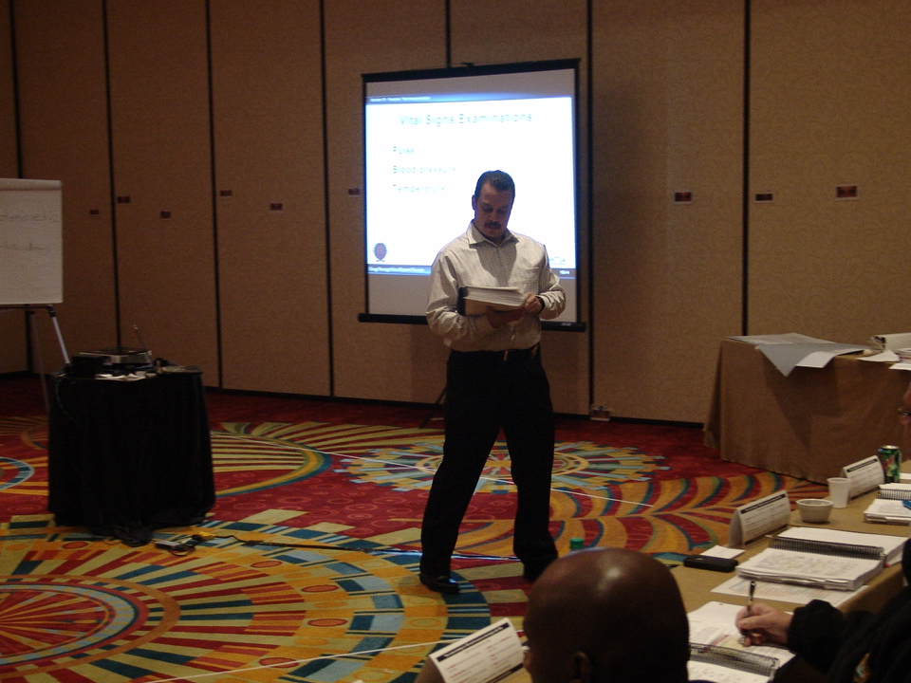
DRE in 60 Seconds
Notes:
Have participants conduct an informal presentation. Remind participants to consider the concepts of primacy and recency in their presentations.
These presentations are DRE/DUID in nature, to help raise participants' comfort level in front of the group. Use an index card with a large "45" printed on it to hold up for the participant to know when they have 15 seconds left. They are not expected to close or summarize the presentation, but the 15-second warning gives them a sense of completion.
*See Appendices in Administrator Guide for presentation topics. (If time allows, have participants present twice.)
Initiate discussion with participants regarding what was accomplished through this exercise. Elicit these points:
All participants presented twice in front of the class
All participants were put “on the spot” during an exercise requiring impromptu speaking
Presenters became more comfortable when they presented the second time
Participants applied presentation methods learned in this session
_________________________________________________________________________________
_________________________________________________________________________________
_________________________________________________________________________________
_________________________________________________________________________________
_________________________________________________________________________________

Slide 21

Questions and/or Concerns
Notes:
K. Closing
Give participants five minutes to reflect on the strategies and document the strategies they want to use in their final presentation. Allow participants an additional ten minutes to write down examples of how they plan to utilize those strategies. An instructor should be assigned to each table to facilitate this process.
_________________________________________________________________________________
_________________________________________________________________________________
_________________________________________________________________________________
_________________________________________________________________________________
_________________________________________________________________________________
_________________________________________________________________________________
_________________________________________________________________________________
_________________________________________________________________________________
_________________________________________________________________________________
_________________________________________________________________________________
_________________________________________________________________________________

