Slide 1



Drug Recognition Expert
Instructor
Development
Course
Session 7 – Dealing with Training Challenges
February, 2017

Slide 2

Content Segments
Dealing with Challenges
Key Considerations in Responding to Problem Situations Created by Participants
Three-Step Correction Strategy
Applying the Three-Step Correction Strategy
Environmental Challenges
Problem Situations Created by Instructors
Questions and/or Concerns
Notes:
Session 7: Dealing with Training Challenges
Estimated time for Session 7: 1 Hour (depending on class size)
Session Objectives
Demonstrate the key considerations in responding to problem situations created by participants using the three-step correction strategy
Apply the three-step correction strategy to problem situations created by participants
Analyze how to address environmental and equipment challenges
Assess problem situations created by instructors
Contents
Dealing with Challenges
Key Considerations in Responding to Problem Situations Created by Participants
Three-Step Correction Strategy
Applying the Three-Step Correction Strategy
Environmental Challenges
Problem Situations Created by Instructors
Questions and/or Concerns
Materials
Presentation slides
Easel/Easel Pad
Markers
Instructional Notes are presented in bold italic throughout the sessions.

Slide 3

Drug Recognition Expert
Instructor Development Course
Session 7:
Dealing with Training Challenges
Notes:
Session 7: Dealing with Training Challenges
Estimated time for Session 7: 1 Hour
Materials
Presentation slides
Easel/Easel Pad
Markers
__________________________________________________________________________
__________________________________________________________________________
__________________________________________________________________________
__________________________________________________________________________
__________________________________________________________________________
__________________________________________________________________________
__________________________________________________________________________
__________________________________________________________________________

Slide 4

Session Objectives
Respond to problem situations created by participants using the three-step correction strategy
Apply three-step correction strategy to problem situations created by participants
Analyze how to address environmental and equipment challenges
Assess problem situations created by instructors
Notes:
Session Objectives
At the conclusion of this session, participants should be able to:
Demonstrate the key considerations in responding to problem situations created by participants using the three-step correction strategy (Demonstration)
Apply the three-step correction strategy to problem situations created by participants (Application)
Analyze how to address environmental and equipment challenges (Activation)
Assess problem situations created by instructors (Integration)
Instruct participants to close their manuals (if the following optional activity is to be conducted).
__________________________________________________________________________
__________________________________________________________________________
__________________________________________________________________________
__________________________________________________________________________
__________________________________________________________________________
__________________________________________________________________________
__________________________________________________________________________

Slide 5

Problem Situations
Notes:
A. Dealing with Challenges
Optional Activity: Have participants close their manuals for this presentation to encourage thoughtful participation.
Do not make the mistake of labeling participants as problem participants. Rather, this is an exercise in handling problem situations. Remember many problem situations are, in fact, the result of particular behaviors by a participant or participants. It does not necessarily make them problem participants.
All faculty members encounter problem situations at some point during their presentations; they must be ready for these challenges. Consider assigning a couple of instructors to act as problem participants in this presentation. For example, ask them to read the paper, talk to each other or one of the other participants, use their cell phones, etc.
Ask them to stop when you use one of the corrective techniques described during this presentation. Record examples of problem situations created by participants:
Some participants are too vocal
Some participants are too quiet or shy
Some participants are disruptive
Some participants lack motivation
Problem Situations
Some problem situations are those in which learning is inhibited due to the behavior of one or more of the participants. The problem is not necessarily the participant, but rather the participant’s motivation. A good instructor develops techniques to invite cooperation and maintain participant motivation. All instructors, even the most skilled and experienced ones, run into problem situations.

Slide 6

Key Considerations with
Problem Situations
Notes:
B. Key Considerations in Responding to Problem Situations Created by Participants
Emphasize: Instructors should avoid harming a participant’s self-esteem; however, on rare occasions, it may be more important to avoid further disruption to learning.
The key considerations to responding to problem situations created by participants are:
Eliminate or minimize the problem behavior
Maintain the participant’s self-esteem
Avoid further disruption to learning
__________________________________________________________________________
__________________________________________________________________________
__________________________________________________________________________
__________________________________________________________________________
__________________________________________________________________________
__________________________________________________________________________
__________________________________________________________________________
__________________________________________________________________________

Slide 7

Three-Step Correction Strategy
Notes:
C. Three Step Correction Strategy
Emphasize: The importance of remaining calm and thinking clearly.
As much as you want to avoid harming a participant’s self-esteem, it is essential you avoid further disruption to learning.
Identify possible strategies to deal with the problem
Compare your possible strategies against the key considerations
Eliminate or minimize the problem behavior
Maintain the participant’s self-esteem
Avoid further disruption to learning
Employ the best strategy
__________________________________________________________________________
__________________________________________________________________________
__________________________________________________________________________
__________________________________________________________________________
__________________________________________________________________________
__________________________________________________________________________

Slide 8
Applying the Three-Step
Correction Strategy
Notes:
D. Applying the Three Step Correction Strategy
Activity: Place participants in up to six groups and assign each group a problem situation (sample problem situations follow). Ask the groups to devise a strategy or strategies for dealing with the situation. Have participants take into account the three-step correction strategy. Have each group report back to the class. Have groups turn to the appropriate problem situation in the participant manual.
Give groups ten minutes to discuss their problem situations and five minutes to report out.
The following are possible strategies for the instructor to highlight during the group reports:
Ignore the problem
Use Classroom space/movement
Move toward the participant creating the distraction
Standing close to a talker usually causes the conversation to end
Use appropriate question/answer techniques
Foreclose the know-it-all
Move attention away from the distracting participant
Give others an opportunity
Vary learning activities
Put the participant to work filling out charts, etc.
Choose discussion leaders where appropriate
Be available to participants outside class time
Talk privately with the participant creating the problem situation

Slide 9

Chatterbox
Notes:
The Chatterbox
Overt Characteristics: In the order of participant problem types, these individuals are probably the most disruptive of all, since (for whatever reason) they never seem to stop talking from the moment they enter the room until the presentation concludes.
People who fall within this category appear to take a great deal of self-satisfaction in carrying on both direct (face-to-face) and indirect (looking at the instructor, but whispering discreetly to their neighbor) conversations that begin to disrupt the flow of information which the instructor is attempting to convey. In certain situations, they will even attempt to carry on a conversation with another member of the audience (either across the table or room), completely ignoring what is being presented.
What are some strategies for dealing with this problem behavior? Evaluate each strategy against the four conditions listed below:
Will it eliminate or minimize the problem behavior?
Will it maintain the self-esteem of the participant whose behavior is causing the problem?
Will it maintain the dignity of the instructor as well as the participant?
Will it avoid further disruption to learning?
Effective Strategies Observed in Class
__________________________________________________________________________
__________________________________________________________________________

Slide 10

Complainer
Notes:
The Chronic Complainer
Overt Characteristics: While perhaps not as disruptive as some of the types already discussed, this type appears to take particular delight in pointing out all of the details that are either unacceptable or are detracting from the session. Negativism is their forte.
Complaints are usually numerous and quite specific. The issues range anywhere from the room being too stuffy, too hot, too cold, too small, too large, to the coffee service arriving late, the complimentary pastry not “tasting quite right, the chairs being uncomfortable, or the M & M’s not containing peanuts. (Most experienced instructors or trainers could add at least 10 additional items to this list.)
Interestingly enough, whether the displeasure is expressed verbally or nonverbally, this type appears to take a subtle pleasure in expressing dissatisfaction with just about every aspect of the training.
What are some strategies for dealing with this problem behavior? Evaluate each strategy against the four conditions listed below:
Will it eliminate or minimize the problem behavior?
Will it maintain the self-esteem of the participant whose behavior is causing the problem?
Will it maintain the dignity of the instructor as well as the participant?
Will it avoid further disruption to learning?
Effective Strategies Observed in Class
__________________________________________________________________________

Slide 11

Hostage
Notes:
The Hostage
Overt Characteristics: Whenever a participant attends a training session because it is mandatory, that person may feel like a hostage. They may react passively or aggressively depending on the degree of resentment they feel at being some place they do not want to be.
This type of problem participant may feel they were forced to attend the training for one reason or another and may consider the instructor to be an adversary as opposed to an ally. Seldom does a group consist exclusively of hostages, but if there is more than one, they will usually sit together in order to commiserate or cause trouble.
This type of participant may be distracting and at some point may vent their anger unless the instructor devises a strategy for dealing with the situation.
What are some strategies for dealing with this type of behavior? Evaluate each strategy against the four conditions listed below:
Will it eliminate or minimize the problem behavior?
Will it maintain the self-esteem of the participant whose behavior is causing the problem?
Will it maintain the dignity of the instructor as well as the participant?
Will it avoid further disruption to learning?
Effective Strategies Observed in Class
__________________________________________________________________________

Slide 12

Apple Polisher
Notes:
The Apple Polisher
Overt Characteristics: This type of problem participant really wants the instructor’s attention. At first, it’s flattering. Then, it gets embarrassing as the participant’s behavior becomes more and more apparent to the rest of the class. Winning the favor and admiration of the instructor is the “game-of-the-day” (or worse, “the game-of-the-week”).
This person may attempt to answer all the questions asked by the instructor. They may also volunteer for any and all “helping activities” and usually hang around after the class to offer suggestions or praise. What’s worse is they portray themselves as the “instructor’s pet” in front of others and can cause the instructor to lose credibility with the rest of the audience.
What are some strategies for dealing with this problem behavior? Evaluate each strategy against the four conditions listed below:
Will it eliminate or minimize the problem behavior?
Will it maintain the self-esteem of the participant whose behavior is causing the problem?
Will it maintain the dignity of the instructor as well as the participant?
Will it avoid further disruption to learning?
Effective Strategies Observed in Class
__________________________________________________________________________
__________________________________________________________________________

Slide 13
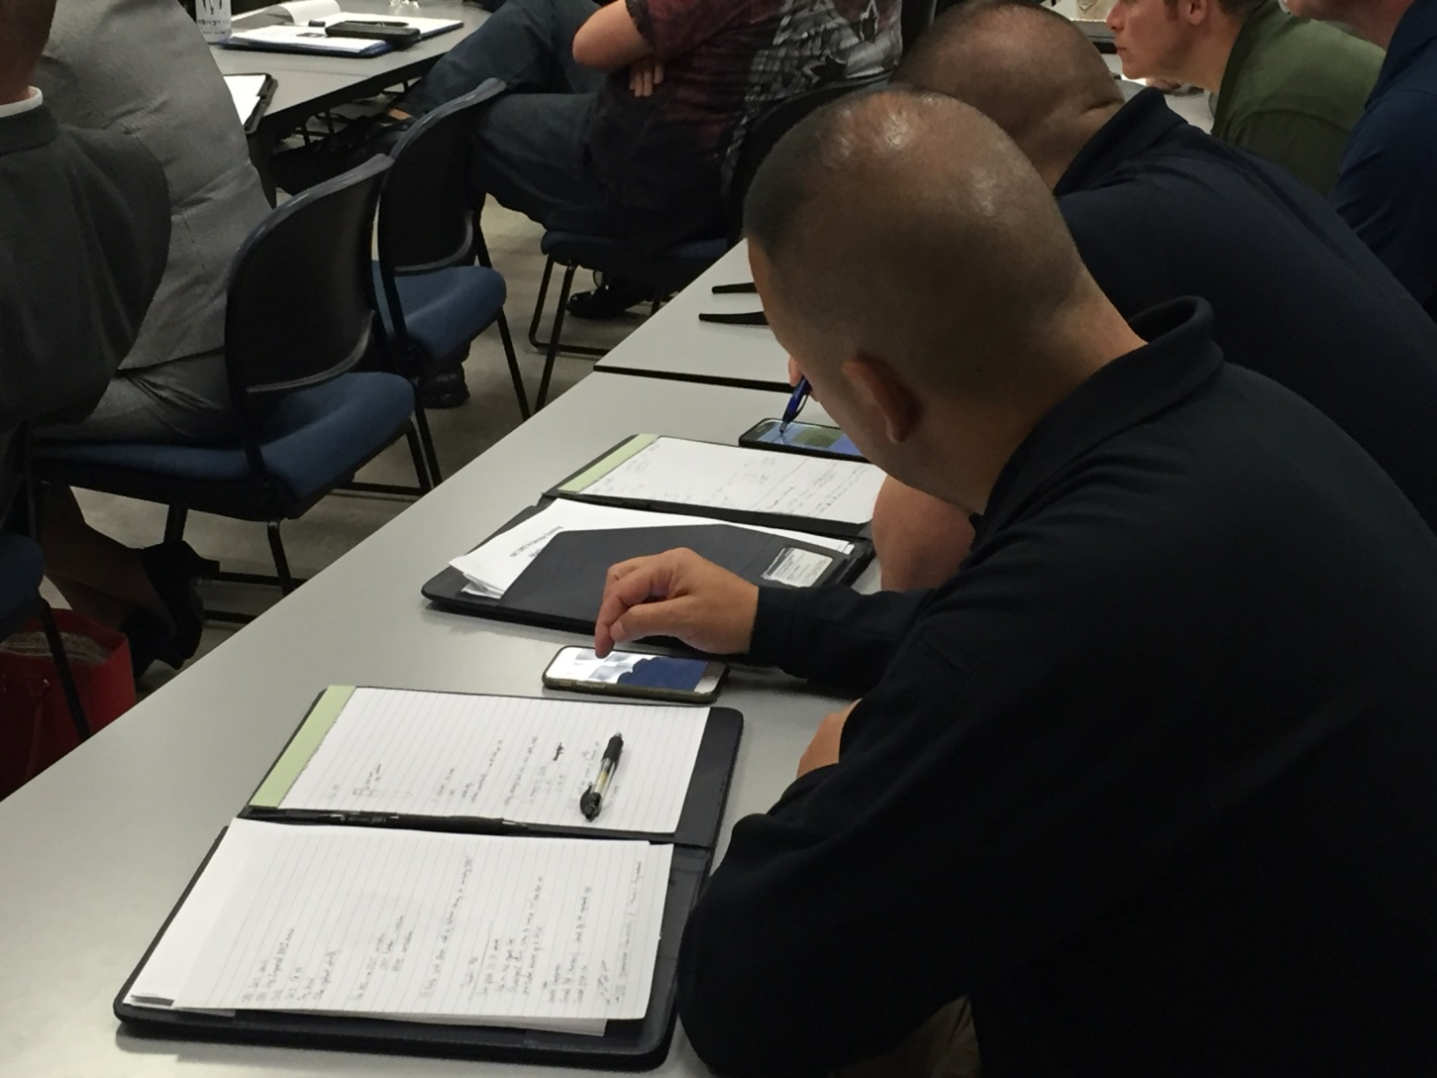
Gadget Guru
Notes:
Gadget Guru
Overt Characteristics: Participants continuously on their techy device (checking email, chatting, texting, surfing the internet). Sometimes it escalates to where they are involving others in their activity during class time. This would include where you have a class that has laptops and they are using it during times where instructors want full attention.
What are some strategies for dealing with this problem behavior? Evaluate each strategy against the four conditions listed below:
Will it eliminate or minimize the problem behavior?
Will it maintain the self-esteem of the participant whose behavior is causing the problem?
Will it maintain the dignity of the instructor as well as the participant?
Will it avoid further disruption to learning?
Effective Strategies Observed in Class
__________________________________________________________________________
__________________________________________________________________________
__________________________________________________________________________
__________________________________________________________________________
__________________________________________________________________________

Slide 14

Super Shy
Notes:
Super Shy
Overt Characteristics: Participant is meek in their nature and does not feel comfortable speaking in front of the group. They may be the last to volunteer or won’t volunteer at all. Their expression reflects their discomfort with interacting with others. They are reluctant to make eye contact. Even if they know the answer to a question, they may not volunteer the answer.
What are some strategies for dealing with this problem behavior? Evaluate each strategy against the four conditions listed below:
Will it eliminate or minimize the problem behavior?
Will it maintain the self-esteem of the participant whose behavior is causing the problem?
Will it maintain the dignity of the instructor as well as the participant?
Will it avoid further disruption to learning?
Effective Strategies Observed in Class
__________________________________________________________________________
__________________________________________________________________________
__________________________________________________________________________
__________________________________________________________________________
__________________________________________________________________________

Slide 15
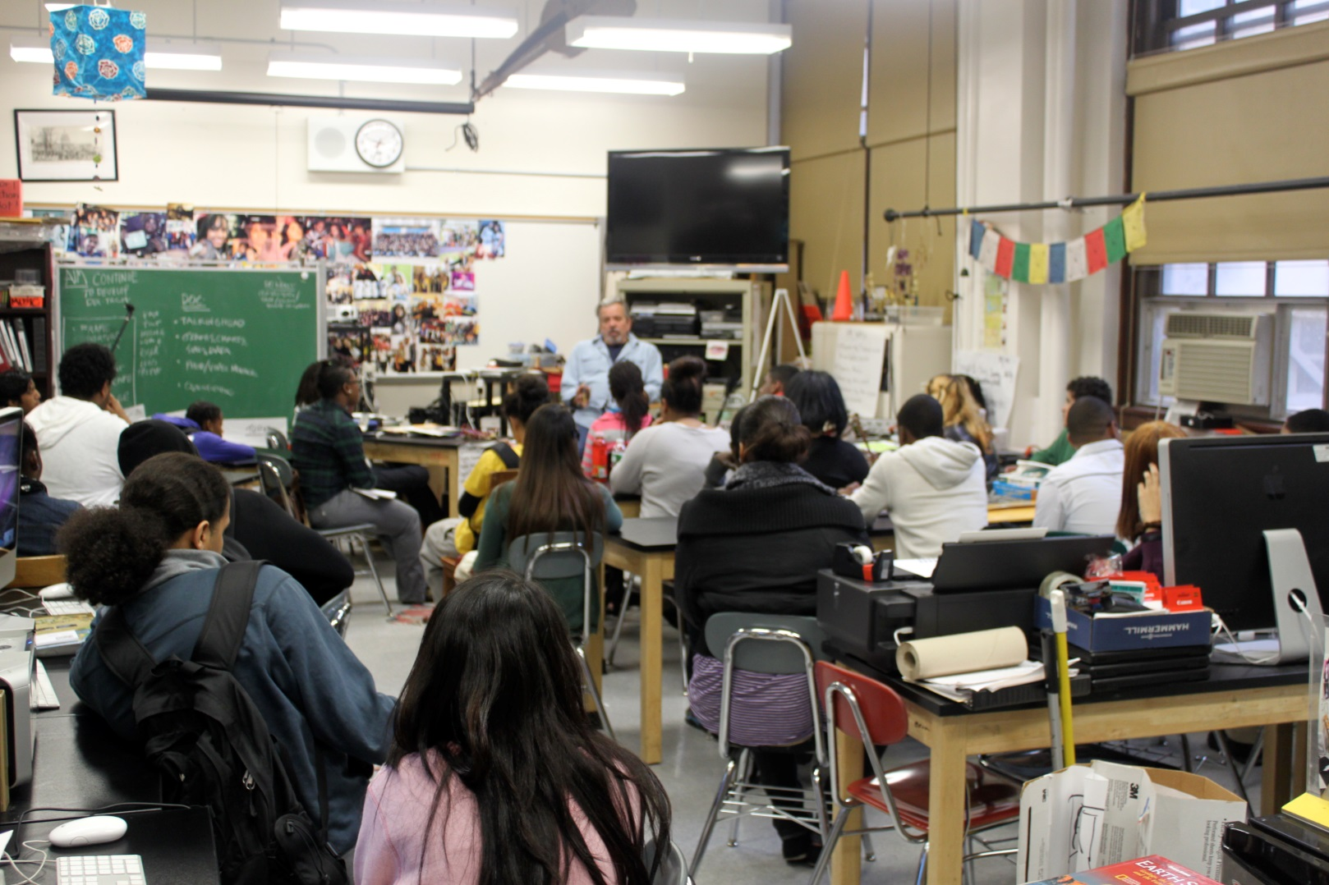
Environmental Challenges and Distractions
Notes:
E. Environmental Challenges
Depending on the physical space and location of the training, various environmental challenges to location, space, and equipment may arise anytime throughout the training. Instructors should identify these potential challenges before the training begins and learn what resources are available to prevent or correct these challenges.
Location and Equipment Challenges
Location distractions
Where is the training located?
Resort; Hotel; Beach; Casino; Windowless room; Basement of the Sheriff’s office; Location without amenities within walking distance; Noise distractions (traffic, train, competing trainings); Police academy
Training room distractions
Temperature; Lighting; Audio/visual; Room design; Poor acoustics; Placement of cords; Creaky doors
Equipment distractions
Does all the equipment work?; Incompatible devices (projectors, types of computers, sound systems, software); Internet accessibility; Lighting conflicting with the projection screen; Batteries; Enough power sources
__________________________________________________________________________
__________________________________________________________________________

Slide 16

Instructor-Created Distractions
Notes:
F. Problem Situations Created by Instructors
Discuss with participants and show examples as necessary on the following distractions created by instructors:
Top 10 Instructor Created Distractions
10. Disrespect the audience (“I am smarter than you.”… culture, background, profession, gender, generation)
9. Body position (do not turn back to the audience, cross arms)
8. War stories (vs. relevant stories supporting the presentation)
7. Arguing with participants
6. Calling on the unprepared participant
5. Fidget (clicking pen, change in pocket)
4. Too much PowerPoint (or overuse of any single medium)
3. Run over time (time mismanagement)
2. Inappropriate language for the audience
1. Disrespect yourself or your presentation (“I do not know why they asked me to do this…” or “You probably know more about this than me…”)
Give an example of a distraction you have overcome. Ask participants to reflect on distractions they recognize in themselves as instructors. Participants should choose at least one of these distractions to focus on improving during their final demonstration. Instructors at each table should facilitate discussion of each participant’s noted distraction and provide feedback on possible remedies.
What distractions do you create when instructing?
__________________________________________________________________________

Slide 17

Questions and/or Concerns
Notes:
G. QuestionS AND/OR CONCERNS
Solicit questions and comments from participants before moving to the next Session.
__________________________________________________________________________
__________________________________________________________________________
__________________________________________________________________________
__________________________________________________________________________
__________________________________________________________________________
__________________________________________________________________________
__________________________________________________________________________
__________________________________________________________________________
__________________________________________________________________________
__________________________________________________________________________
__________________________________________________________________________
__________________________________________________________________________

